Slide 2
During this lesson you will learn
What sustainability is
What causes climate change, its effects and how we need to be more sustainable to look after our planet
That using public transport will lower your emissions and help reduce the effects of climate change
How to make a pledge to reduce your carbon emissions to be more sustainable
Notes:
Warm Up – 5 minutes. Pupils to rearrange the words to make the sentence to explain what sustainability is

Slide 3
Notes:
Warm Up – 5 minutes. Pupils to rearrange the words to make the sentence to explain what sustainability is

Slide 4
Weather describes the conditions outside right now in a specific place. For example, if you see that it’s raining outside right now, that’s a way to describe today’s weather. Rain, snow, wind, hurricanes, tornadoes — these are all weather events.
Notes:
Before we look at climate change we need to understand the difference in weather and climate

Slide 5
Climate, on the other hand, is more than just one or two rainy days. Climate describes the weather conditions that are expected in a region at a particular time of year
Earth’s climate has constantly been changing — even long before humans came into the picture. However, scientists have observed unusual changes recently. For example, Earth’s average temperature has been increasing
During this lesson, when we refer to climate change, we are describing the way weather and climate systems are changing due to human activities.

Slide 6
Burning Fossil Fuels
Deforestation
Agriculture
For more info CBBC Newsround | GLOBAL WARMING | How are extra greenhouse gases produced?
Notes:
Burning fossil fuels – such as coal, oil gas which contain carbon dioxide that has been 'locked away' in the ground for thousands of years. When we take these out of the land and burn them, we release the stored carbon dioxide into the air.
Deforestation - Forests remove and store carbon dioxide from the atmosphere. Cutting them down means that carbon dioxide builds up quicker since there are no trees to absorb it. Not only that, trees release the carbon they stored when we burn them.
Agriculture - Planting crops and rearing animals releases many different types of greenhouse gases into the air.

Slide 7
Rising Temperatures
Loss of habitats
Flooding
Glaciers melting
Endangered species
Plant species shifting location

Slide 8
2020 was confirmed as one of the top five hottest years on record, and one of the top ten wettest years
What can you do?
Discuss these images with your partner
How do they help?
Can you think of anything else?
Notes:
Public transport instead of private car use, showers not baths, growing own food (and eating more veg options to meat), switching off lights, recycling.

Slide 9
Transport is the largest emitting sector of greenhouse gases in the UK - 27% of domestic emissions in 2019
BUT rail accounts for just 1% of domestic transport emissions.
After walking and cycling –it’s the greenest way to travel.
What other forms of public transport are there? What do you use?

Slide 10
To school?
To the shops?
To see your family?
For leisure?
Notes:
Create tally charts for particular journeys – either to school or to family. Do this as a class or in small groups. Discuss the results

Slide 11
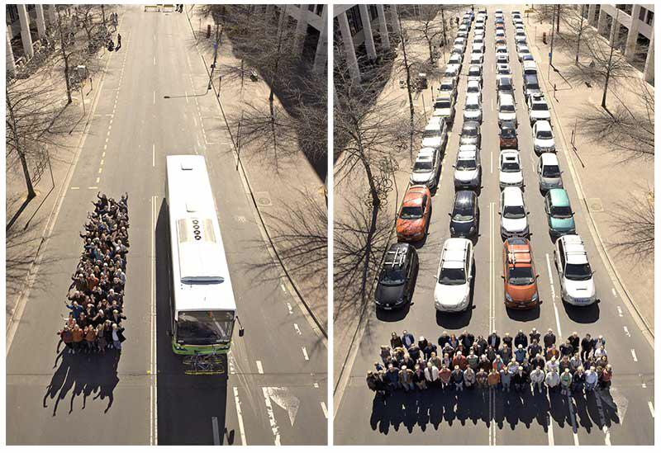
Notes:
Discuss this image – one bus takes all those cars off the road. There is more space for people to enjoy, less emissions and less traffic! Imagine with a train

Slide 12
Activity – go to Environment | Southeastern (southeasternrailway.co.uk)Type in your town and a destination you travel to or would like to
How much lower are your emissions for a train rather than a car?
Notes:
This can be done as a whole class activity or in smaller groups if you have the technology

Slide 13
Take a Pledge
Think about baths/showers
How you travel – what trips could be made on foot, by bicycle or public transport?
Lights/electricity
Food waste
Water use
Re-use clothes/goods – little waste

Slide 14
Notes:
You can go around the class and find out what everyone’s pledges are. Children could design their pledge card and decorate accordingly

