Slide 1
EMR Rail Safety Pathway
9th May 2024
Kaye Robinson – Community Engagement Manager

Slide 2
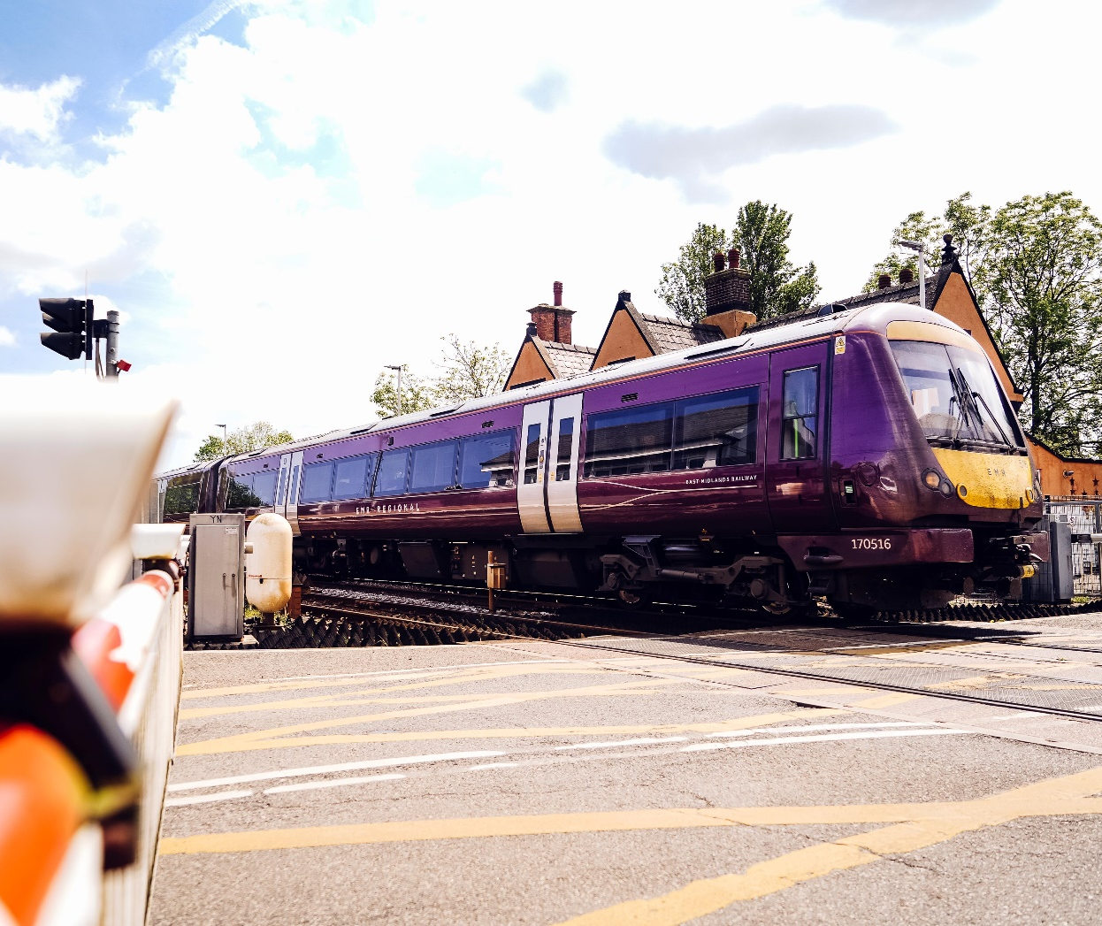
Background
Rail Safety not defined – everyone doing different things
Funding
Staff requests
Rail Safe Friendly

Slide 3
What did we do…
Looked at what was available within the industry
Defined our aims
Created an EMR Rail Safety Pathway to add value to what was already available

Slide 4
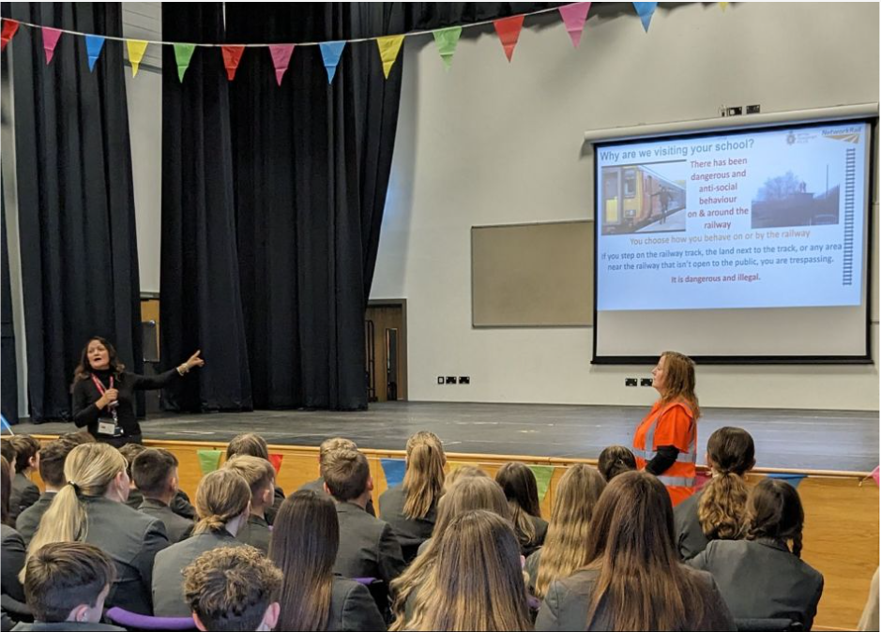
Our pathway
Bronze Tier:
Schools will receive Rail Safety Friendly videos
Silver Tier:
Interactive lessons featuring primary presentations, primary PE lessons, and secondary presentations.
EMR activity books, railway safety pamphlets, and links to national resources will also be provided.
Gold Tier:
Schools can collaborate with Community Rail Partners and local station adopters to implement a longer-term scheme of work, including a curriculum-based program spanning six weeks, "Try the Train" familiarization sessions, and artwork creation for the station.

Slide 5
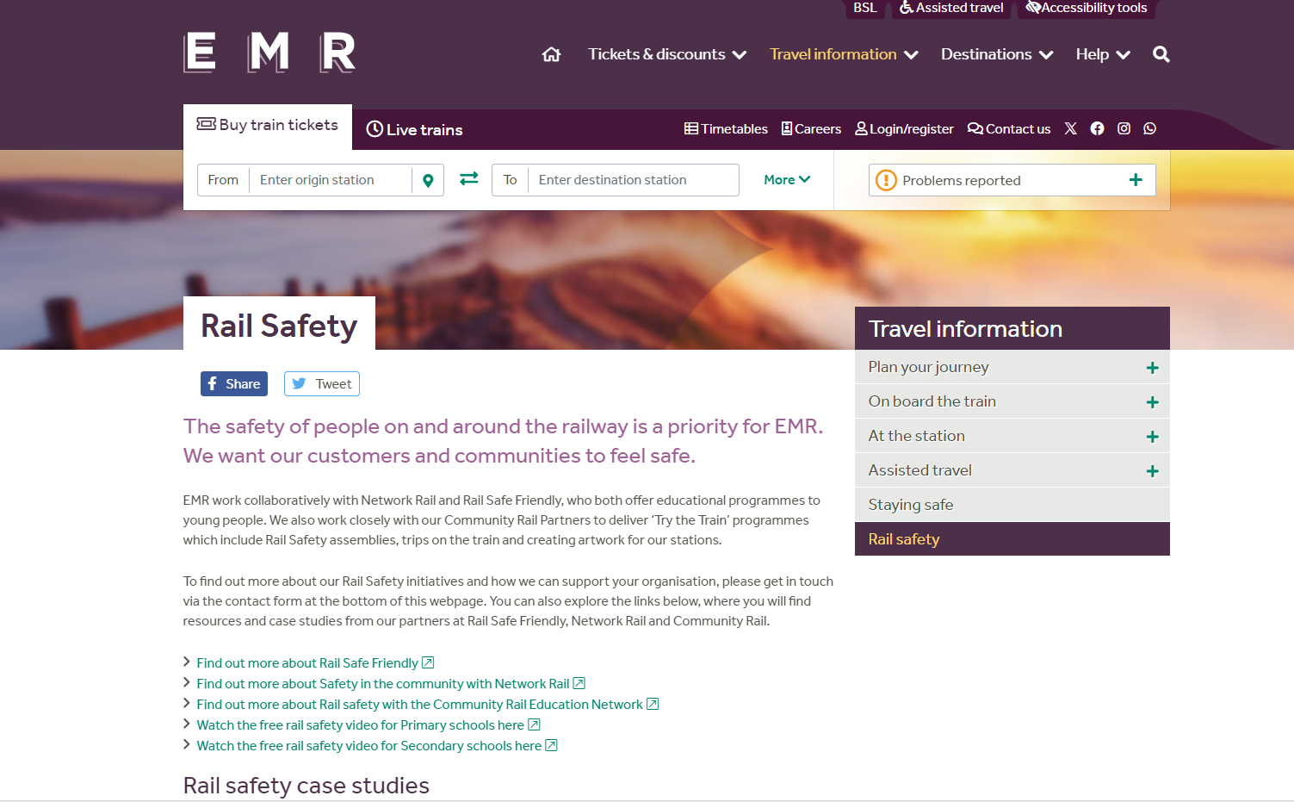
Resources & contact - webpage

Slide 6
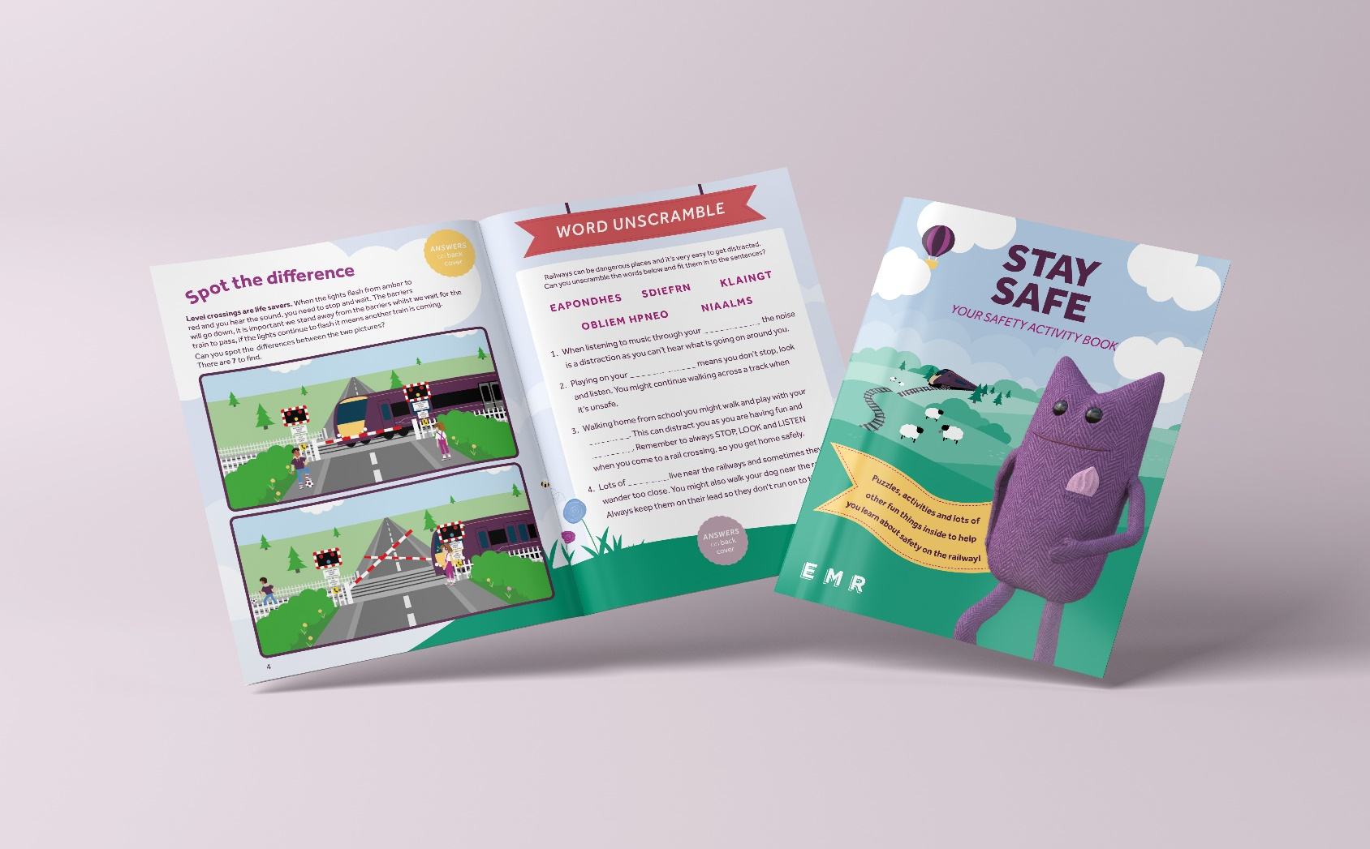
Resources & contact – Miles Rail Safe Activity book

Slide 7
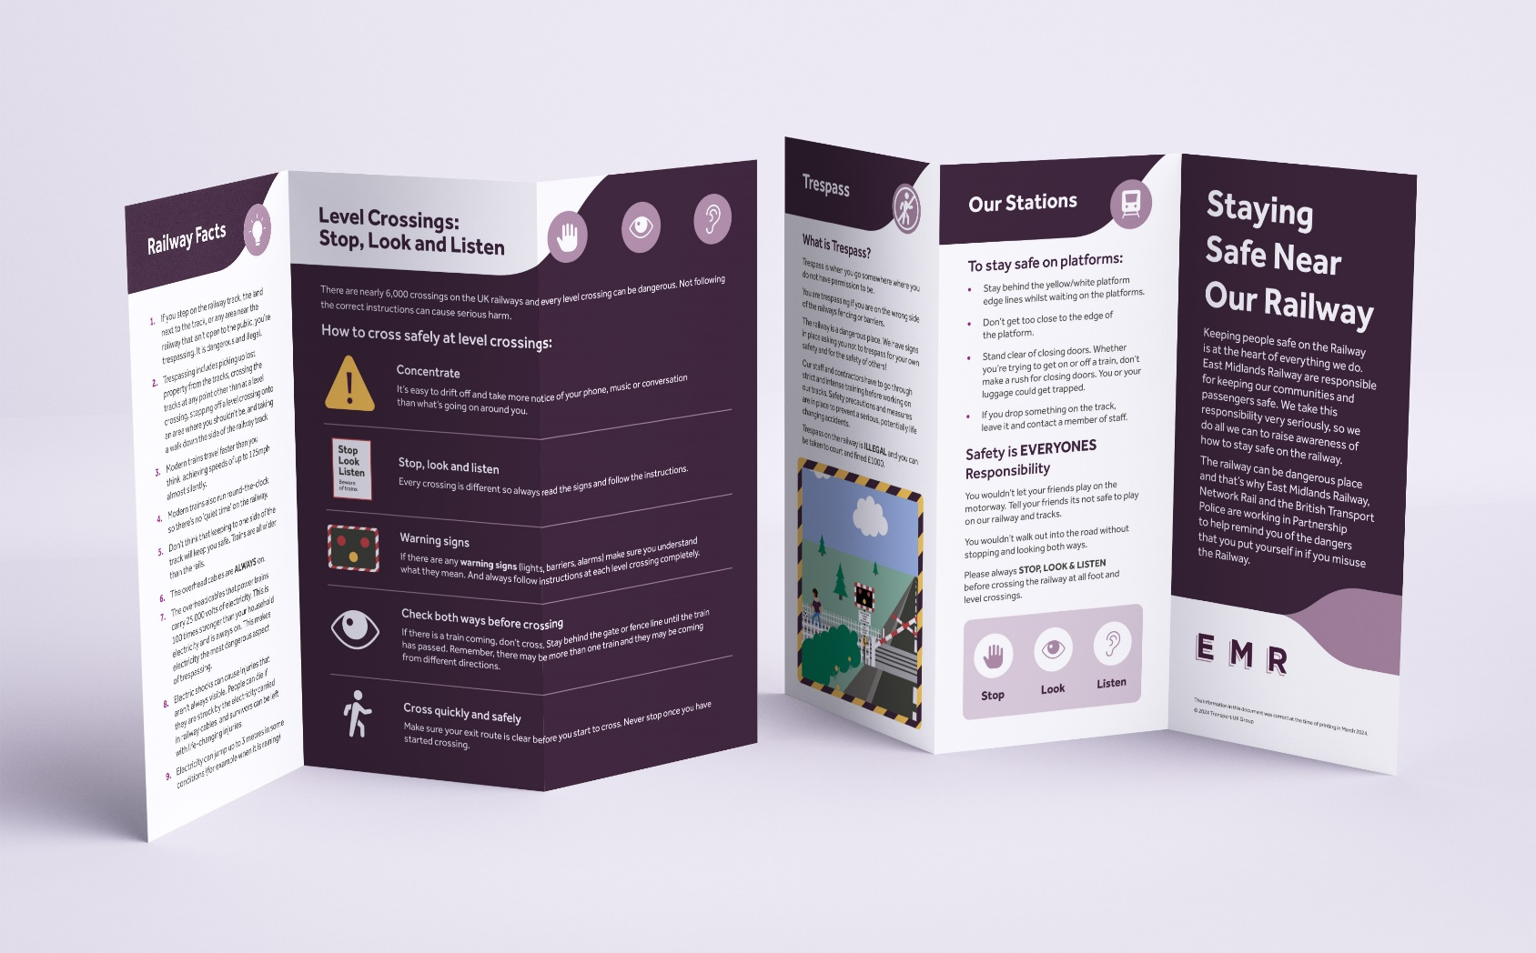
Resources & contact – Pamphlet for Ks2 and beyond

Slide 8
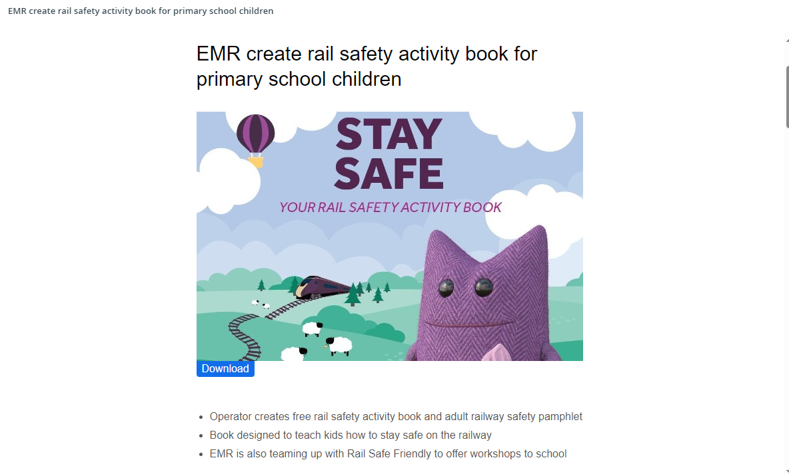
What next?
Press
Rail Safety champions
Rail Safe Friendly renewal for EMR & CRPs
Training for CRPs with Network Rail in June
Rail Safety Week
Encourage shared resources across the industry

Slide 9
Questions and Contact
Kaye.Robinson@eastmidlandsrailway.co.uk
RailSafety@eastmidlandsrailway.co.uk
www.eastmidlandsrailway.co.uk/community-rai/rail-safety

