Slide 1

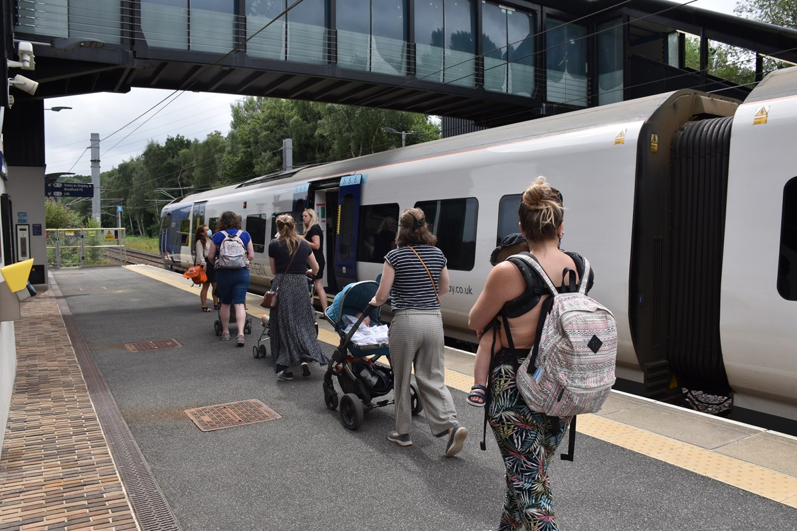
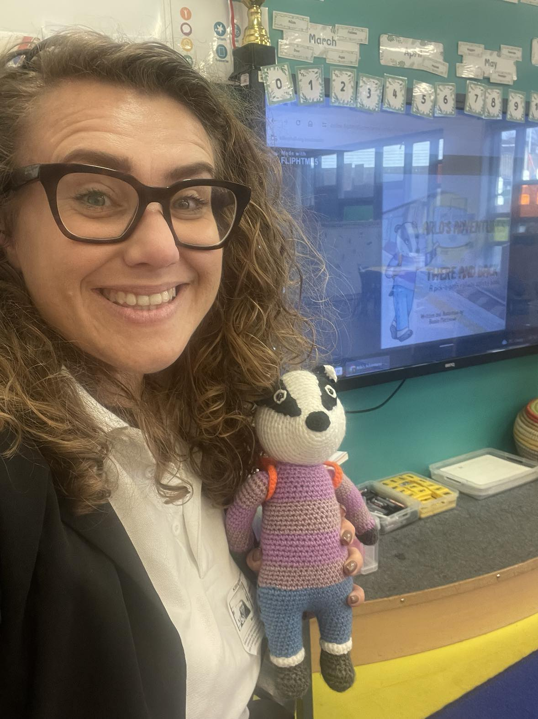


Slide 2
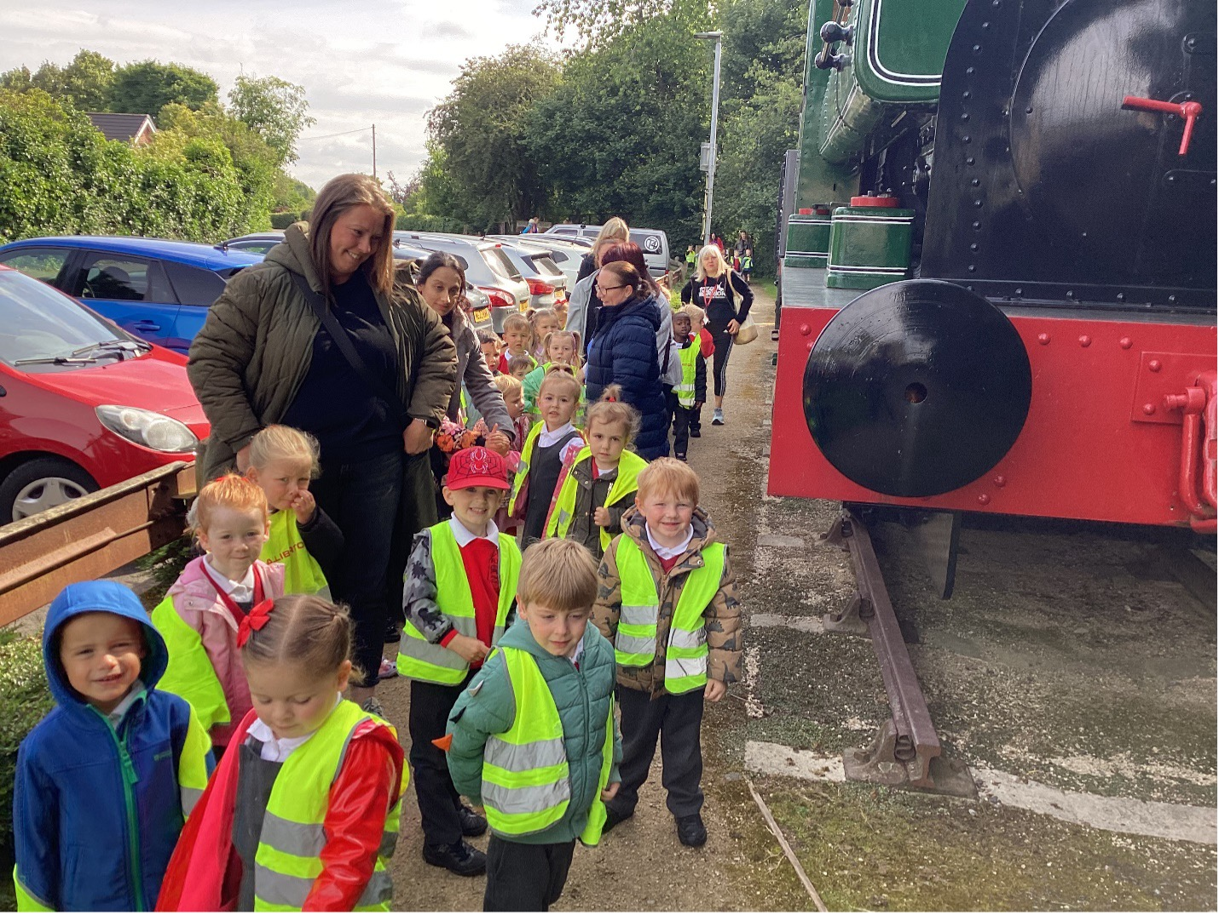
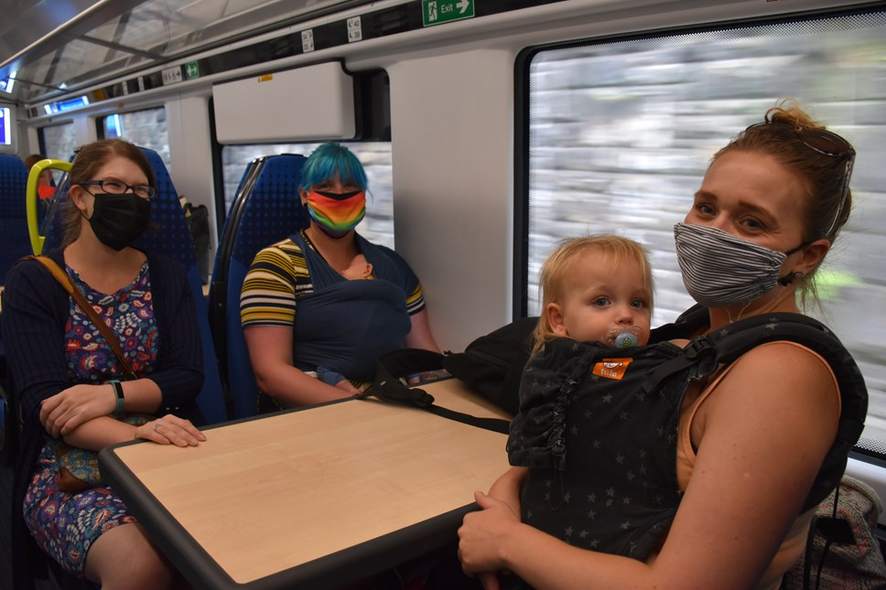

What do we mean by Early Years?
Birth to 5

Slide 3
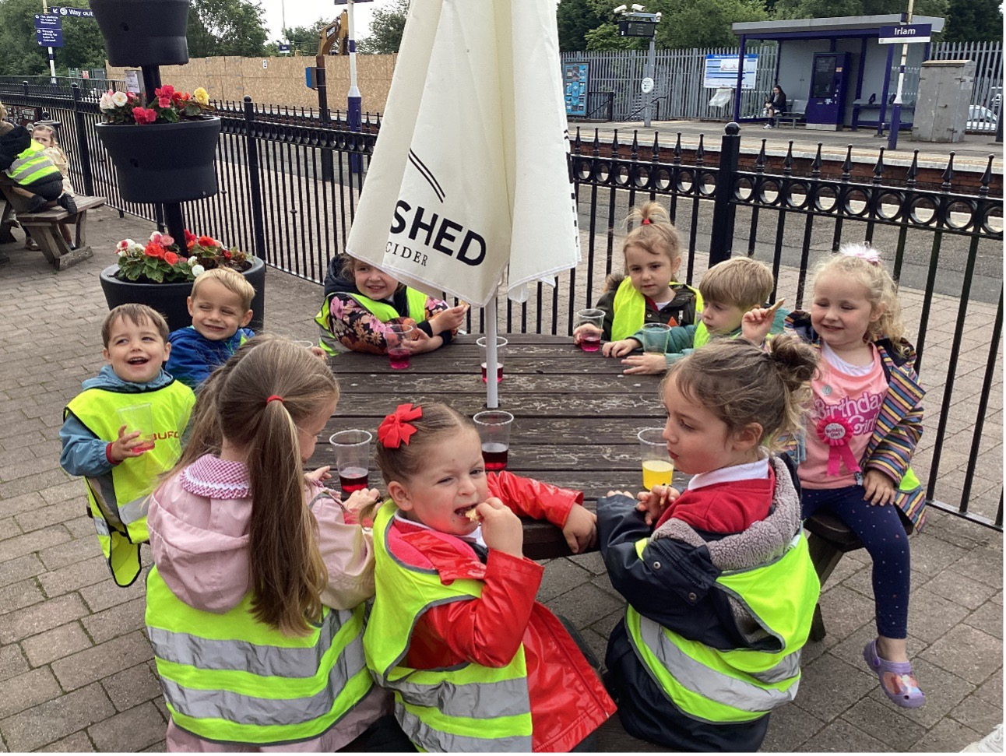
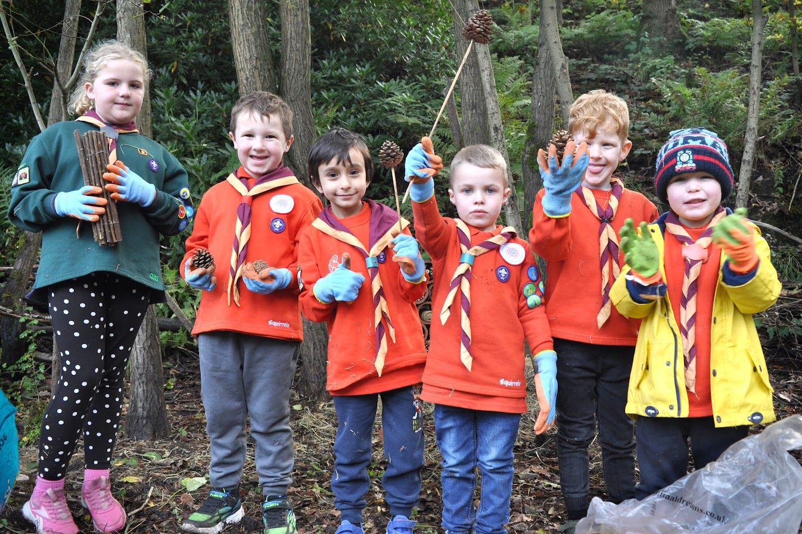
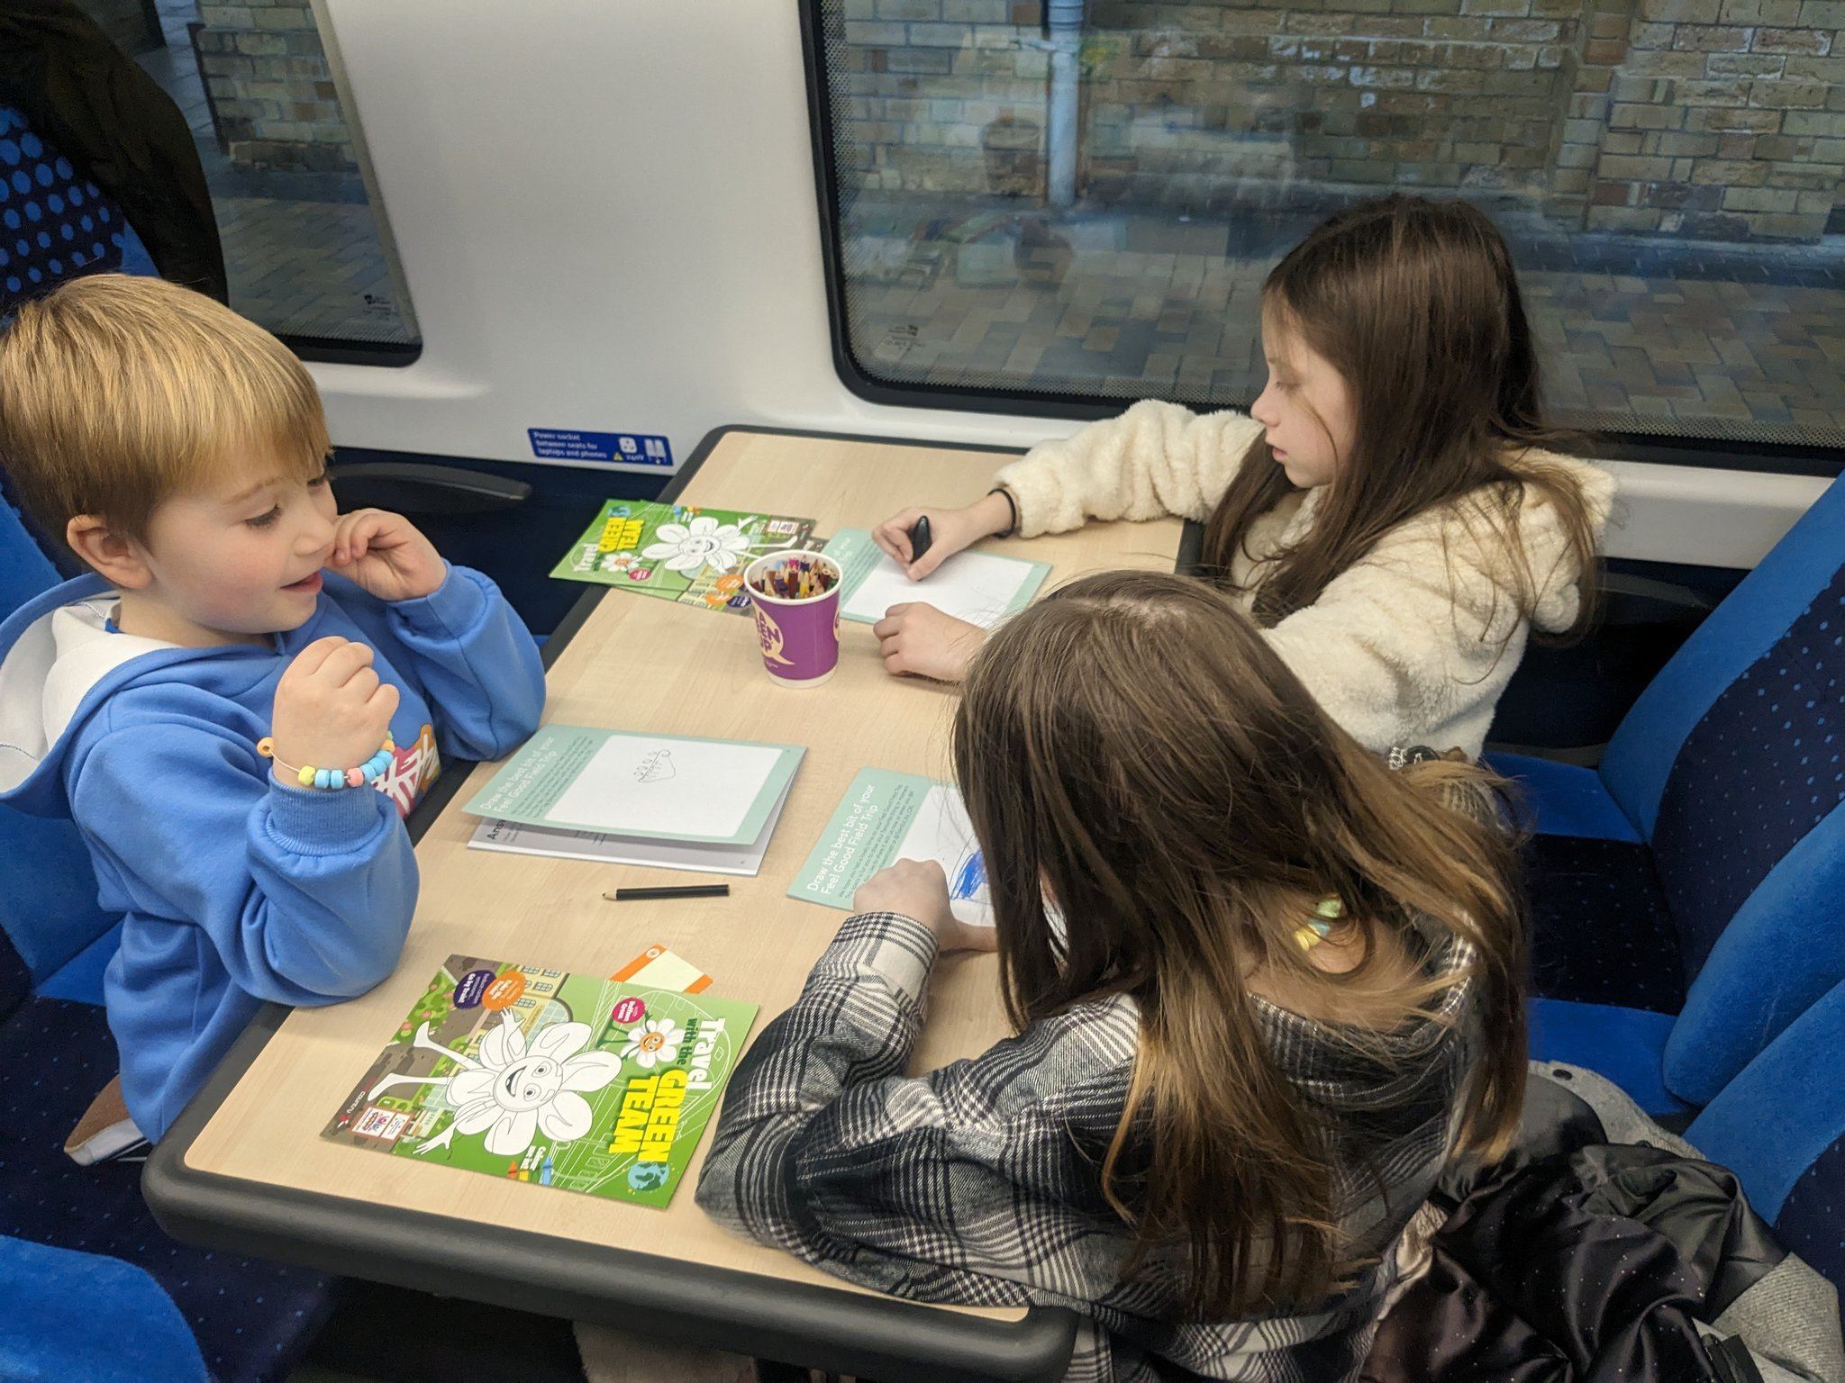
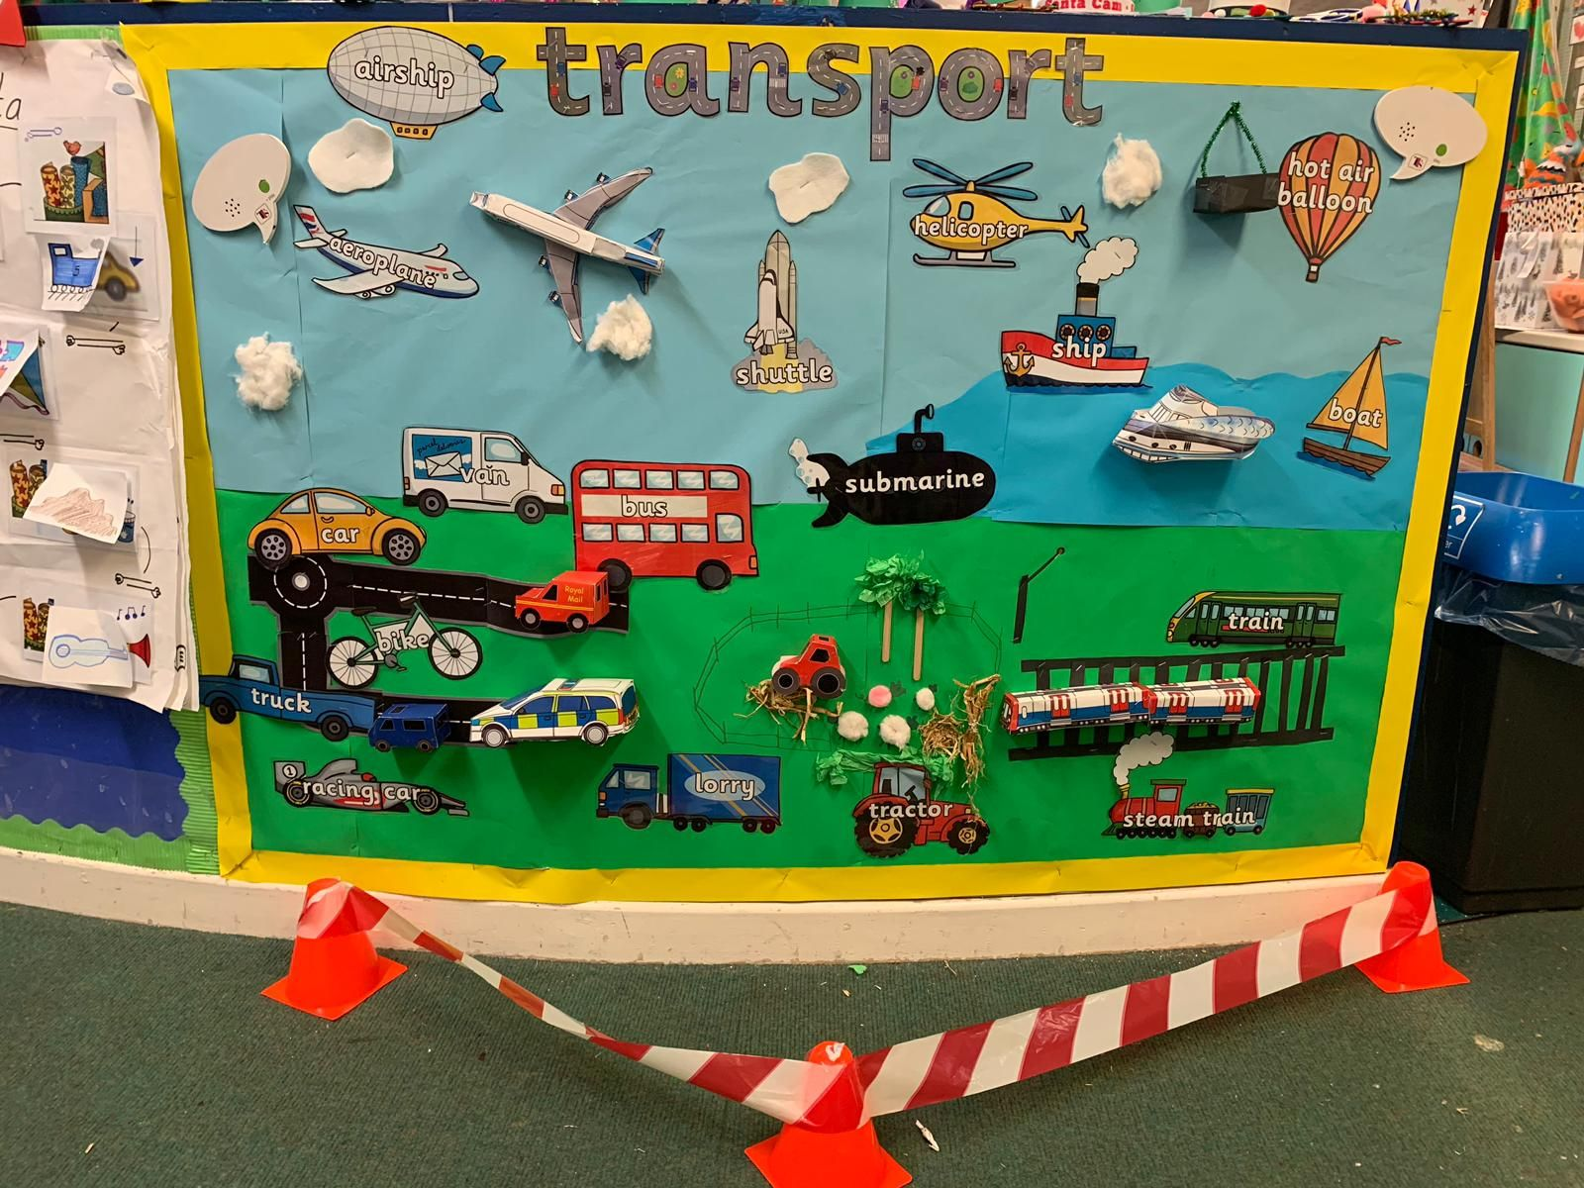
What groups?
Nursery
Squirrels
Childminders
Reception
Sling Express

Slide 4
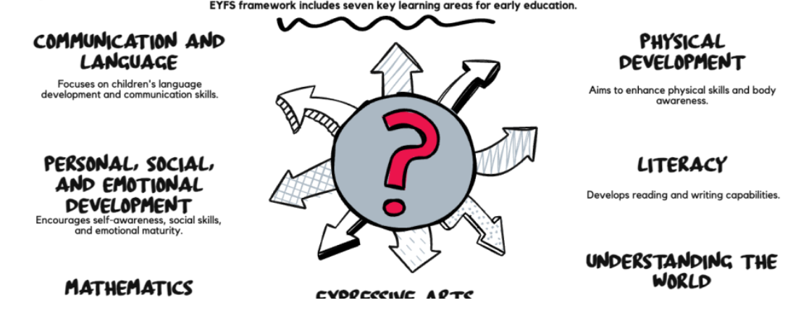
The curriculum

Slide 5
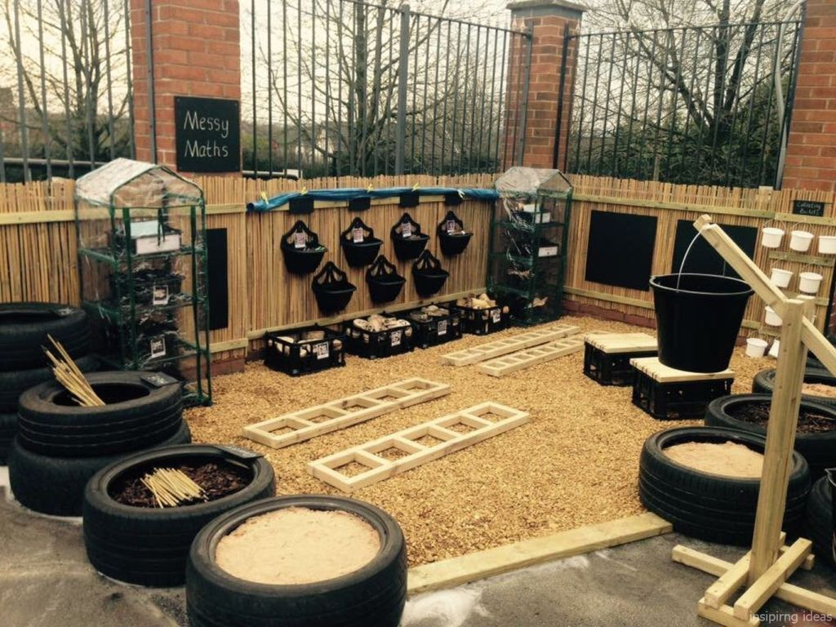
Implementing this curriculum
Observe and assess children’s interests, needs, and stages of development.
Provide a mix of adult-led and child-initiated activities.
Offer opportunities for both indoor and outdoor learning.
Incorporate a variety of resources and materials that cater to different learning styles and preferences.

Slide 6
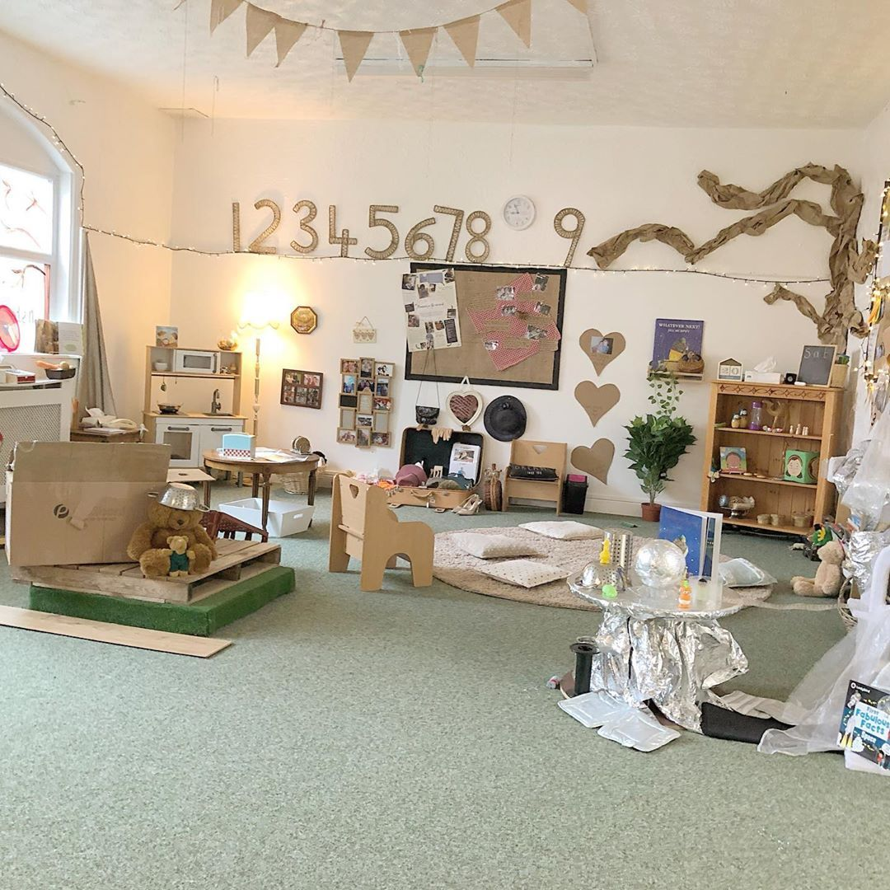
The learning environment
Safe, secure, and inclusive, promoting a sense of belonging for all children.
Stimulating and engaging, with a range of resources and materials that encourage exploration and discovery.
Flexible and adaptable, allowing for different types of play and learning experiences.
Reflective of children’s diverse backgrounds, cultures, and interests.

Slide 7
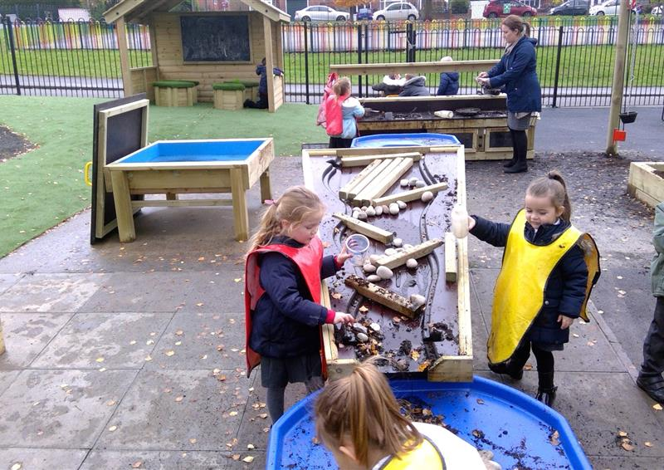
The role of play
Provide ample time and space for both structured and free play.
Offer a balance of solitary, parallel, and cooperative play experiences.
Engage in play alongside children, scaffolding their learning and extending their thinking.
Observe and document children’s play, using these insights to inform future planning.

Slide 8
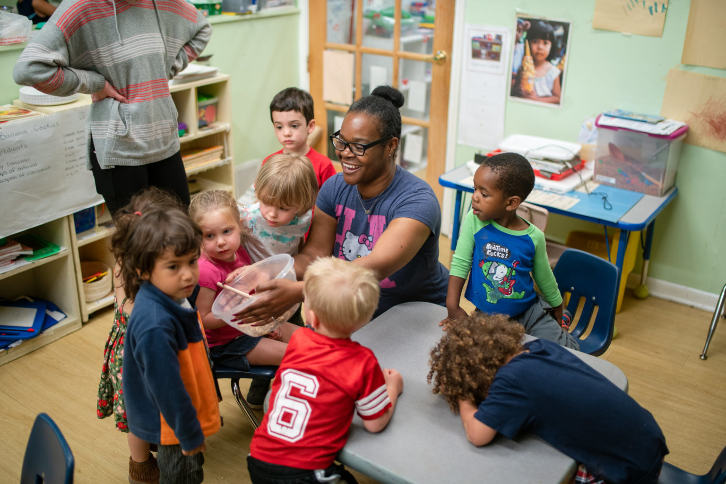
Adult/child led
Plan purposeful adult-led activities that target specific learning objectives.
Provide open-ended resources and materials that encourage child-initiated learning.
Be responsive to children’s interests and ideas, adapting plans and provisions accordingly.
Engage in sustained shared thinking, using questioning and discussion to extend children’s learning.

Slide 9
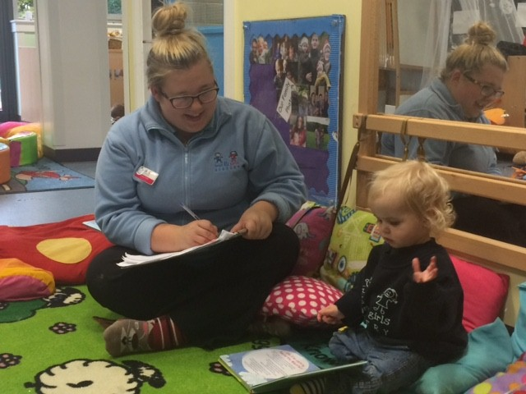
The role of observation
Observe children regularly during everyday activities and play.
Use a range of assessment tools, such as the EYFS profile, learning journals, and samples of children’s work.
Involve children in the assessment process, encouraging them to reflect on their own learning and achievements.
Use assessment information to identify next steps and inform future planning.

Slide 10
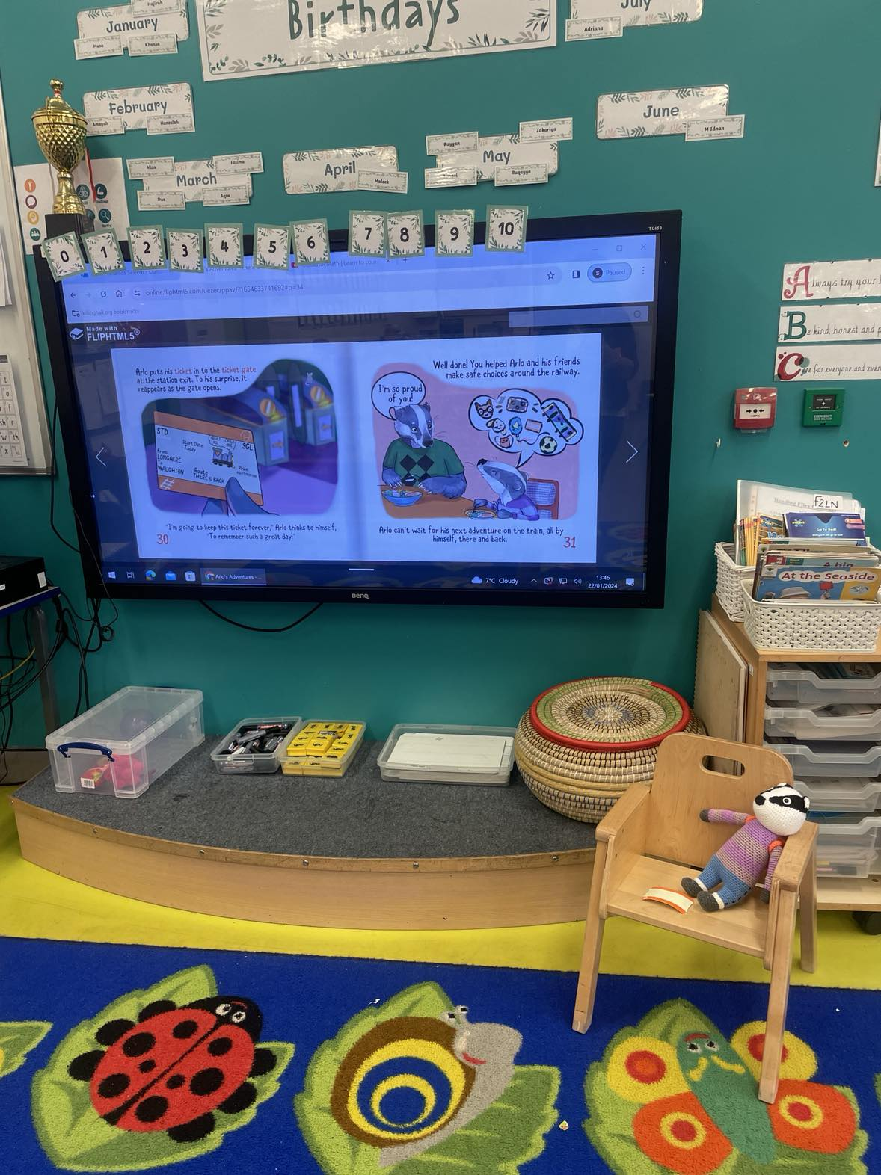
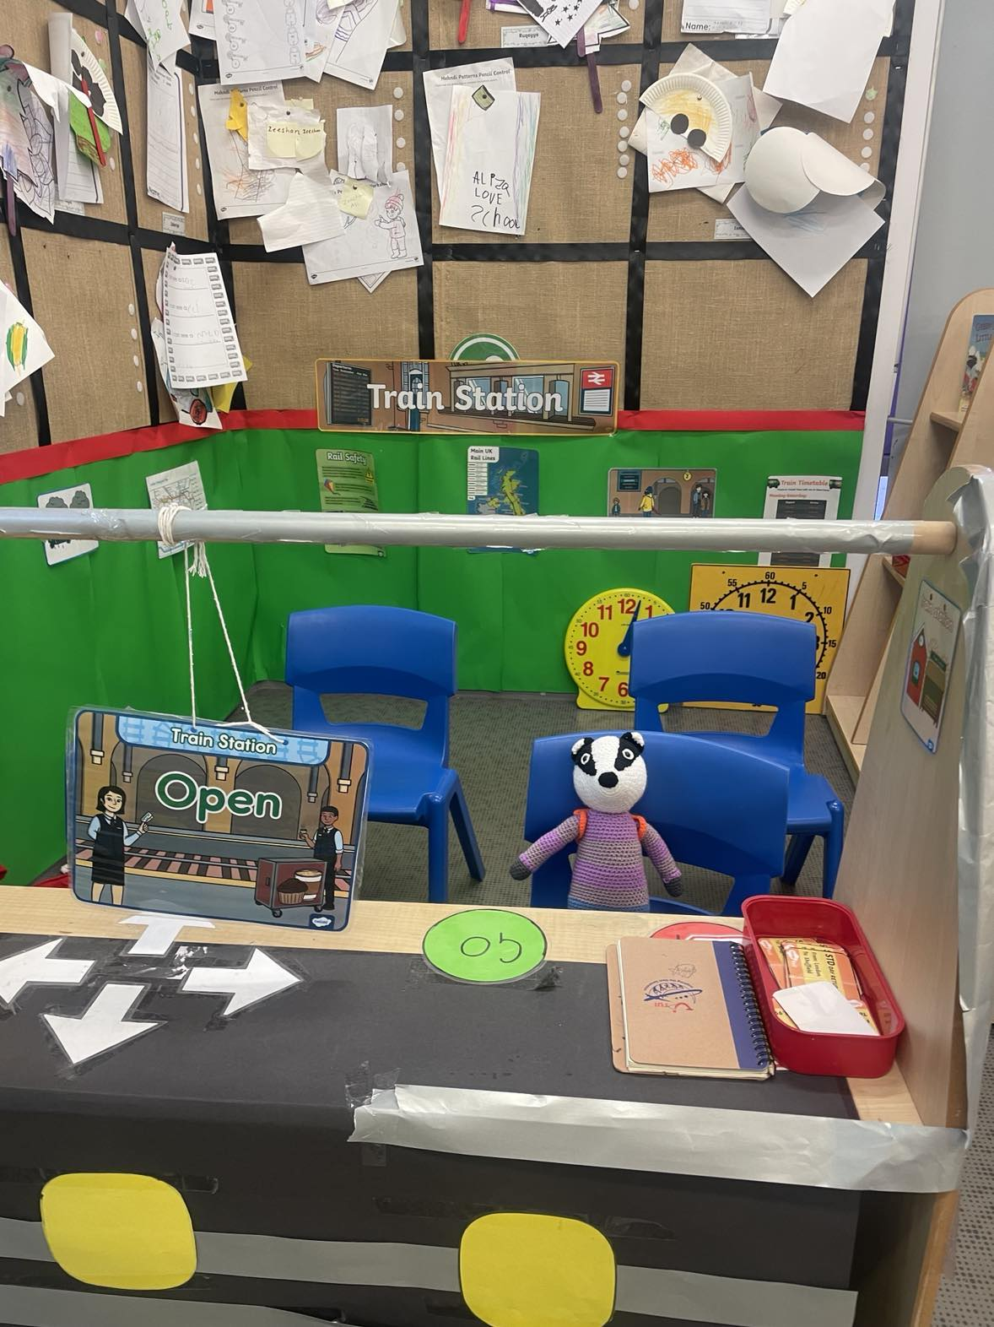
Final thoughts from me…

Slide 11
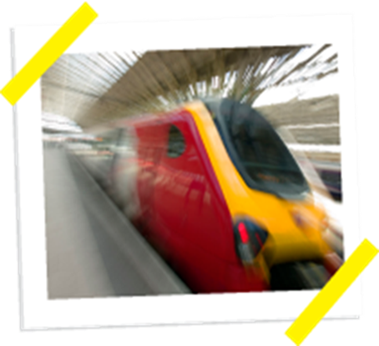

Early Years and KS1
Jess Young
Education Officer

Slide 12
Early Years Foundation Stage Framework
Personal, Social and Emotional Development: ELG: Managing Self
Explain the reasons for rules, know right from wrong and try to behave accordingly.
Key Stage 1 (5-7 years old)
Citizenship | Developing a healthy, safer lifestyle: g. rules for, and ways of, keeping safe, including basic road safety, and about people who can help them to stay safe.
PSHE (Taken from the PSHE Association Programme of Study) | Keeping safe forms part of the core health and wellbeing theme: Recognising risk in everyday situations and actions to minimise harm Ways to keep safe in familiar and unfamiliar environments About the people whose job it is to help keep us safe How to get help in an emergency Living in the wider world theme: about what rules are, why they are needed, and why different rules are needed for different situations

Slide 13
Learning Objectives | To know how to keep myself safe when near or using the railway.
Success Criteria | I know that stations and level crossings can be dangerous places. I can talk about some of the dangers around the railway. I can explain how to keep myself safe in a station or at a level crossing.

Slide 14
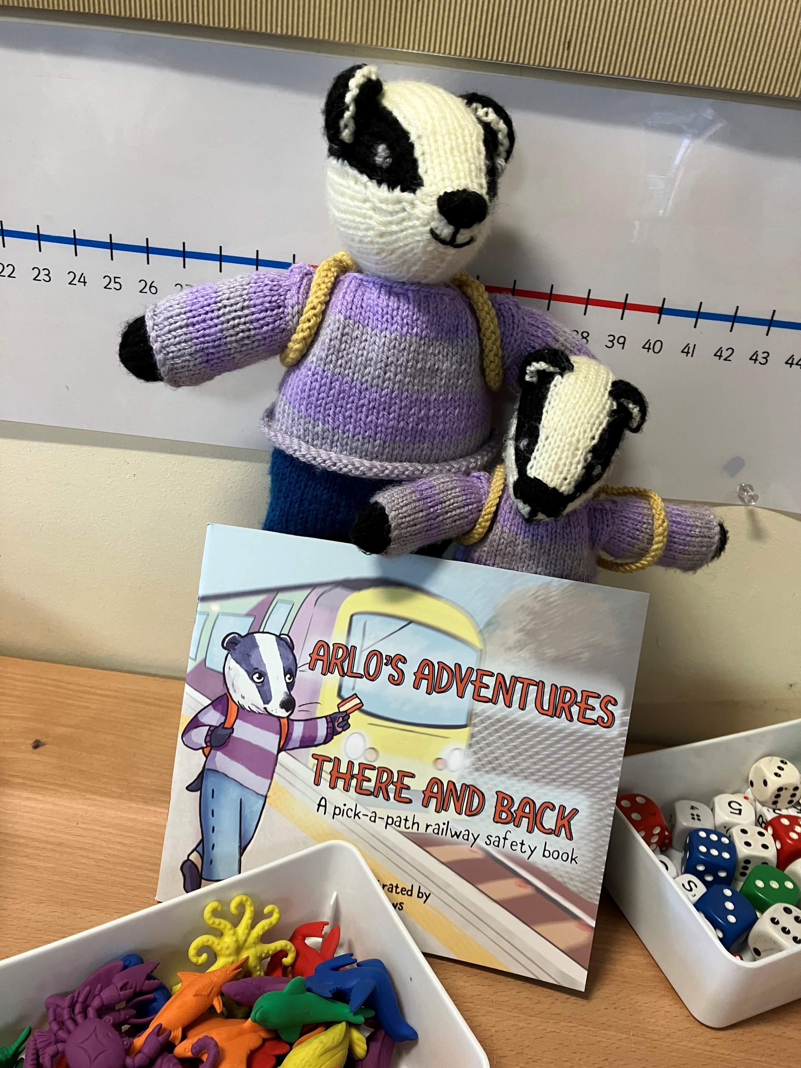

Slide 15
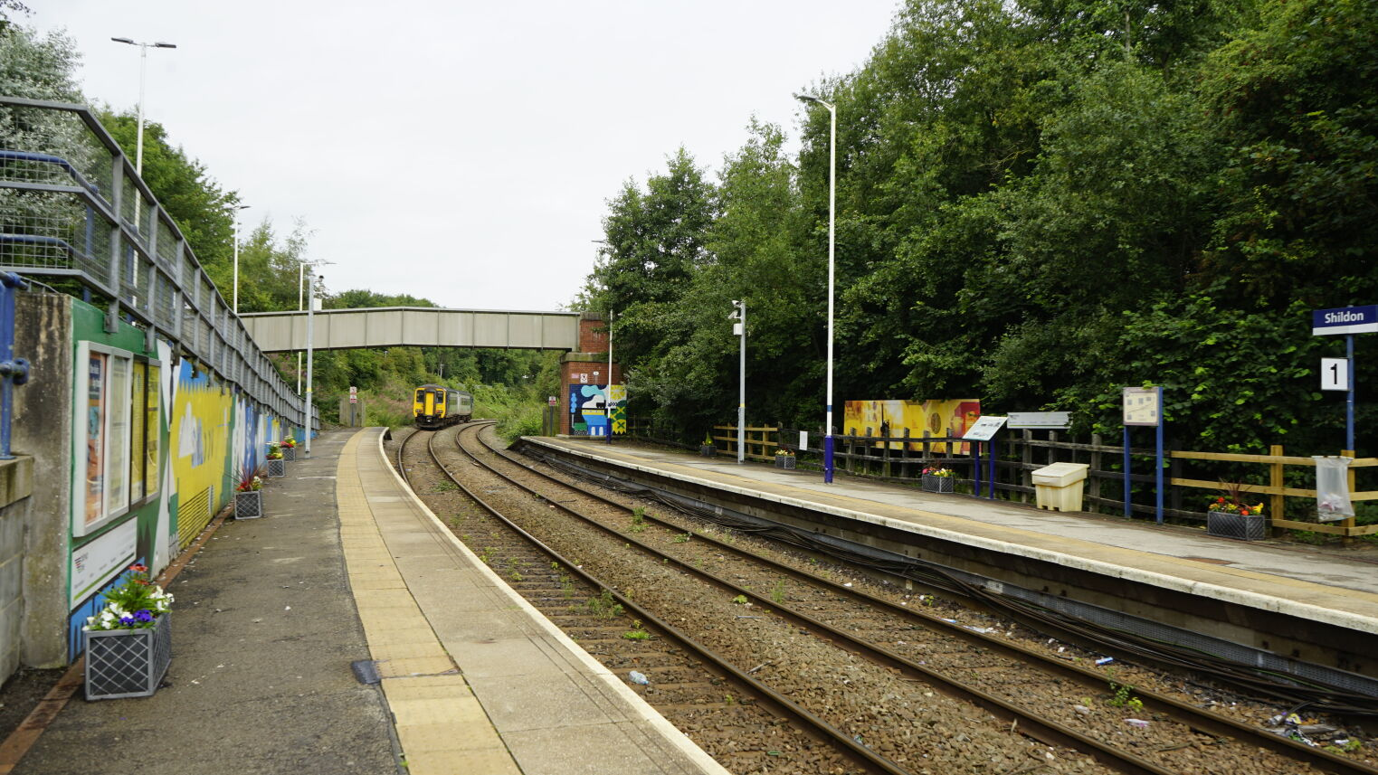
Shildon Station

Slide 16


Slide 17
Clackety Clack, Stay off the track!
You’ll be fine, behind the yellow line!

Slide 18
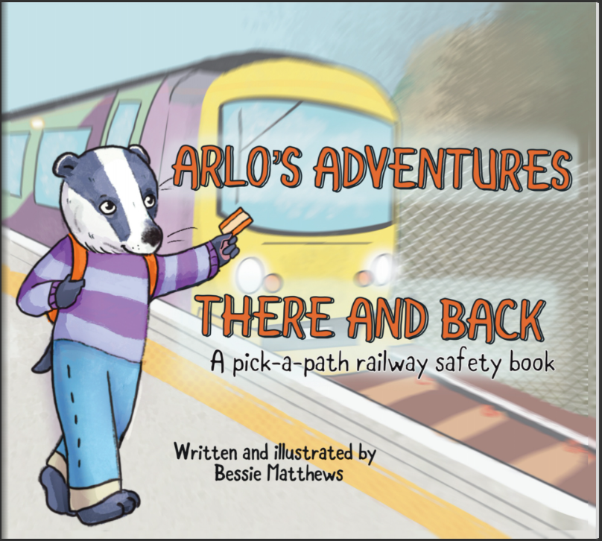
Notes:
Arlo's Adventures - There and Back (fliphtml5.com)

Slide 19
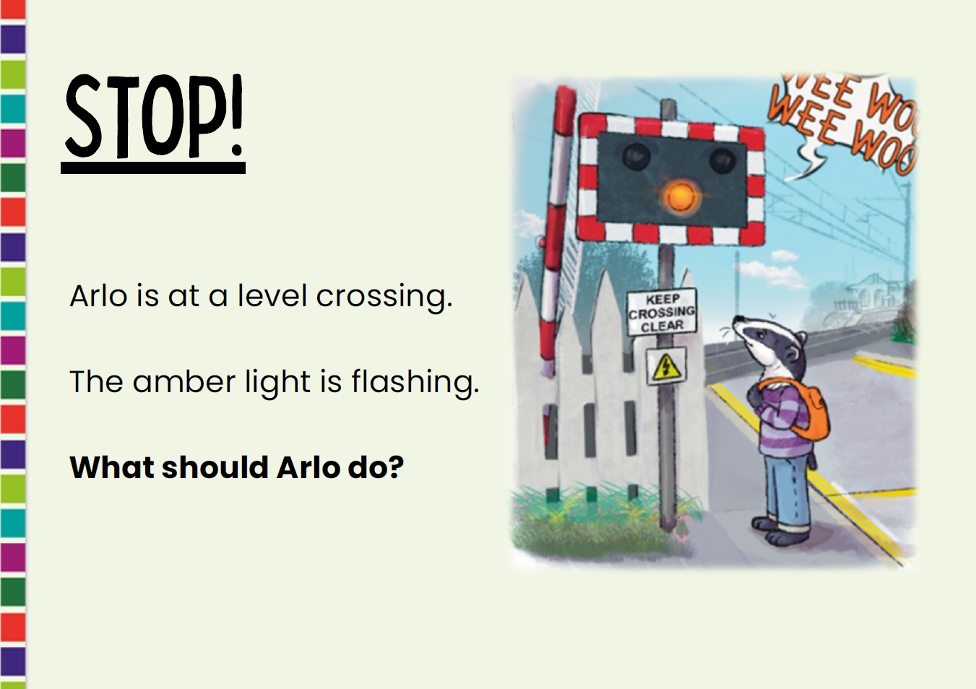

Slide 20
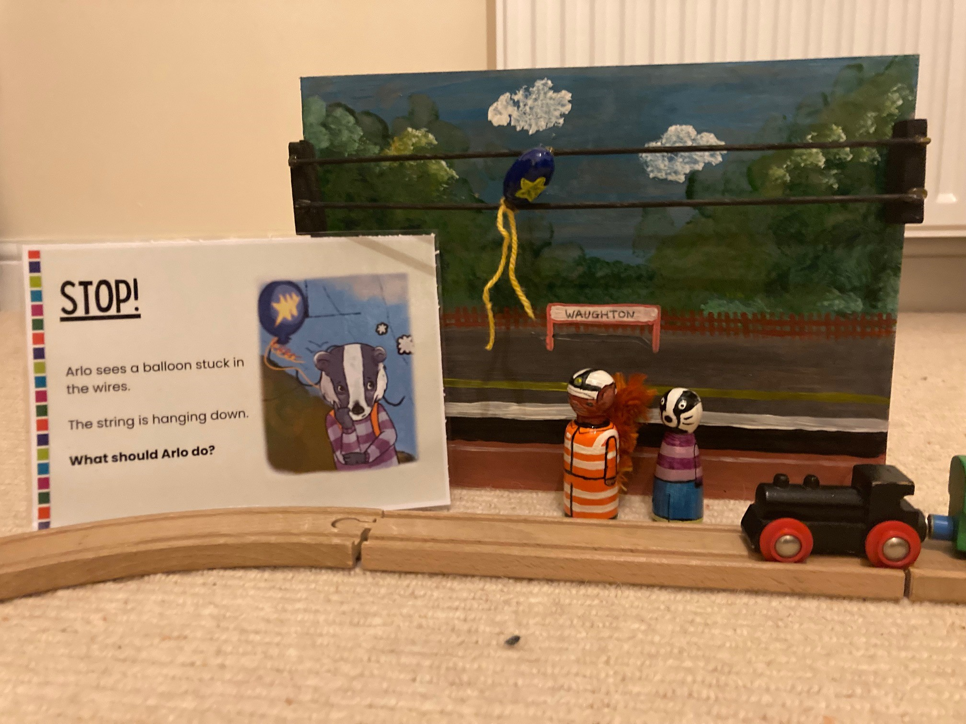

Slide 21
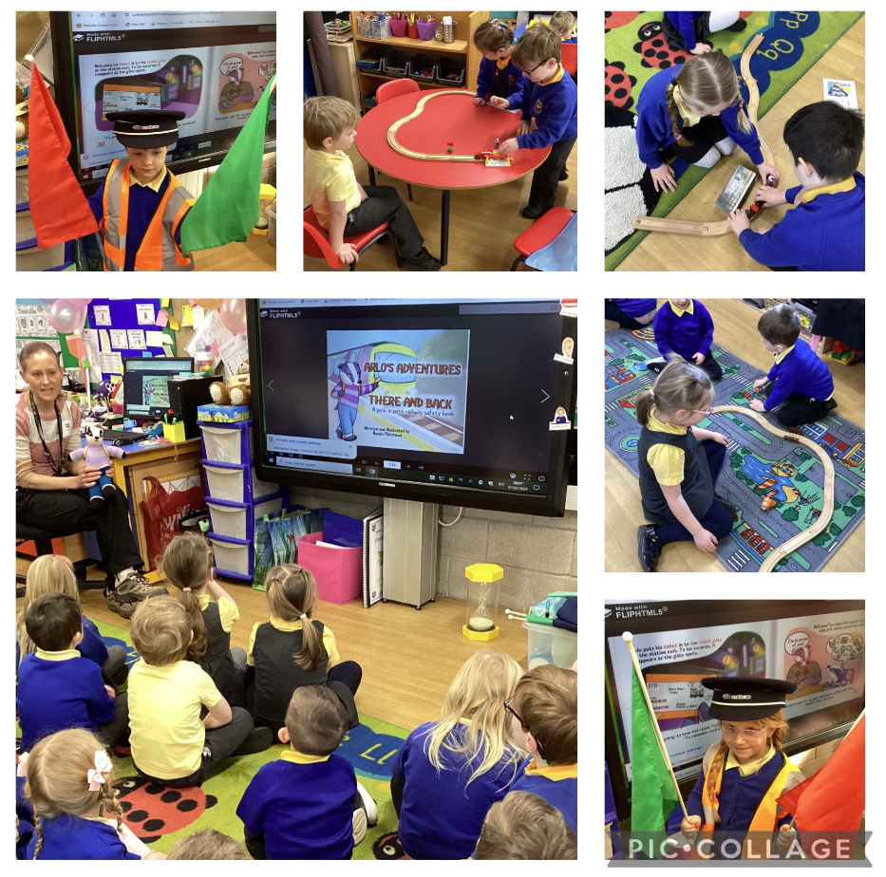

Slide 22
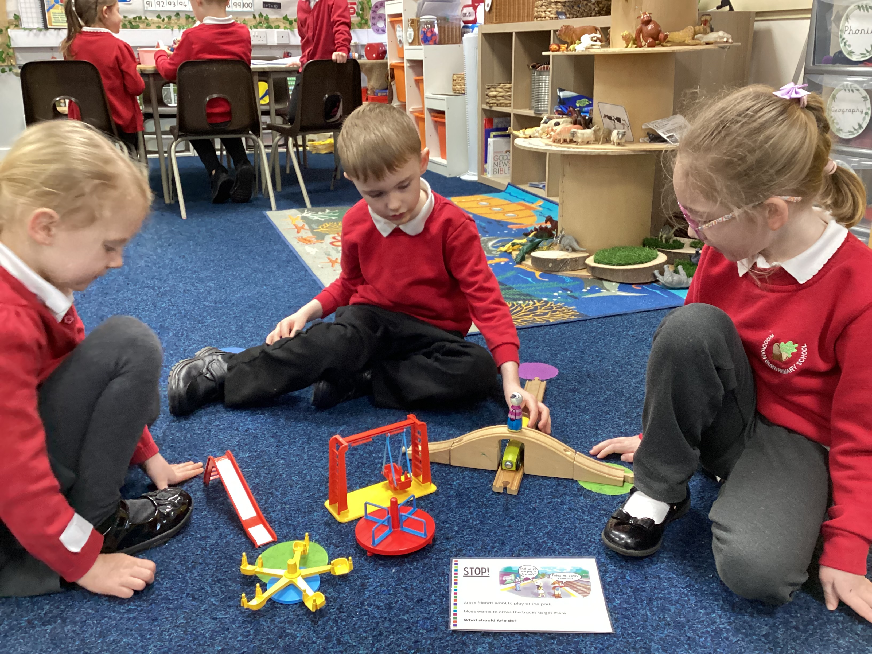
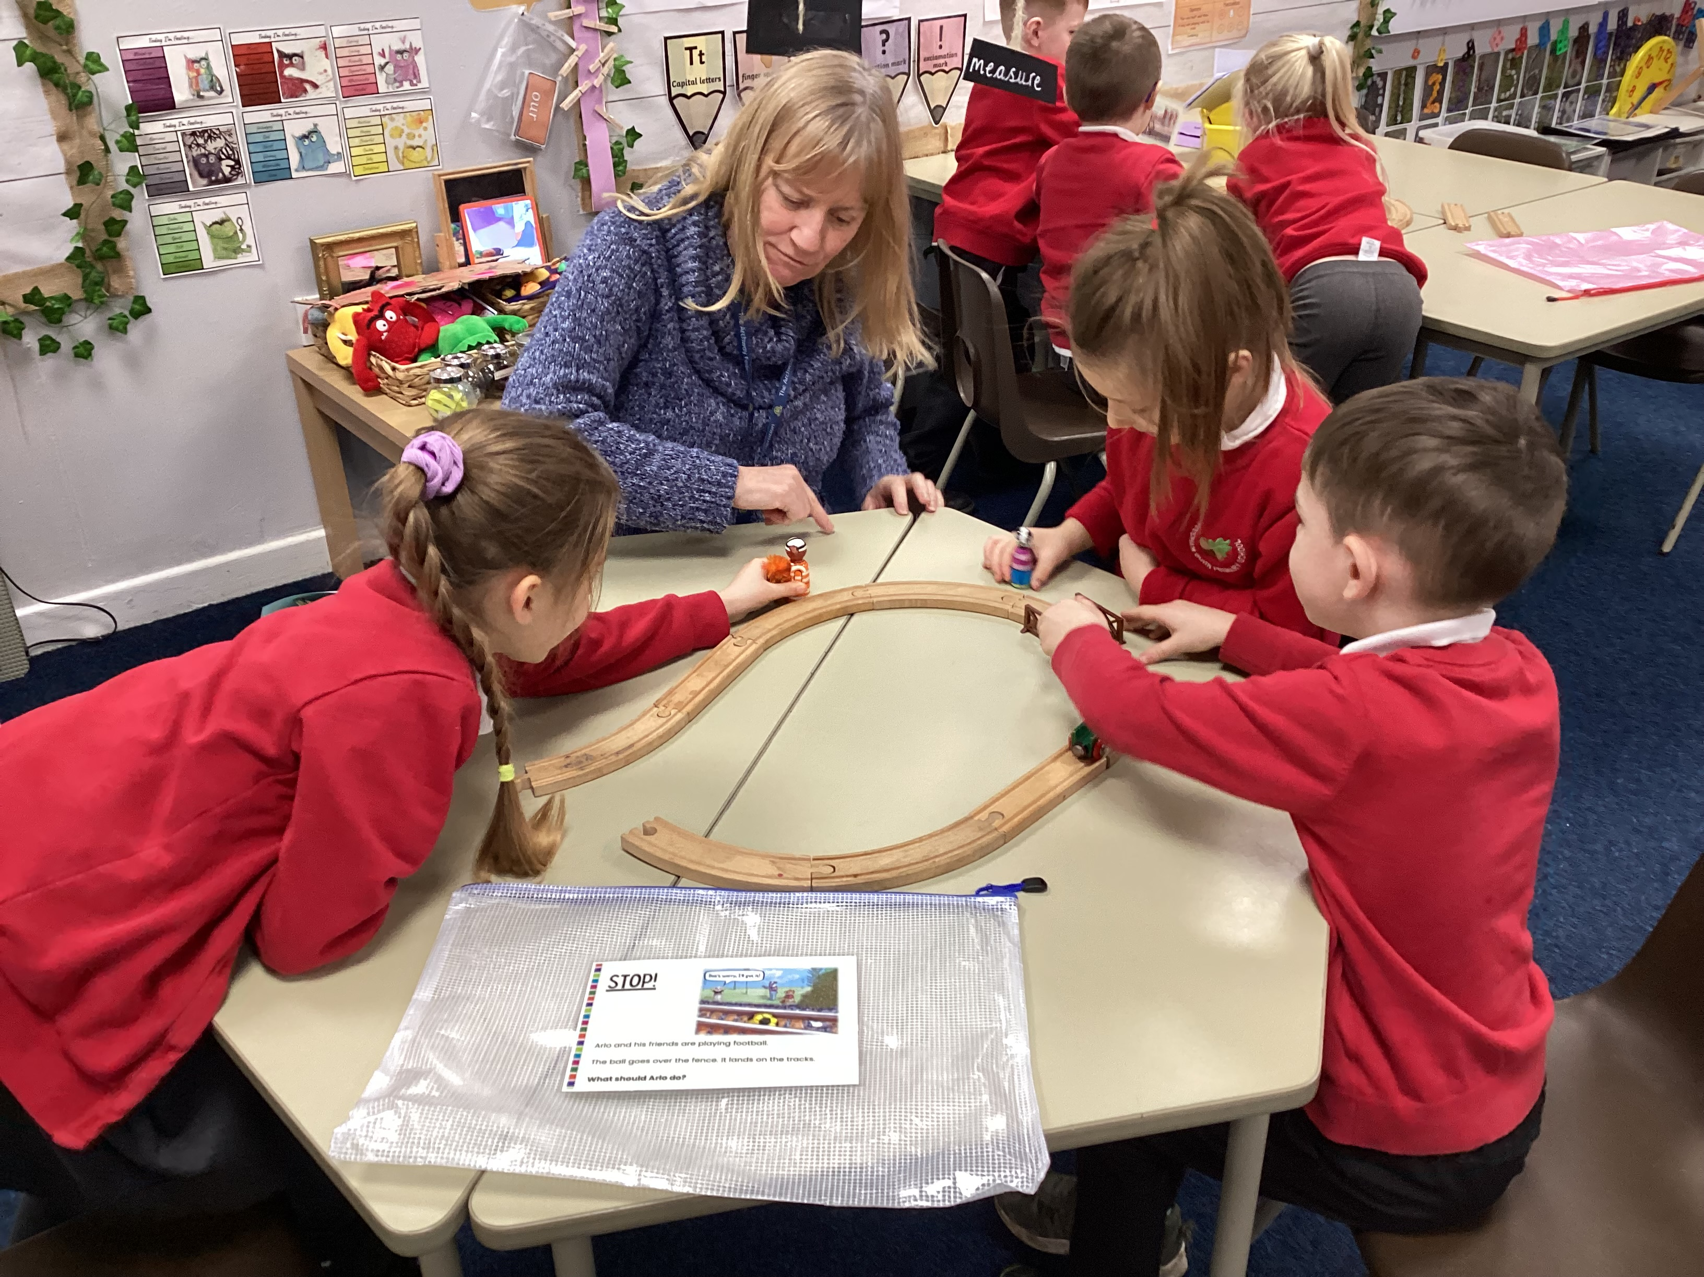
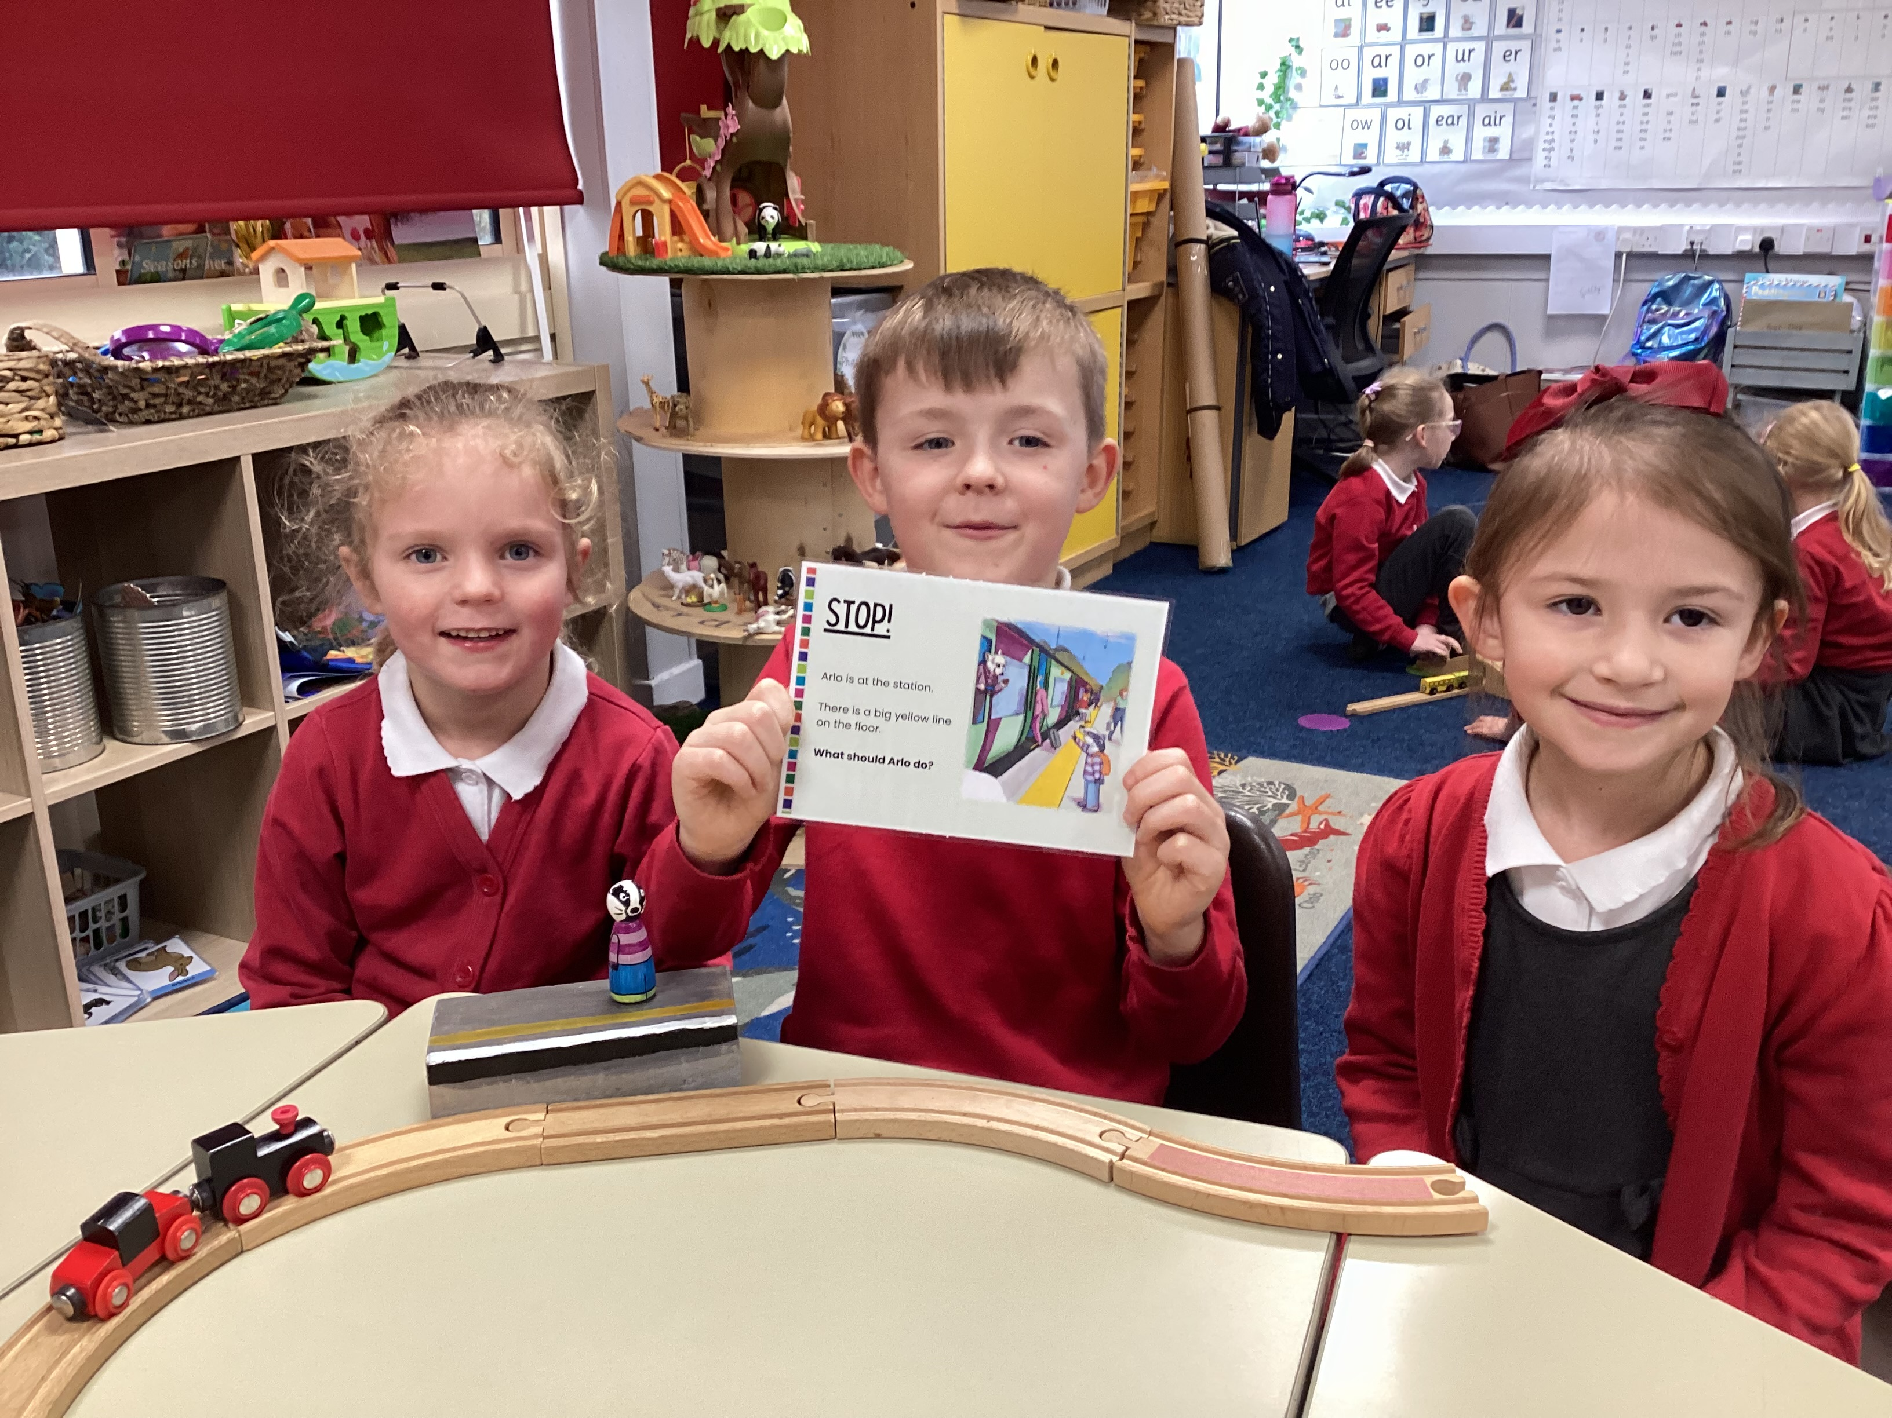
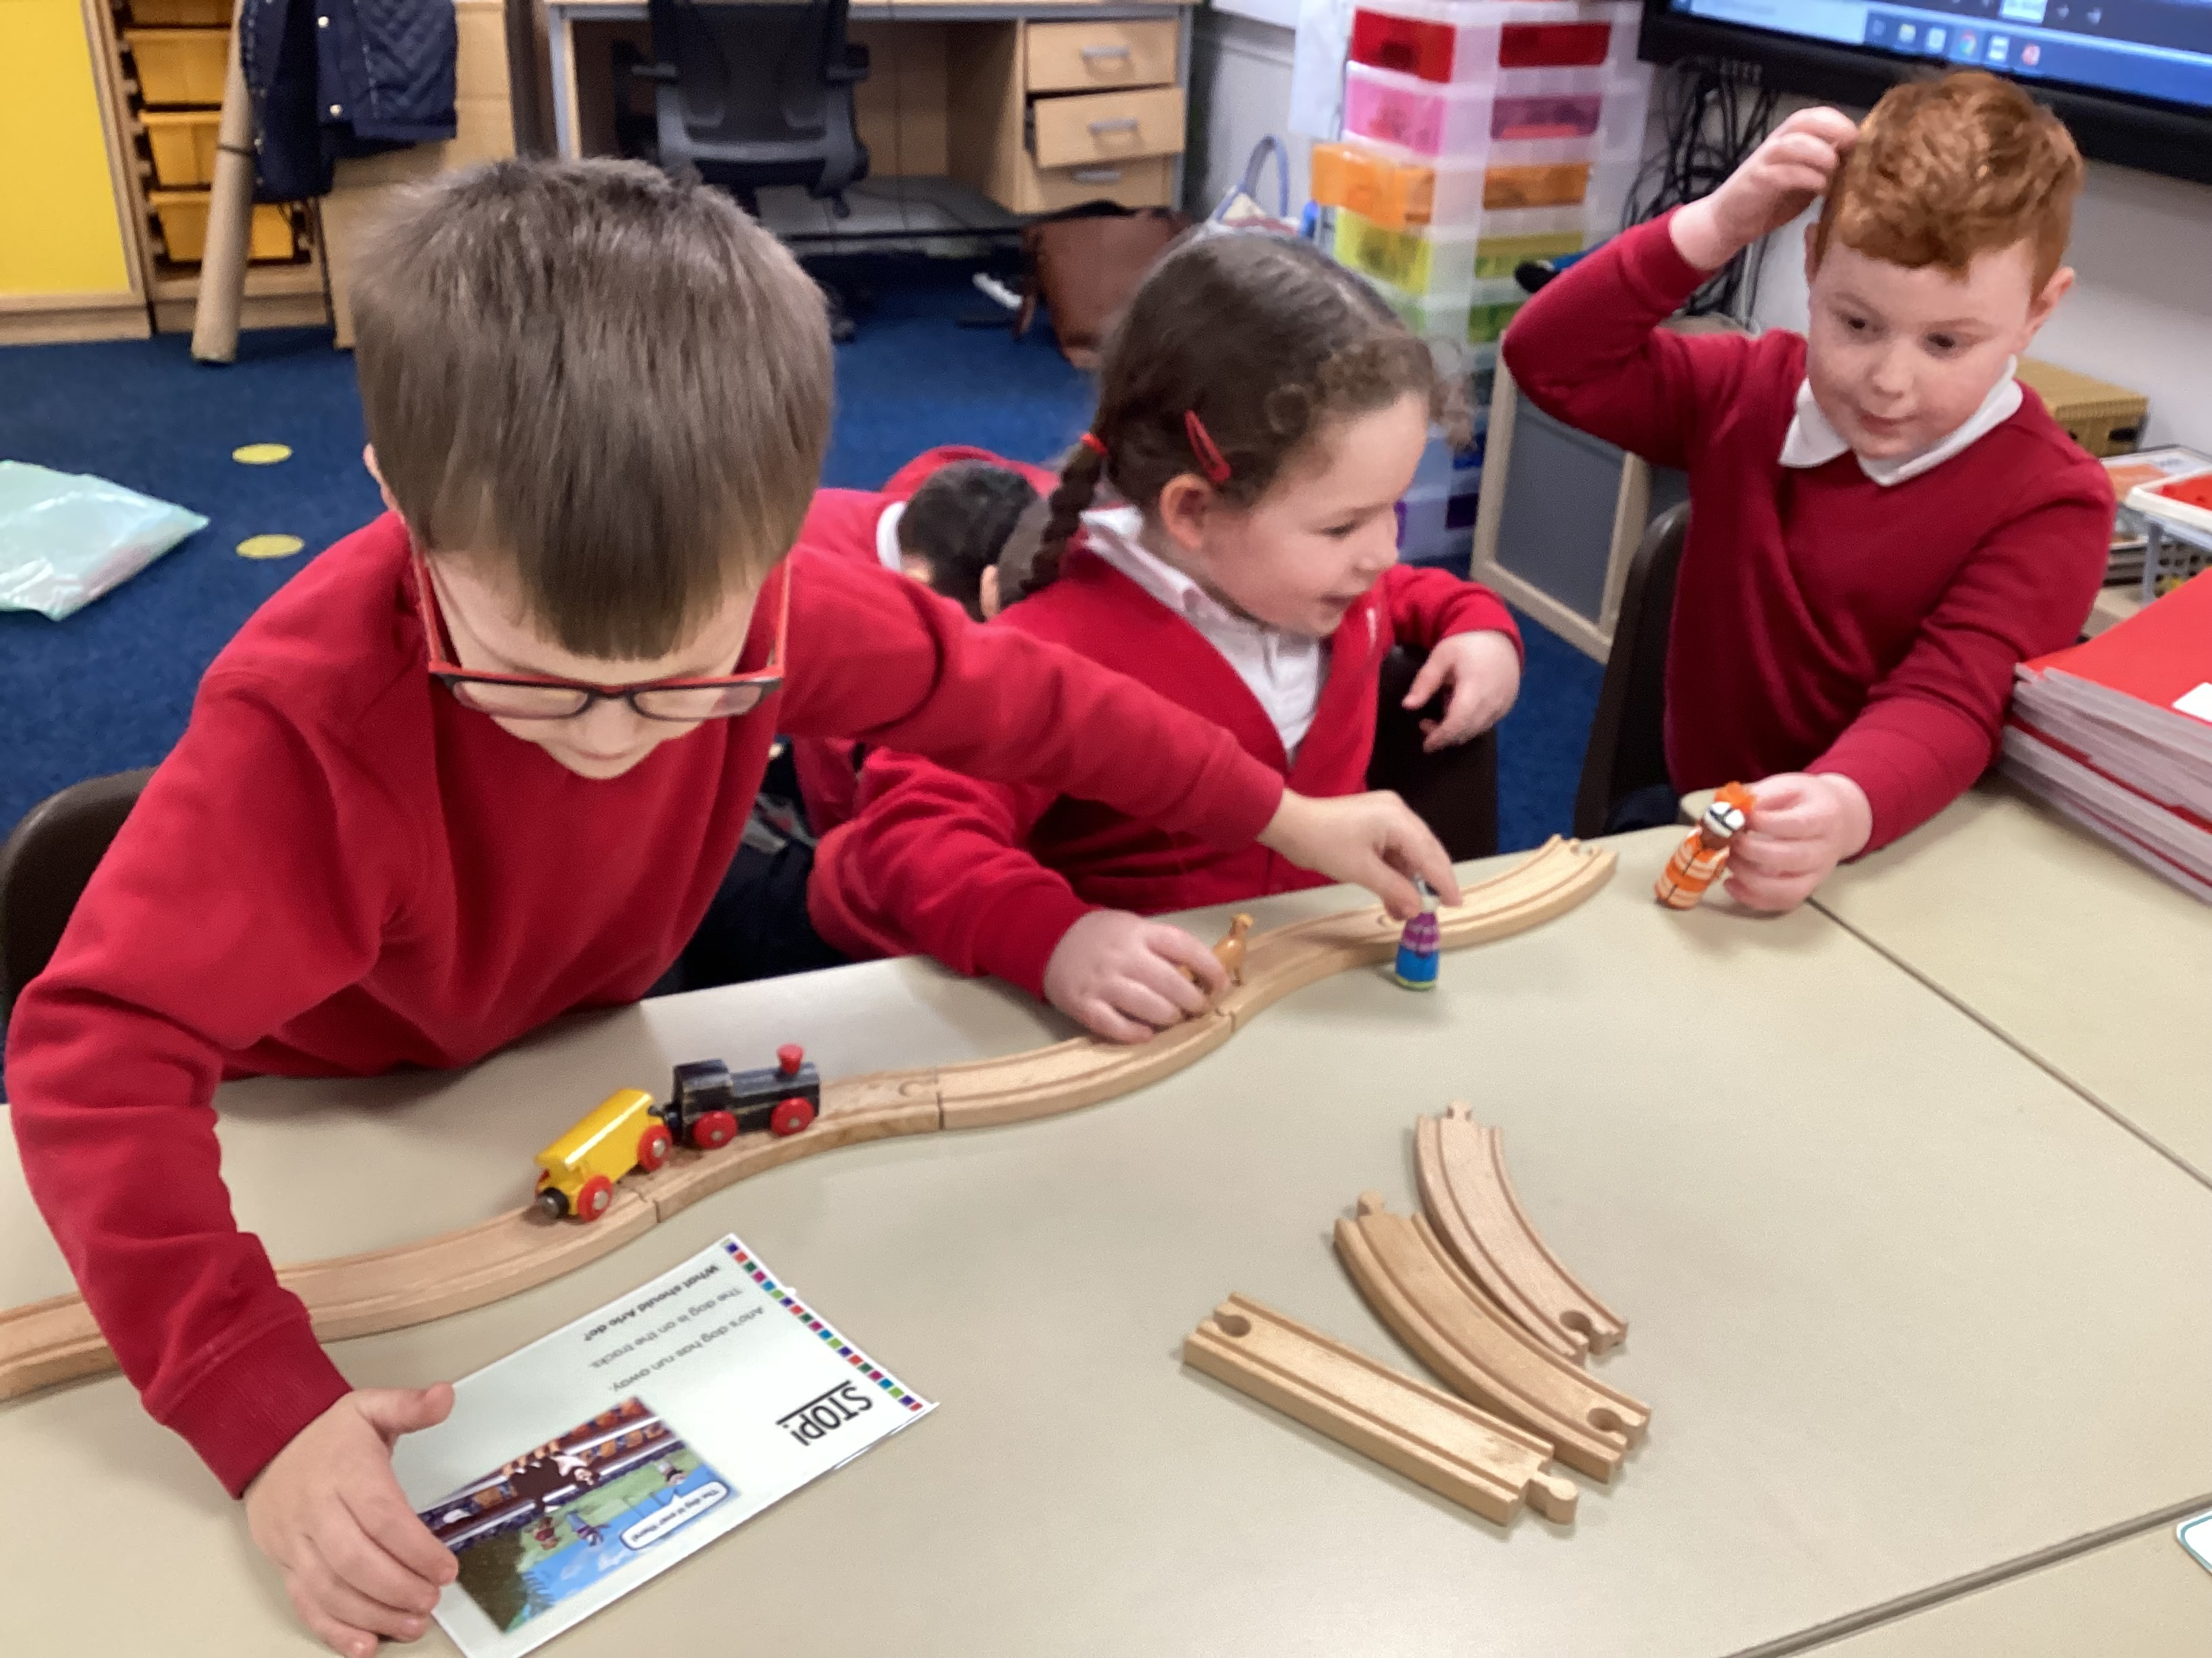

Slide 23
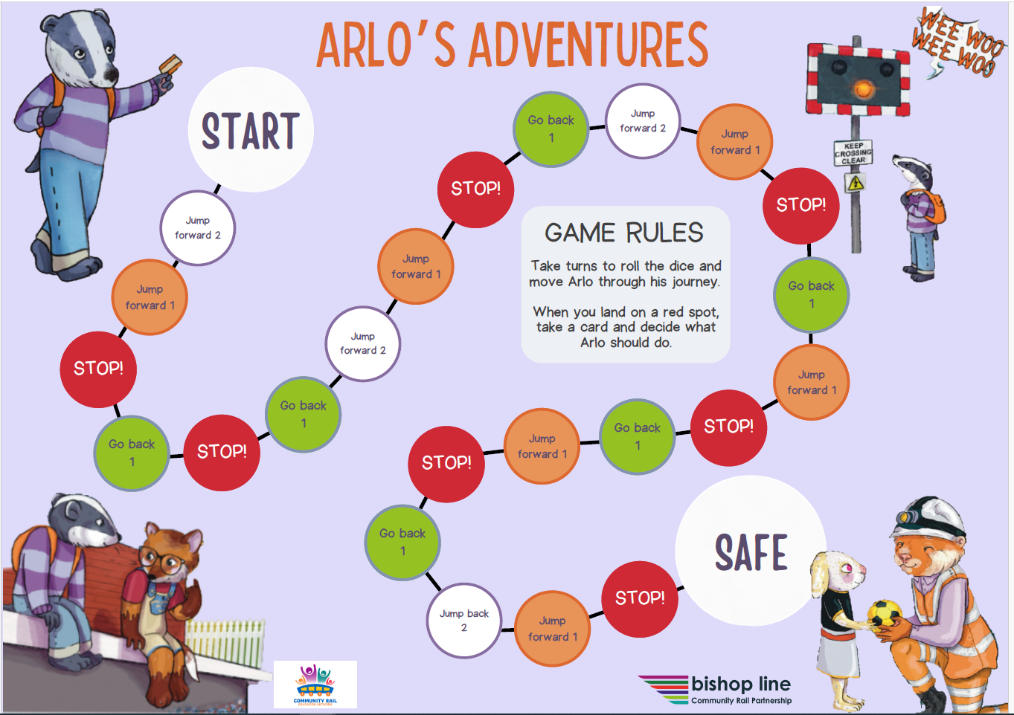

Slide 24
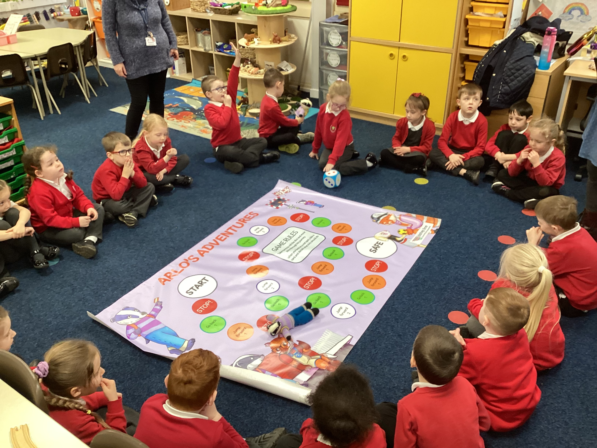

Slide 25
Top Tips
Keep it simple – focus on a few key learning points.
Over-learn – practical/play activities to reinforce the learning. (simple songs and poems, actions, drama)
Not too long! – as a rule of thumb young children can focus their concentration for 1 minute for every year they’ve been alive!
Small Groups! – can the school tell you how many before you arrive?

Slide 26
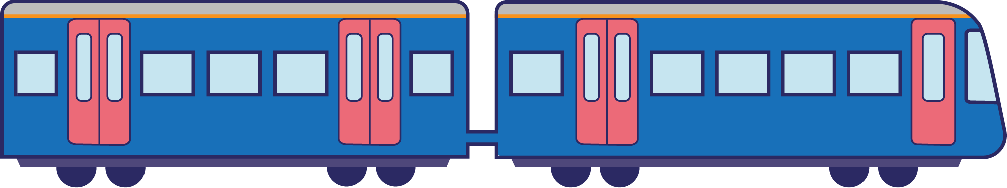
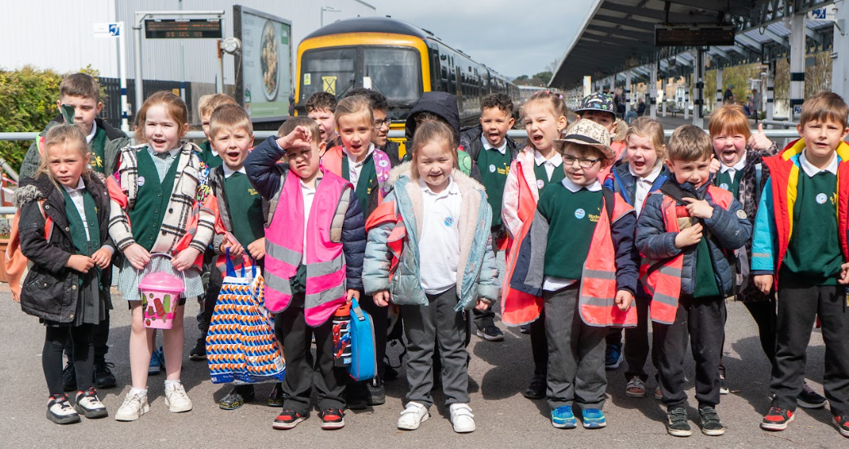

Tickets for practice!
Early Years
Discussion points:
Pre-travel workshop
On the train
Destination
Lessons learnt

Slide 27
Pre travel workshop
Who has travelled on a train?
Notes:
So to prepare us for that trip next week, I am here to talk to you a bit about rail safety, to build up your confidence and to talk a little bit about how we should behave on the railway

Slide 28


How do you feel about travelling by train?
Notes:
So to prepare us for that trip next week, I am here to talk to you a bit about rail safety, to build up your confidence and to talk a little bit about how we should behave on the railway

Slide 29

What are the good things about travelling by train?
Notes:
So to prepare us for that trip next week, I am here to talk to you a bit about rail safety, to build up your confidence and to talk a little bit about how we should behave on the railway

Slide 30

What are the good things about travelling by train?
safe
kind to the planet
fun!
Notes:
So to prepare us for that trip next week, I am here to talk to you a bit about rail safety, to build up your confidence and to talk a little bit about how we should behave on the railway

Slide 31
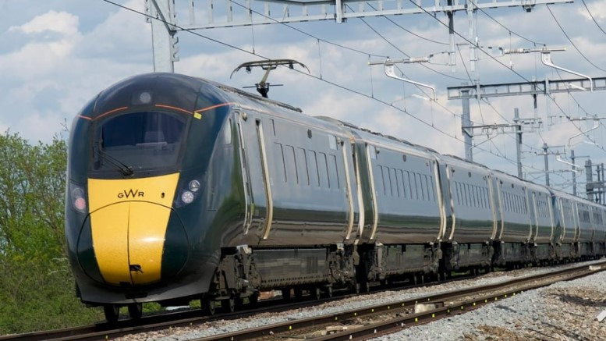

Some trains are powered by electricity
But the electricity is very dangerous!
Notes:
Some railways are now run with electricity. We know that electricity is dangerous. We never ever touch sockets etc and that’s why we never ever touch a rail track or overhead cables

Slide 32
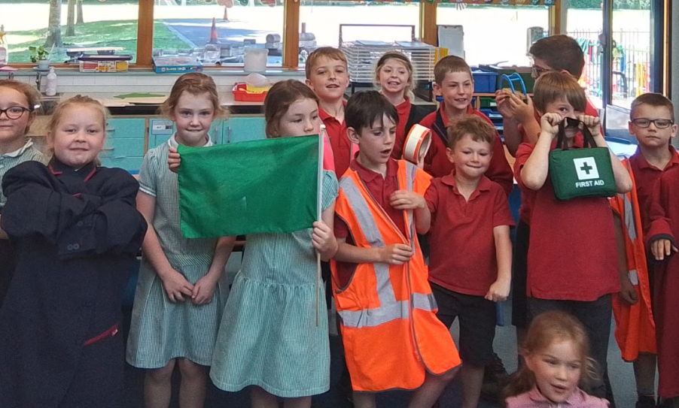

Make it practical

Slide 33
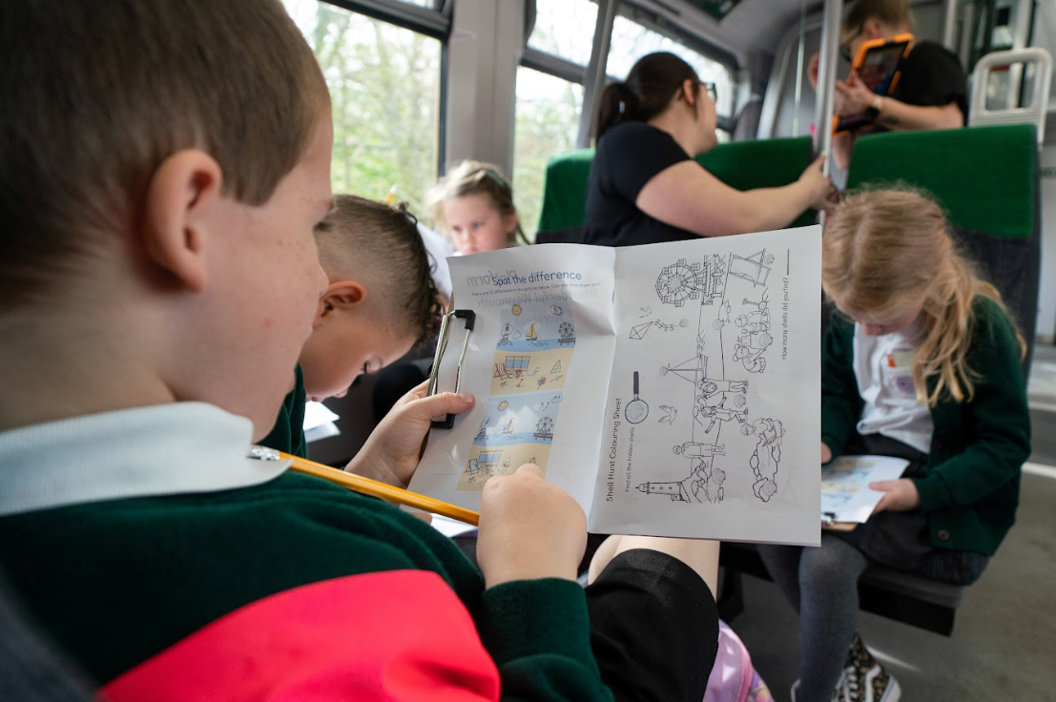
Activities for the train

Slide 34
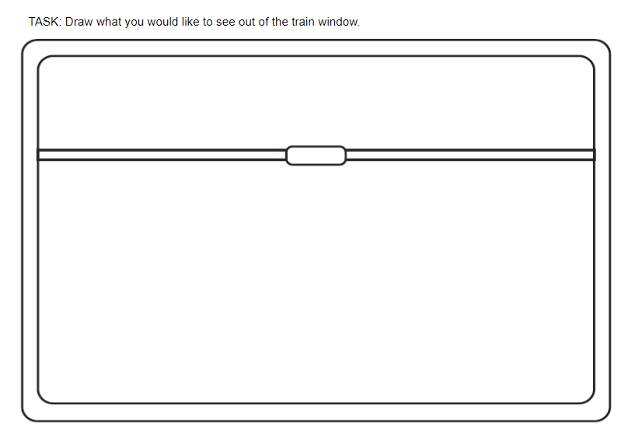
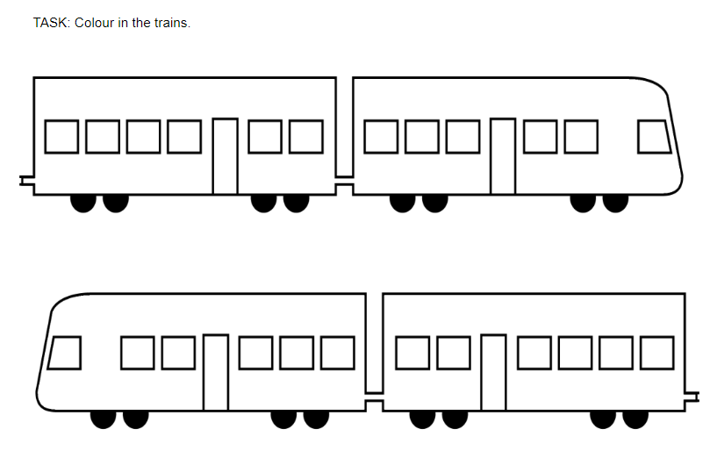
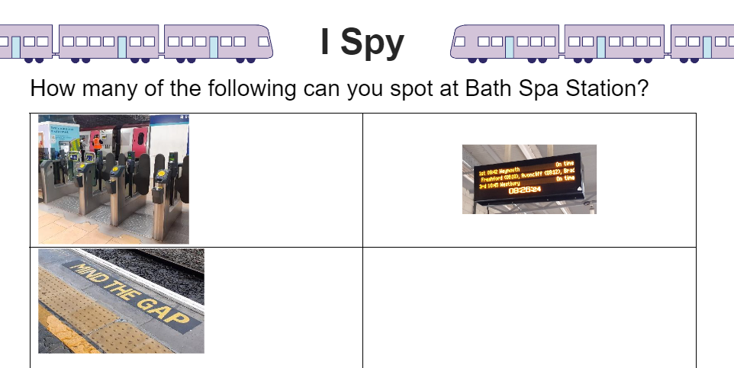
Activities for the train
Colouring
Spot the difference
Drawing
I spy

Slide 35
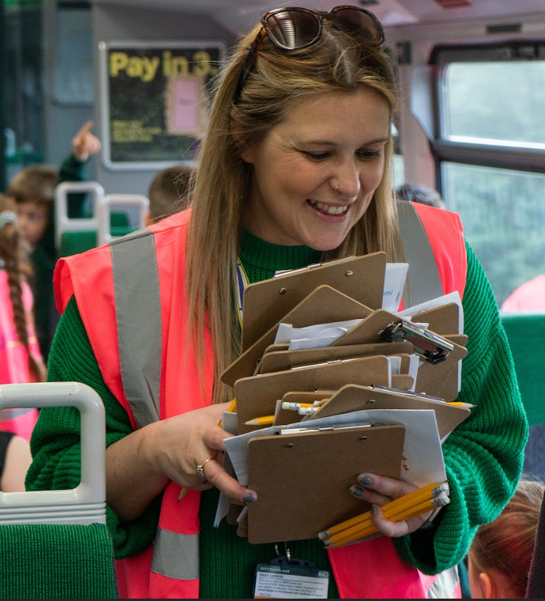
On the train
Be prepared:
Activity books
Pencils
A5 clipboards

Slide 36
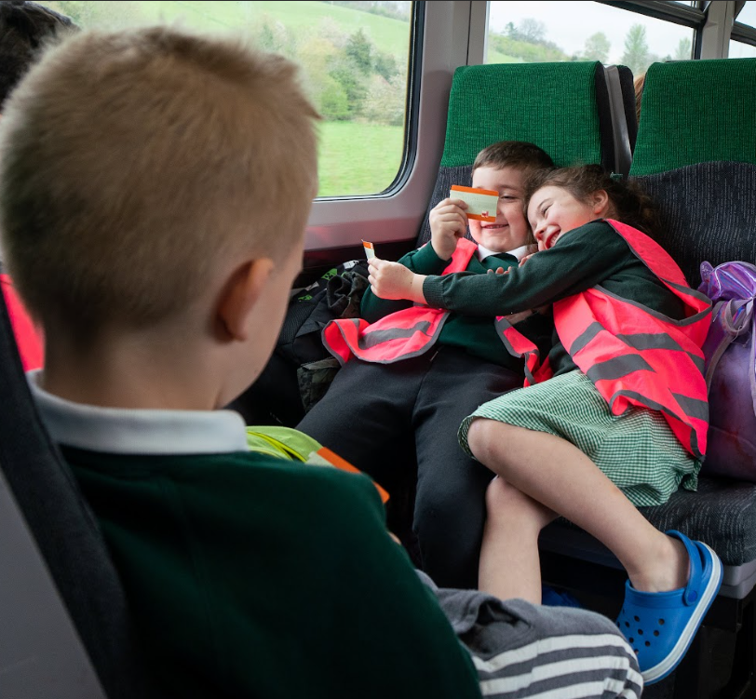

On the train
Be prepared:
Bring some tickets for practice

Slide 37
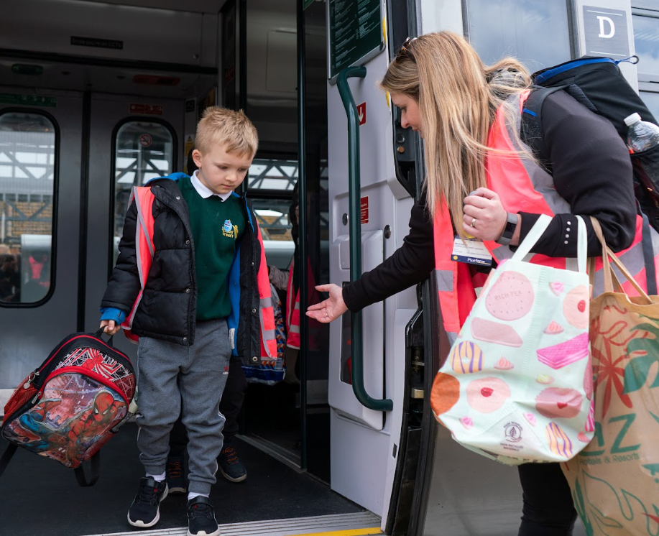
Destination
Things to bear in mind:
May have buggies
May need passenger assist
Limit walking
Lots of extra adults
Toilets!!

Slide 38

Lessons learnt
look

Slide 39
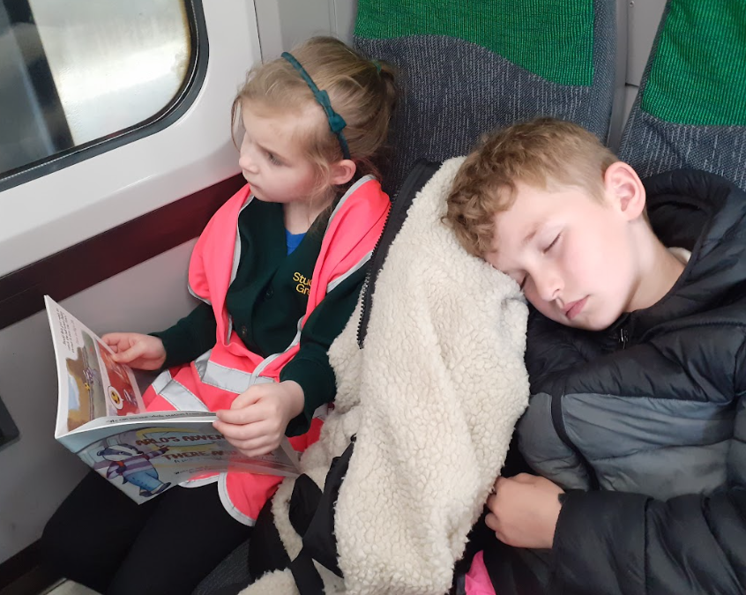
Lessons learnt
Don’t assume reading ability
Keep it simple
Keep it practical
Keep them busy!
Don’t be over ambitious
Be especially aware of facilities available

Slide 40
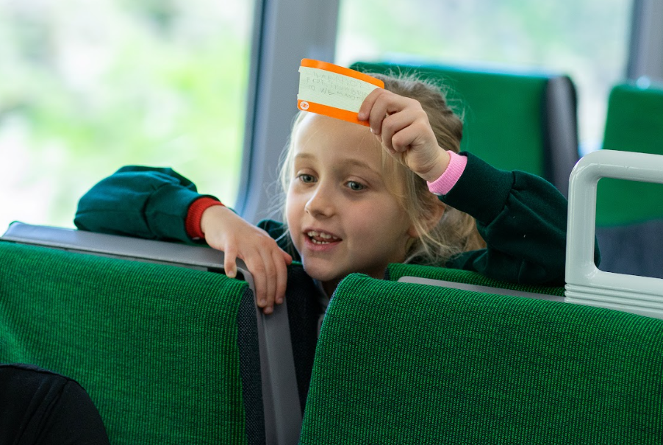
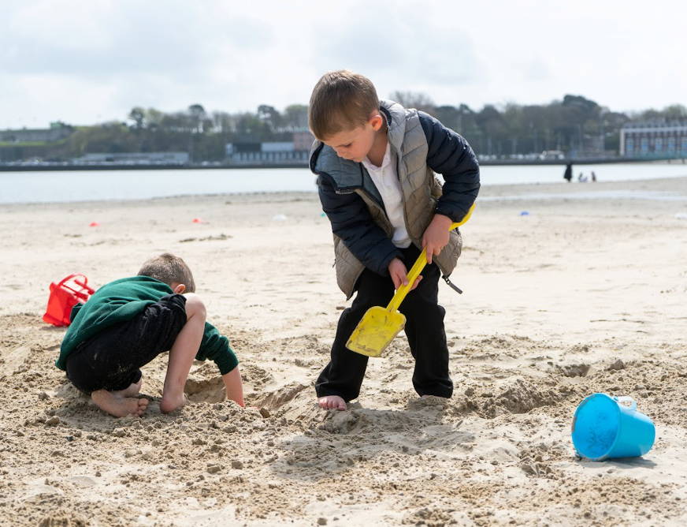
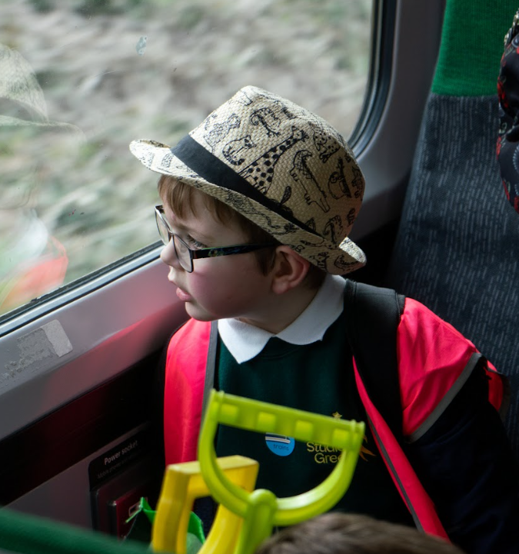
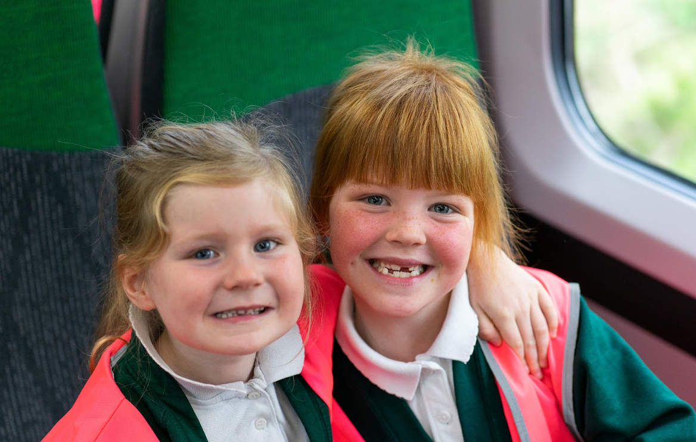
Thanks for listening

