Slide 1
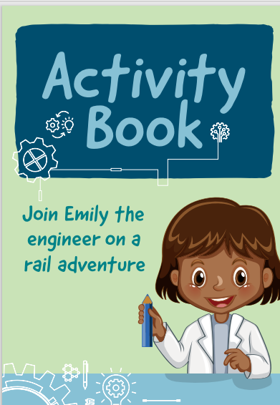
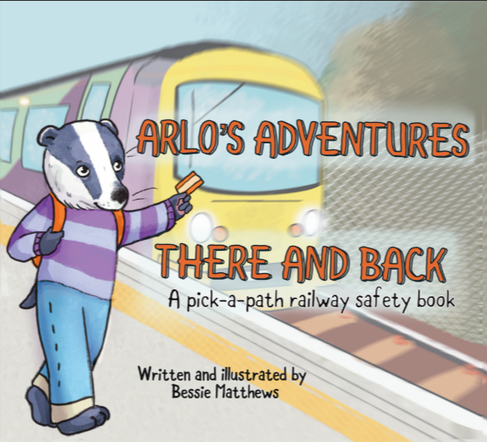
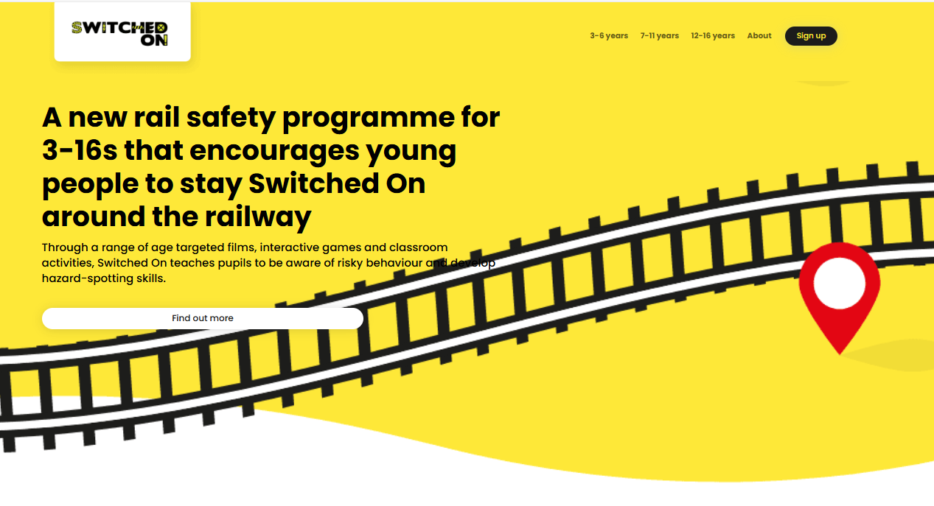
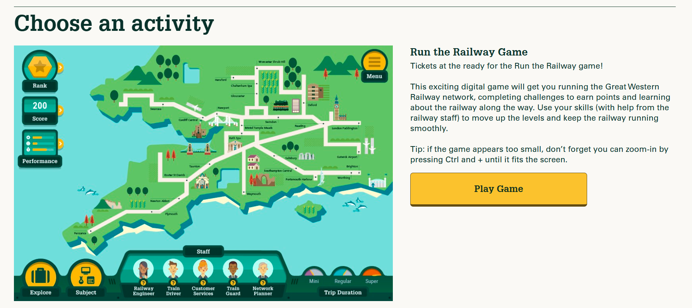
Resources for Rail Education

Slide 2
GWR – Run the Railway
Pupils | GWR (younggreatwesterners.com)

Slide 3
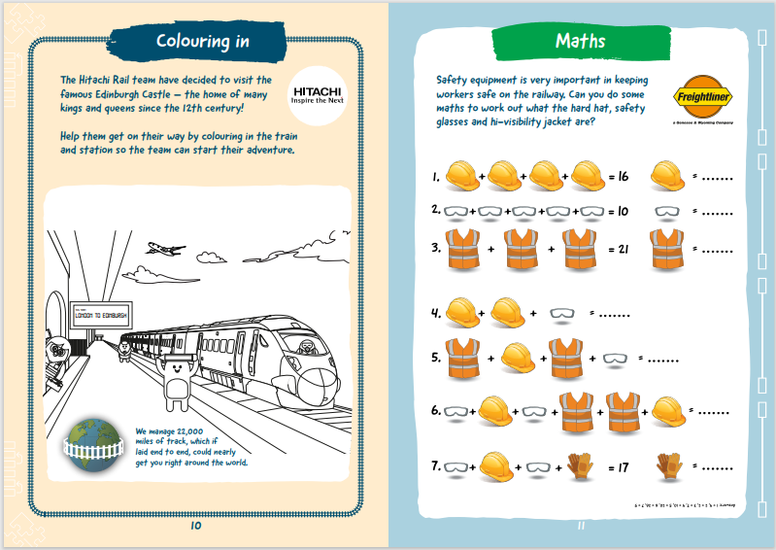
Emily the Engineer
Emily-the-Engineer-FINAL-copy.pdf (networkrail.co.uk))

Slide 4
Switched On
Home - Switched On! (switchedonrailsafety.co.uk)

Slide 5
Routes into Rail
Routes into Rail

Slide 6
You V Train
You Vs Train - Network Rail

Slide 7
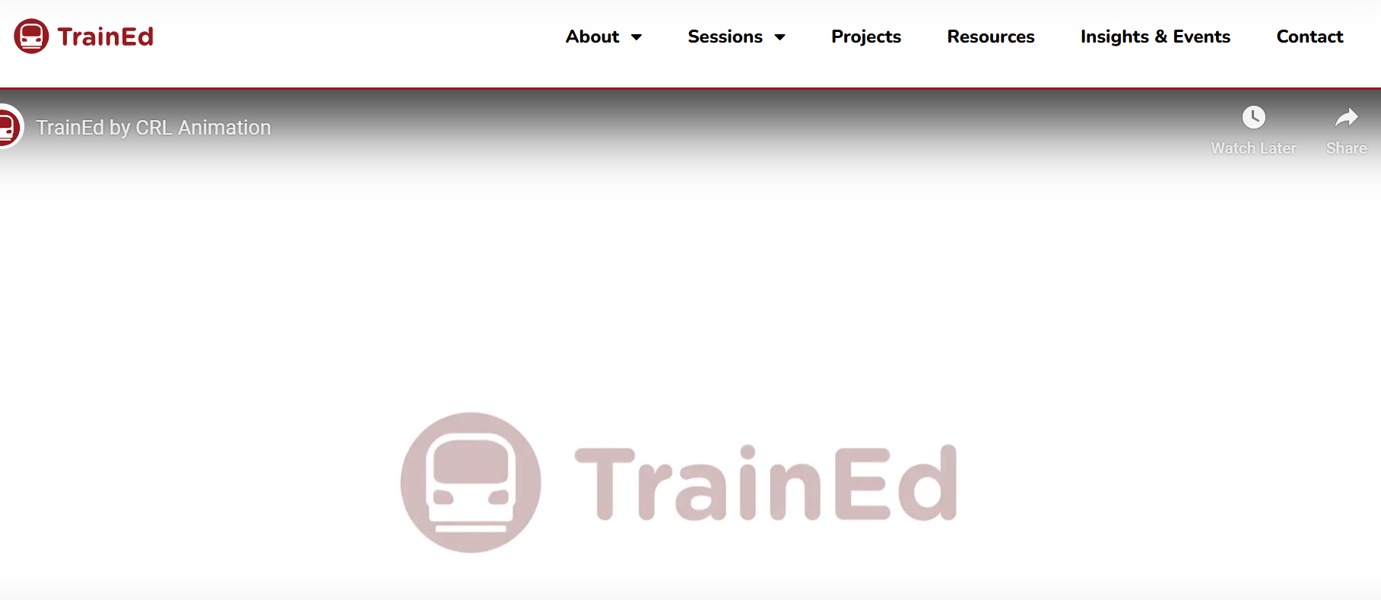
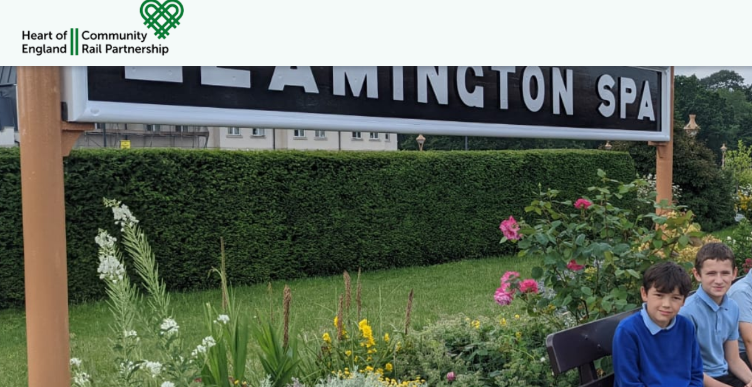
CRP Websites
Resources Archive - Platform (platformrail.org)
TrainEd - Inclusive railway engagement
Free activities for your train journey - Southeast Communities Rail Partnership (southeastcrp.org)
Education – Heart of England CRP (heartcommunityrail.org.uk)

Slide 8
Education Network Resources
Travel with the Green Team - TrainEd
Home - Backtrack Rail Anti-trespassing Competition (backtrackcompetition.co.uk)
Arlo's Adventures - There and Back (fliphtml5.com)

Slide 9
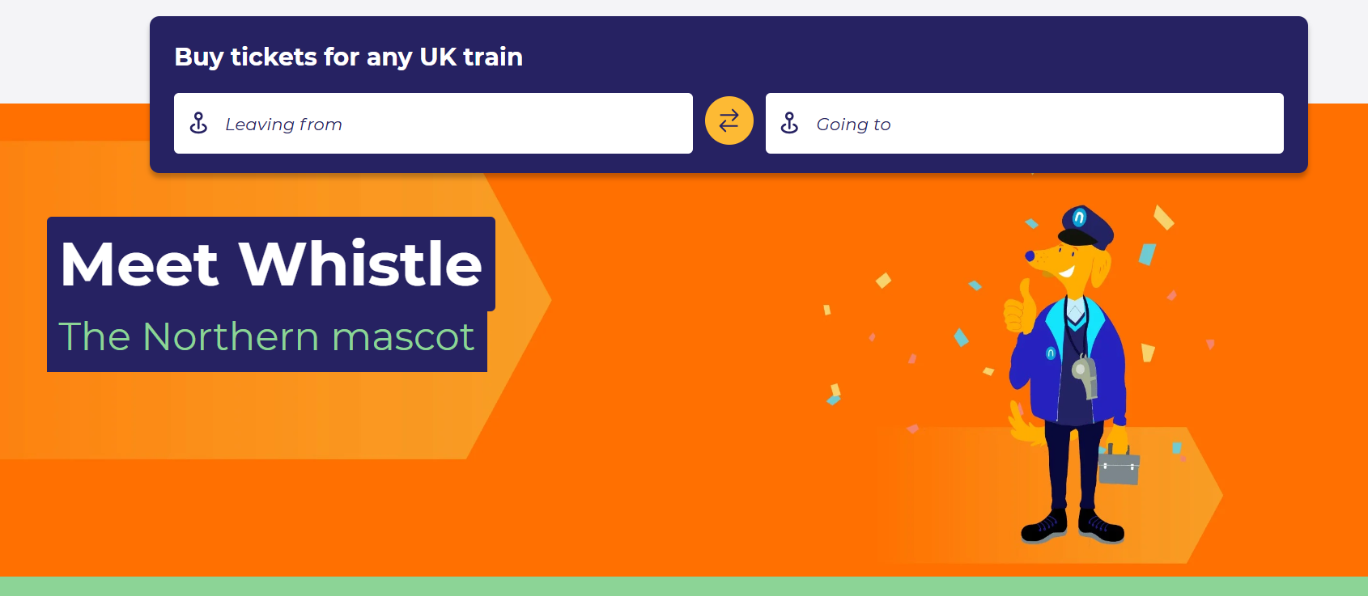
TOC Resources
Meet Whistle | The Four-Legged Northern Mascot | Northern (northernrailway.co.uk)
download (eastmidlandsrailway.co.uk)

Slide 10
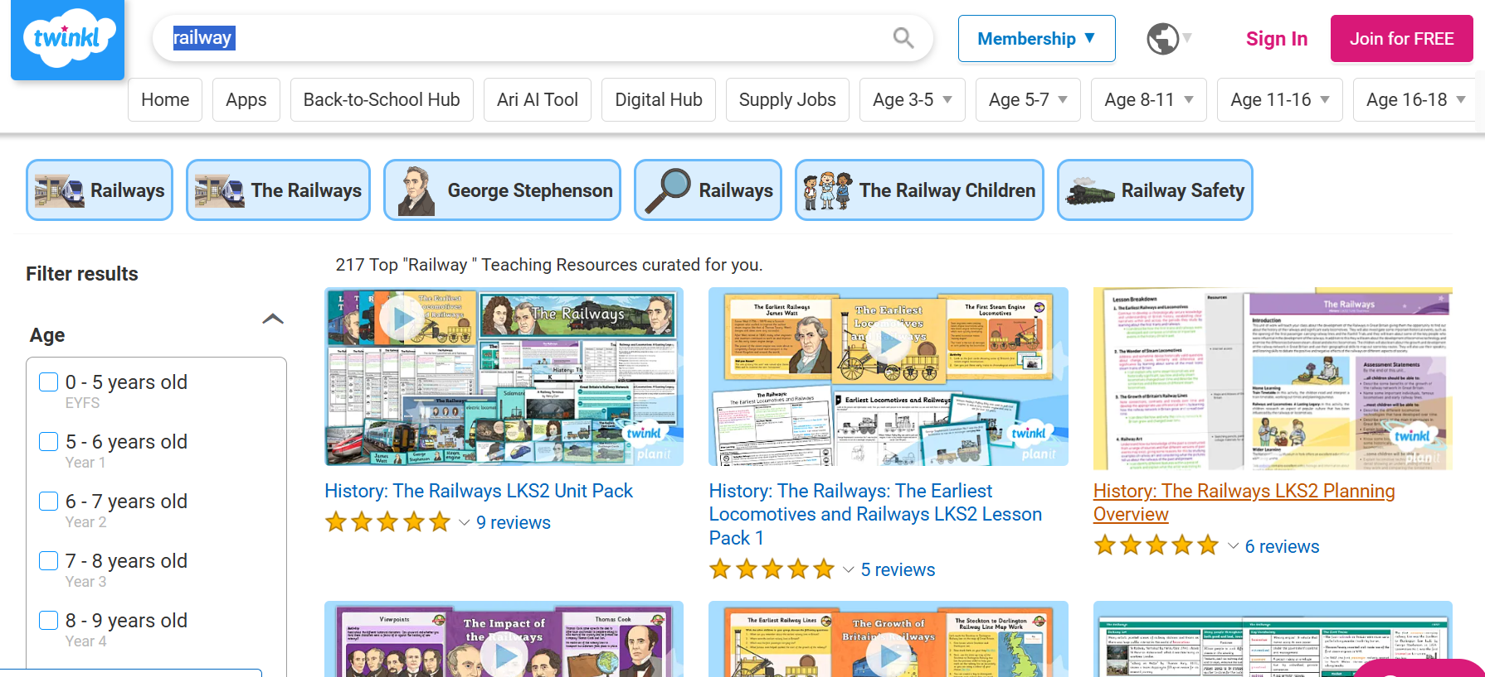
Twinkl also worth looking at – there is a cost but if you know a teacher with an account they might be able to access some resources for you

