Slide 1

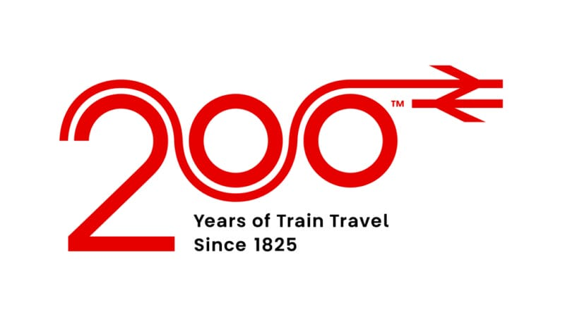

Slide 2
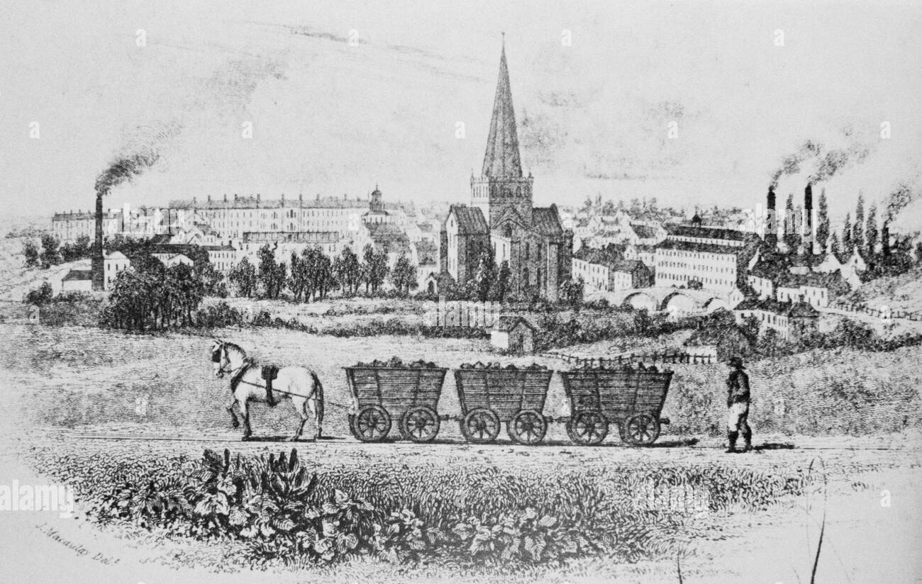
Over 400 years ago

Slide 3
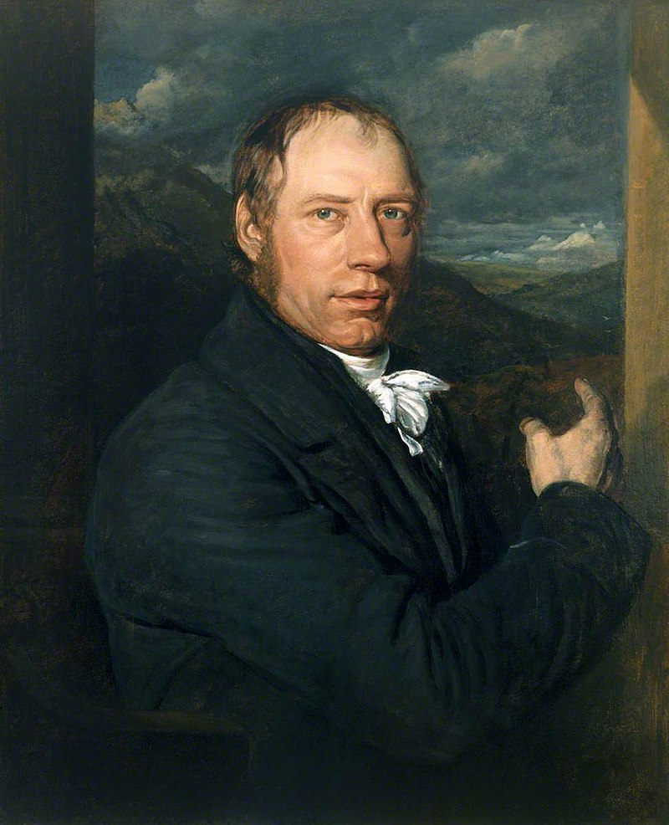
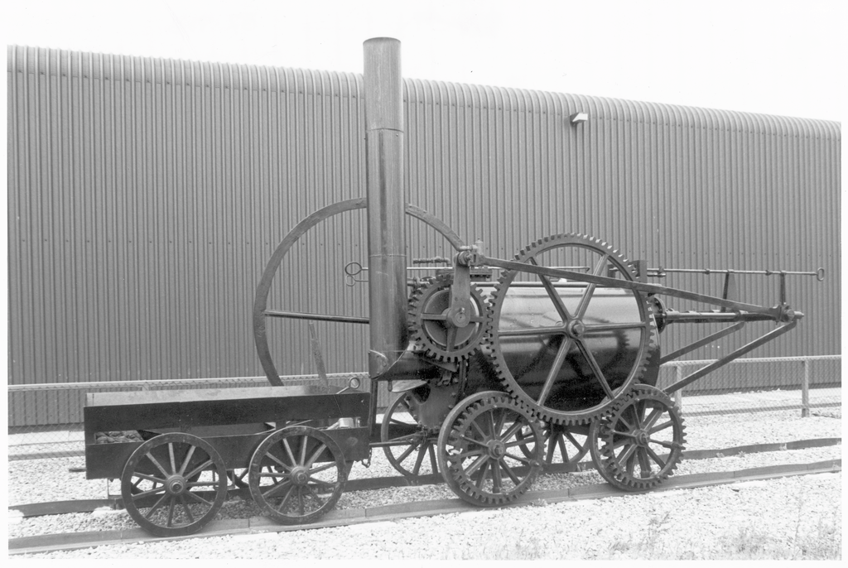
Early 1800s Richard Trevithick built first steam locomotives – no passengers

Slide 4
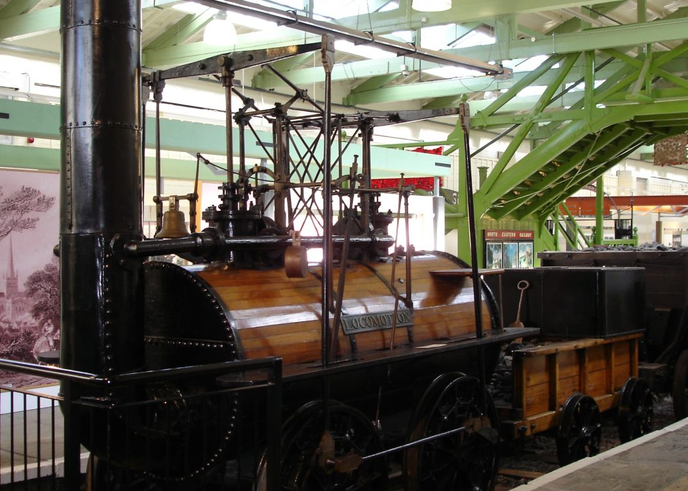
The Stockton & Darlington Railway opened in 1825. It was the first public railway in the world to transport goods and passengers using steam locomotives. Locomotion No. I was built by George Stephenson and his son Robert. George himself drove the engine on the Railway’s opening day at speeds of up to 12 mph, which was very slow by today’s standards.
History KS3 & KS4/GCSE: The Stockton and Darlington Railway - BBC Teach

Slide 5
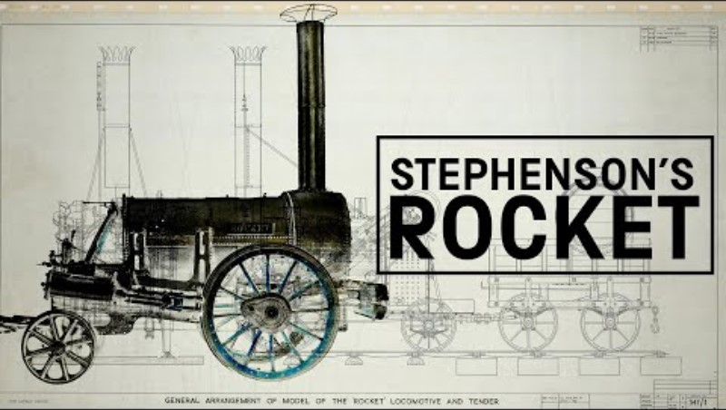
How Stephenson's Rocket Changed The World

Slide 6
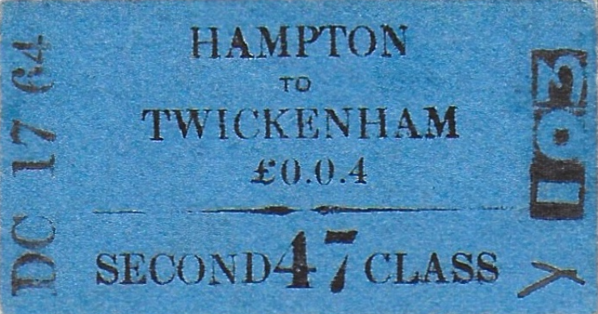
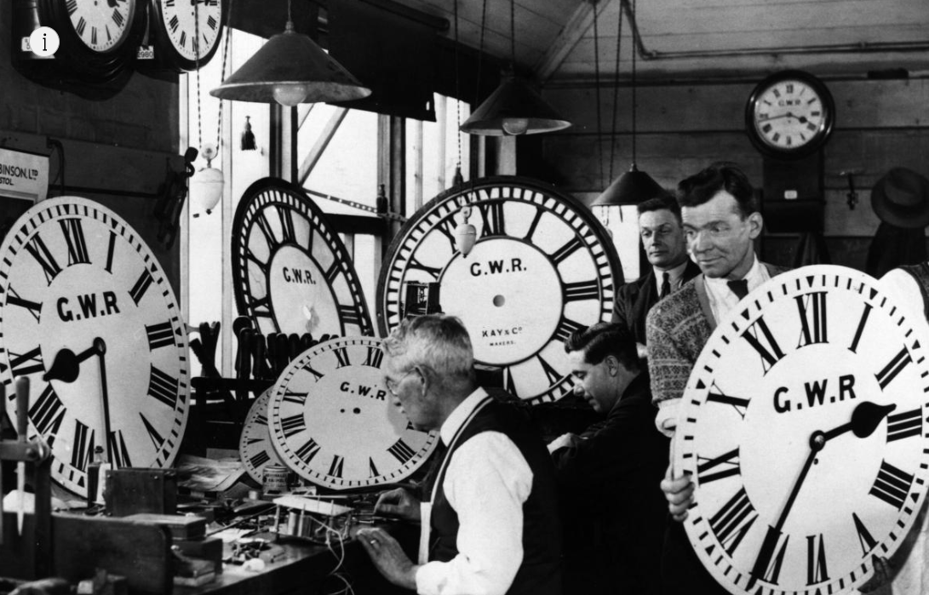
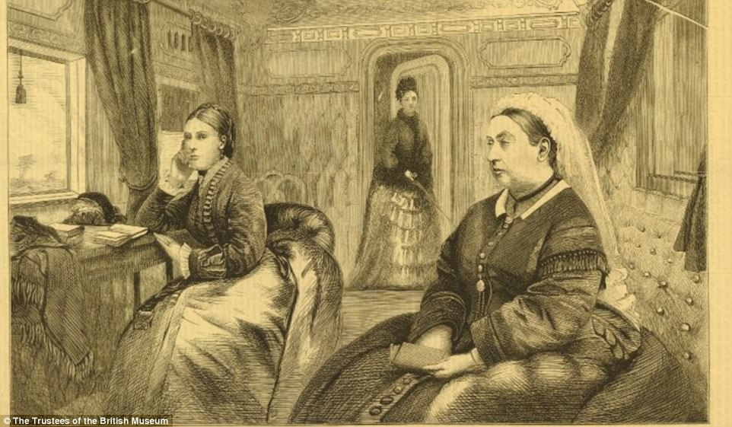
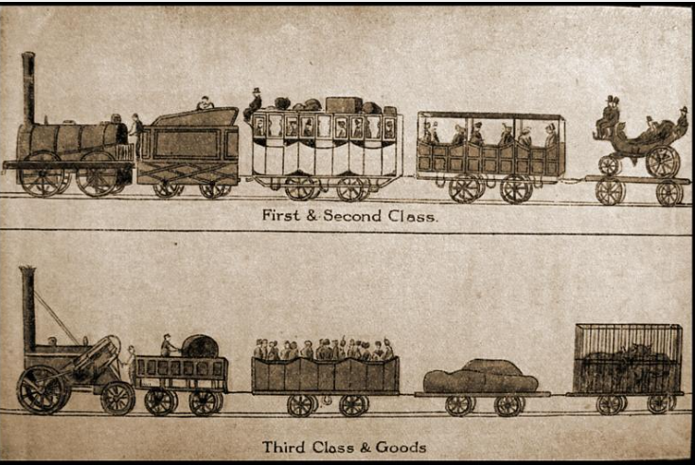
1840s and 1850s

Slide 7
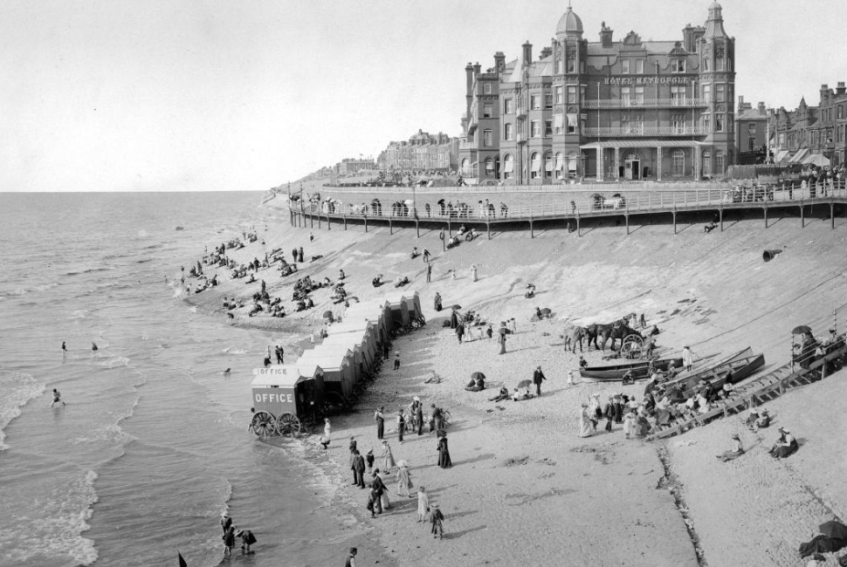
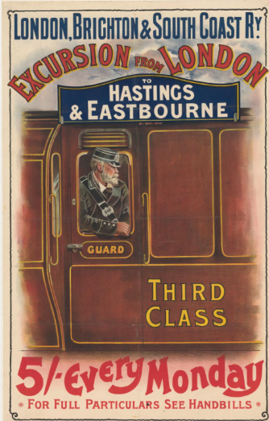
In 1860 railways carry 23,000 visitors to the seaside in Blackpool: rail is creating mass tourism. In the 1800s and 1900s, factories closed for part of the summer for maintenance, and workers took their holiday. These were known as Wakes Weeks or, in Scotland, Fairs Fortnights – dates varied by area.
1860s

Slide 8
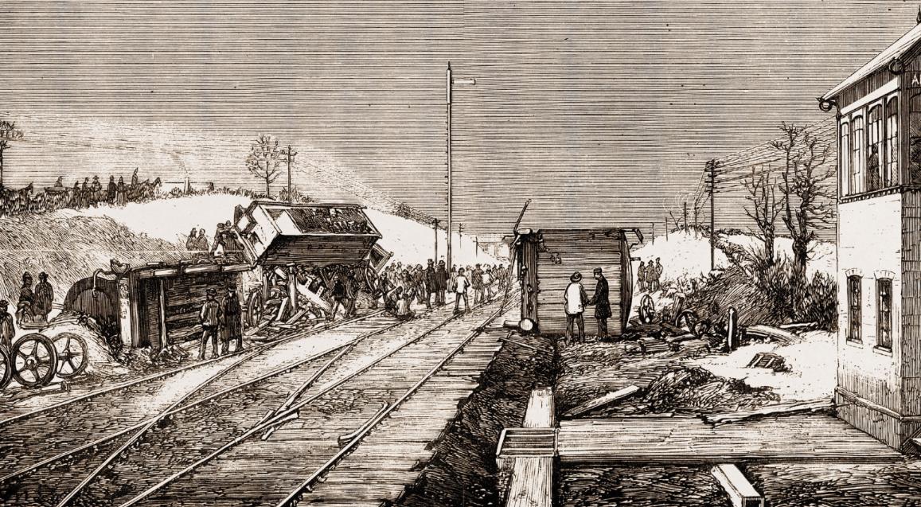
1870s
Heavy snow jams the signal arm at Abbots Ripton, making it seem like an all clear ahead signal is showing. Thirteen people die in a terrible crash, which wrecks 3 trains. After the accident, signal improvements are made. ‘Danger’ is made the default signal setting, making sure that drivers do not assume the line ahead will be clear..

Slide 9
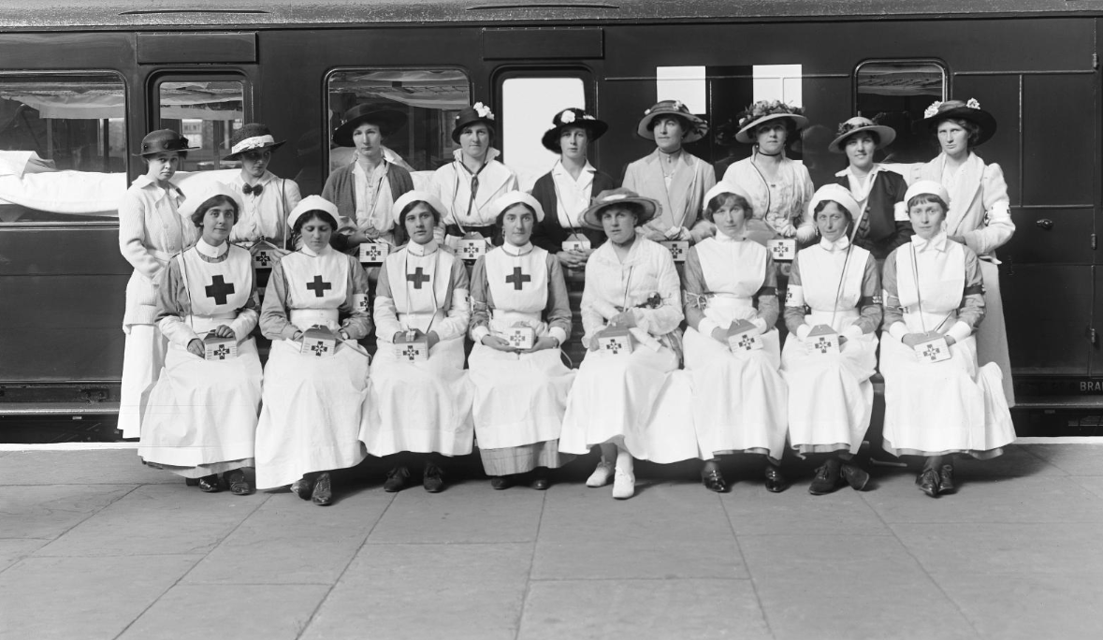
1914-1918
When Britain declared war on Germany in 1914 , trains efficiently moved huge numbers of troops and equipment between the Home Front and France.
Trains also transported rations, water and coal across Britain and continental Europe in a way not previously possible during conflict.
More than 20,000 railway workers from Britain lost their lives during WWI , after more than 100,000 enlisted when war broke out.

Slide 10
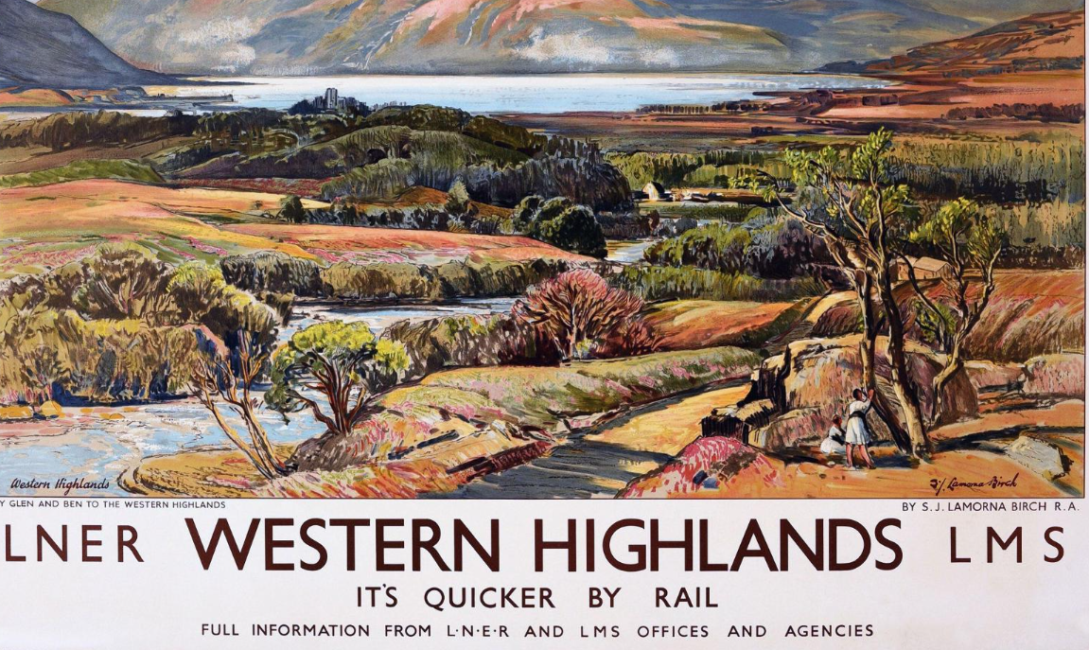
1923 – The Big 4
The "Big Four" railway companies – LNER (London and North Eastern Railway), LMS (London, Midland and Scottish Railway), GWR (Great Western Railway), and Southern Railway (SR) – are created following the Railways Act of 1921. This combines many small companies into four larger ones, aiming to improve services for customers..

Slide 11
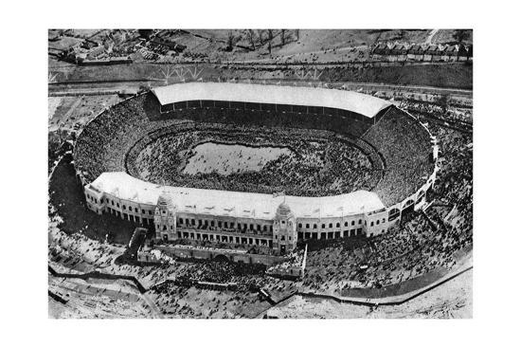
1923
In 1923, the now iconic Wembley stadium hosts its first FA Cup final. Over 270,000 people travelled in 145 special services to the final that featured West Ham United and Bolton Wanderers. .
Since football began, railways have galvanised the sport. Many teams, including Manchester United, have their origins in railway employee clubs.

Slide 12
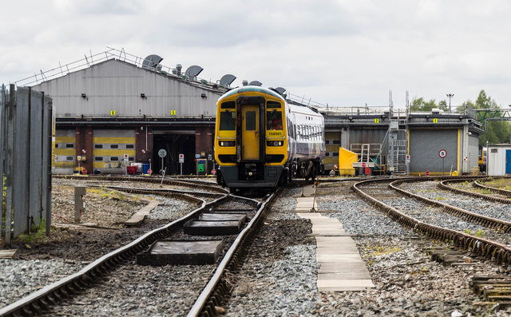
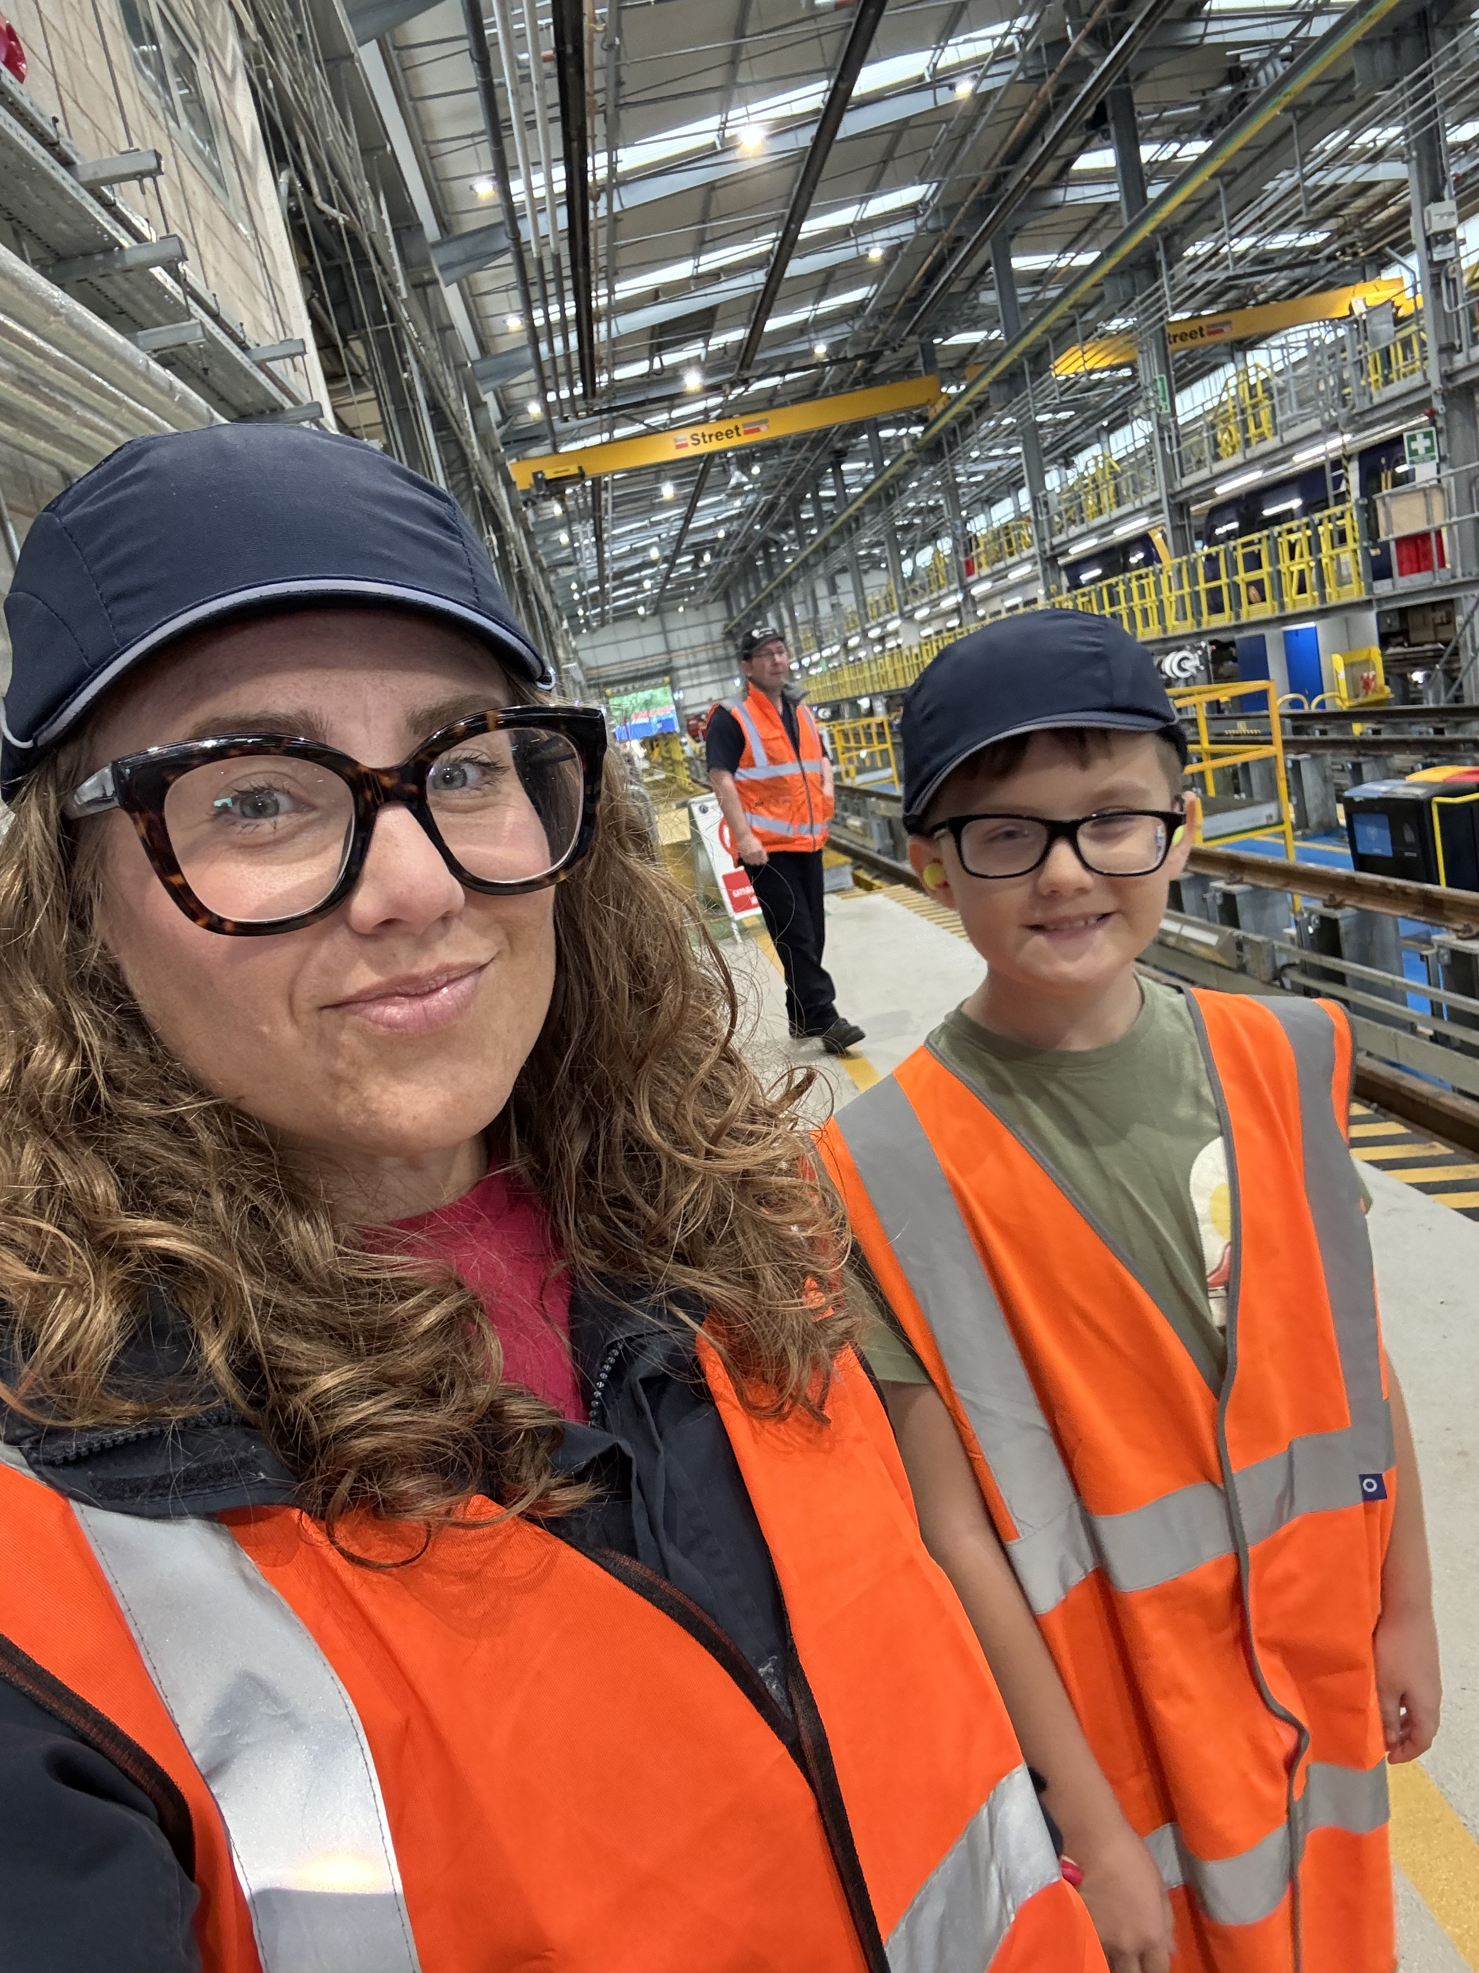
Newton Heath Train Care Centre in Manchester - Manchester United were founded as Newton Heath LYR Football Club in 1878, but changed their name to Manchester United in 1902.

Slide 13
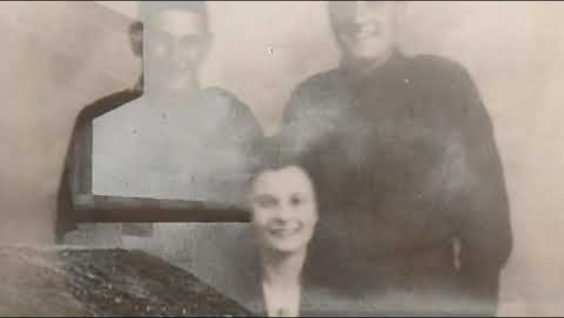
Film: The Railway at War - 1939-1945 - Network Rail
1939-1945
Film: The Railway at War - 1939-1945 - Network Rail

Slide 14
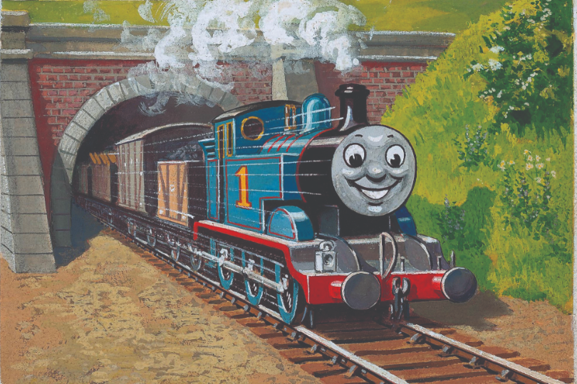
1946

Slide 15
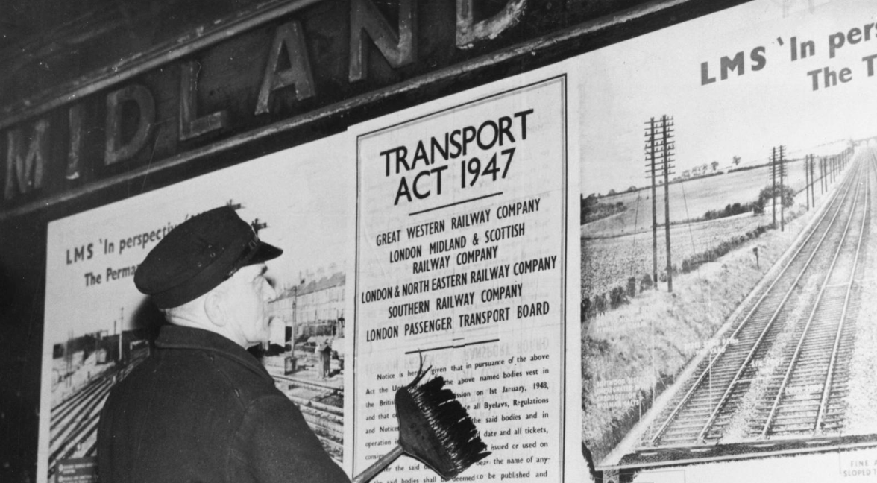
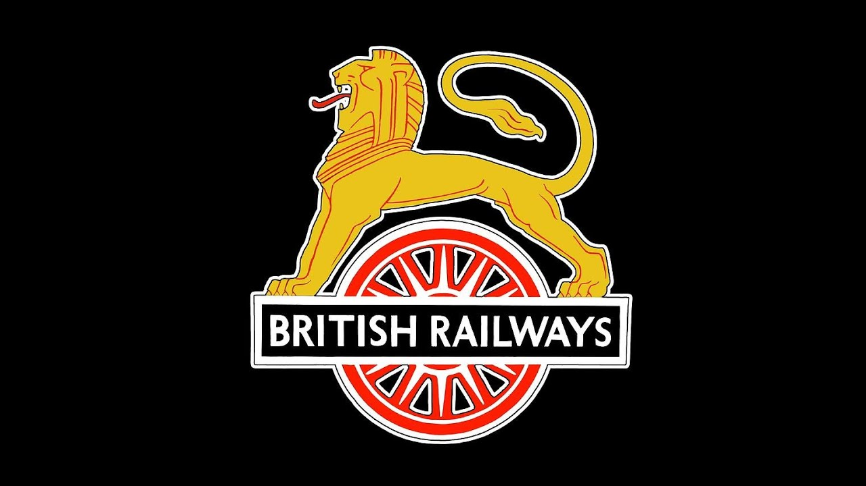
Nationalisation
1948

Slide 16
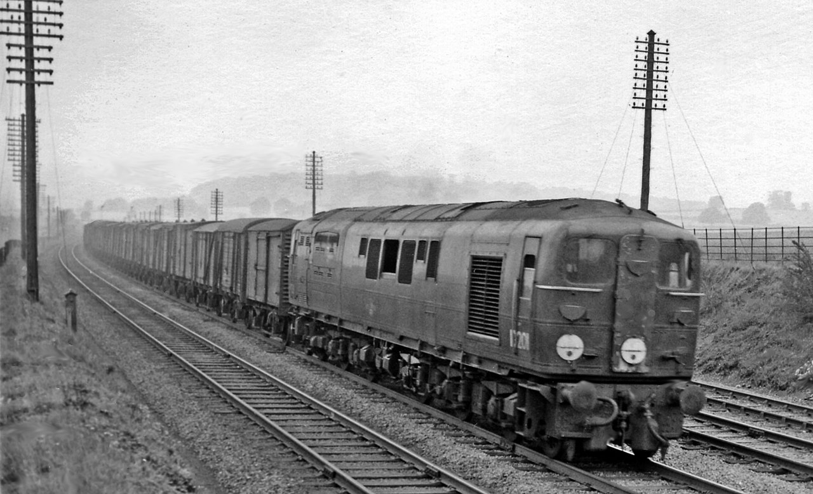
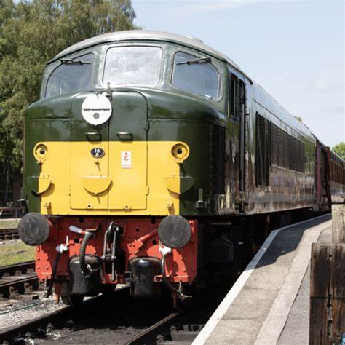
Diesel Power
1950s

Slide 17
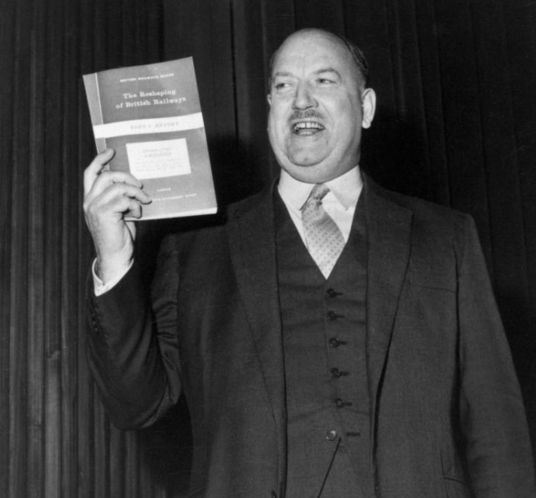
1963 – Beeching Report
Dr. Richard Beeching is appointed to oversee a controversial period of change. Over 2,000 stations and 5,000 miles of track are earmarked for closure.

Slide 18
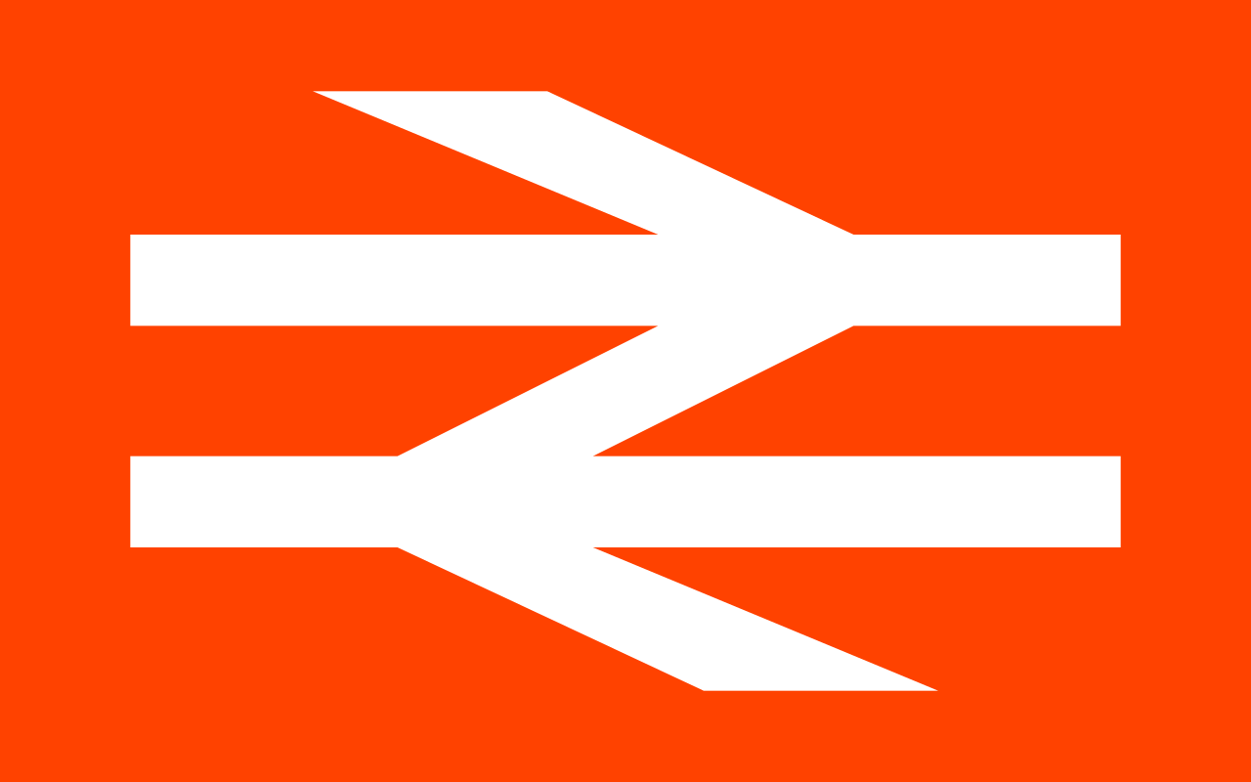
1965 – Double Arrow logo

Slide 19
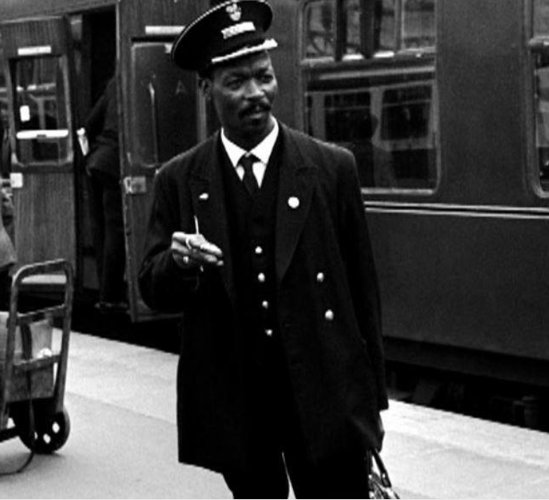
1966
Asquith Xavier is rejected from a guard job at Euston because of an internal ban on non-white employees. He takes his case to the British Railways Board. This leads to an investigation and the introduction of equal opportunities for people of colour working at major stations.

Slide 20
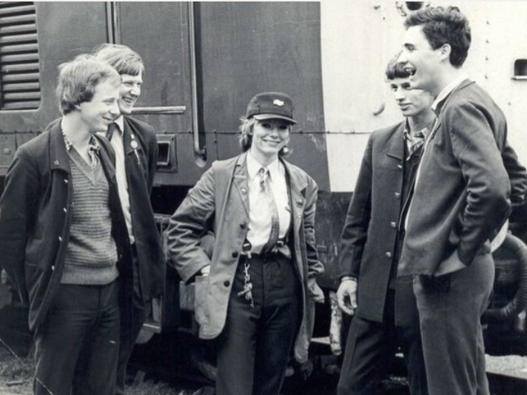
1979
Karen Harrison applies to the British Rail driver training programme, signing her application K. Harrison. At interview stage, bosses realise she’s not a man. Karen qualifies as one of the first female drivers, but workplace recognition is a challenge.

Slide 21
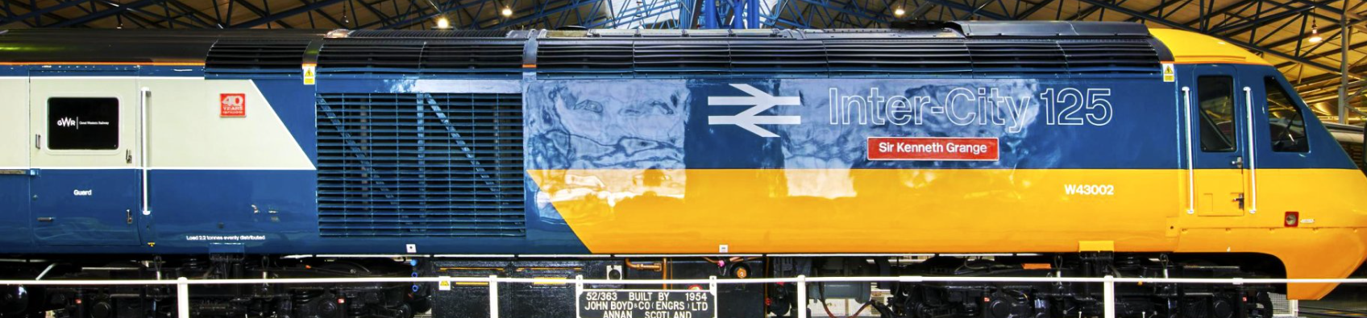
1986 – Intercity Rebrand

Slide 22
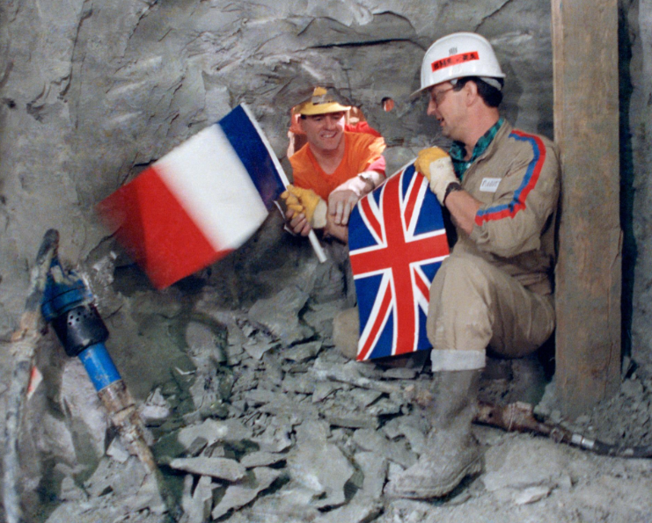
1990
On 1 December 1990 there is a literal breakthrough as British and French teams connect the service tunnel beneath the Channel.

Slide 23
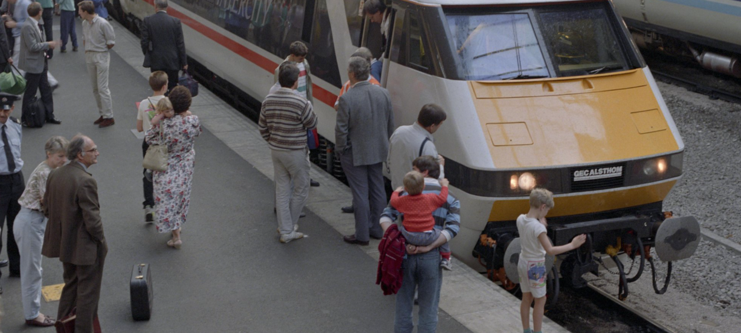
1994
The government begins a railway privatisation process, discussed since the 1980s. Private firms take over running rolling stock, services, infrastructure and networks. No one involved in the original talks is entirely happy with the resulting compromise, made over years of changes.

Slide 24
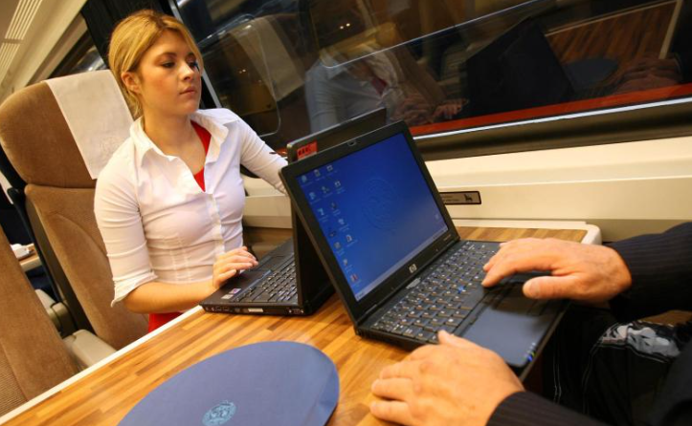
2003 - Wifi
GNER becomes the first company to roll out WiFi on passenger trains, after a successful trial. This helps thousands work as they travel and surf the net. It’s the latest in a series of passenger-focused innovations over the years, which have included radio, cinema, catering and other services.

Slide 25
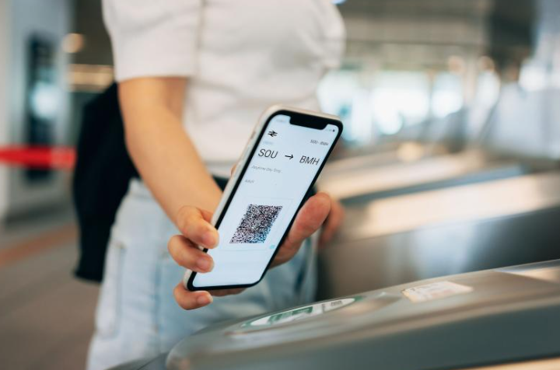
2013 – Digital ticketing
Trials begin for full digital ticketing on the mainline network. This improves how passengers move through major stations, but reveals the uneven technology spread across the network and among the travelling public.

Slide 26
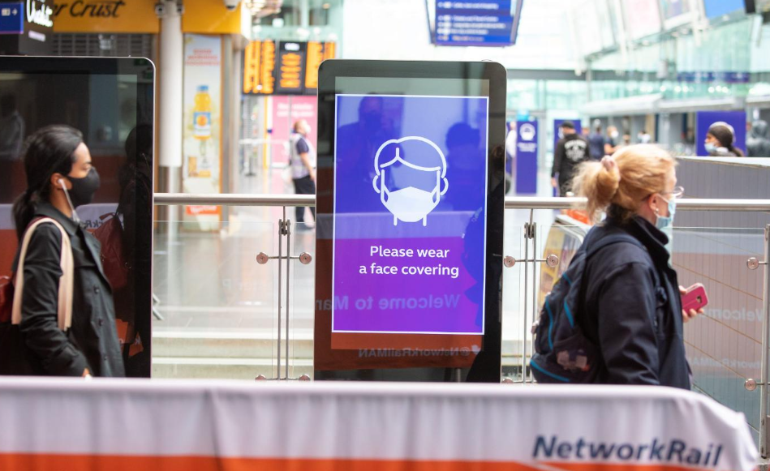
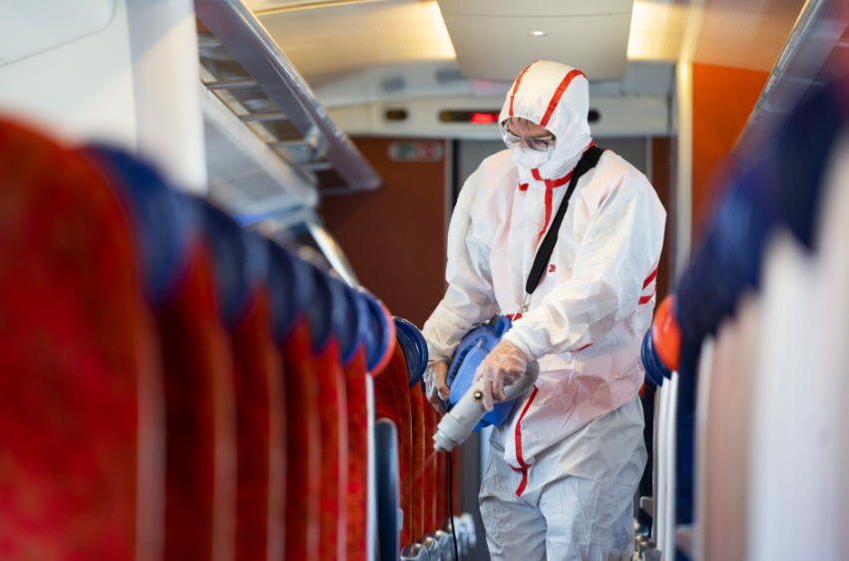
2020 – A Global Pandemic
The COVID-19 pandemic presents serious obstacles for the railway, with passenger numbers plummeting due to lockdowns and travel restrictions. Social distancing, hygiene protocols and new cleaning regimes demand significant adjustments both at stations and on board trains.

Slide 27
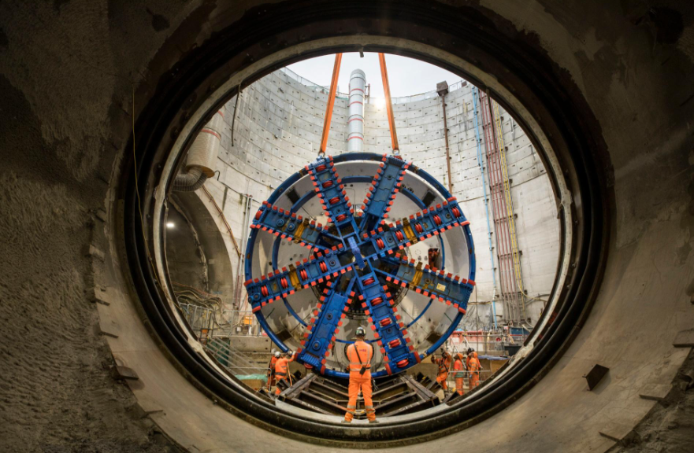
2020 – HS2 Construction begins

Slide 28
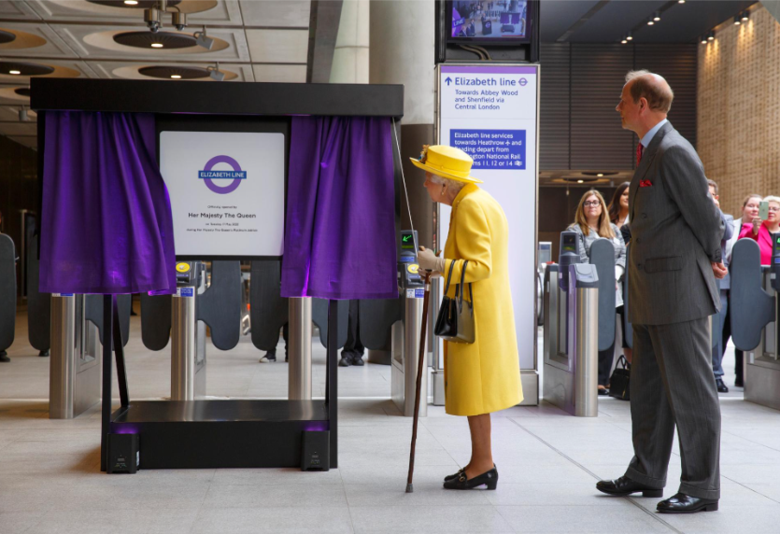
0
2022 – The Elizabeth Line Opens

Slide 29
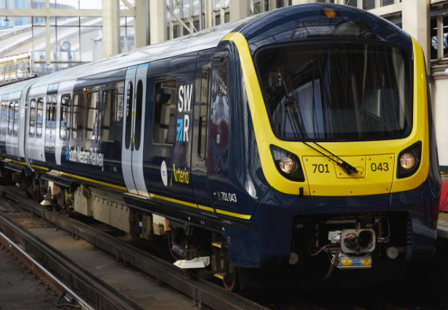
A new Labour government passes legislation to nationalise most of the railway, bringing track and train together.
2024 – Return to Public Ownership

Slide 30
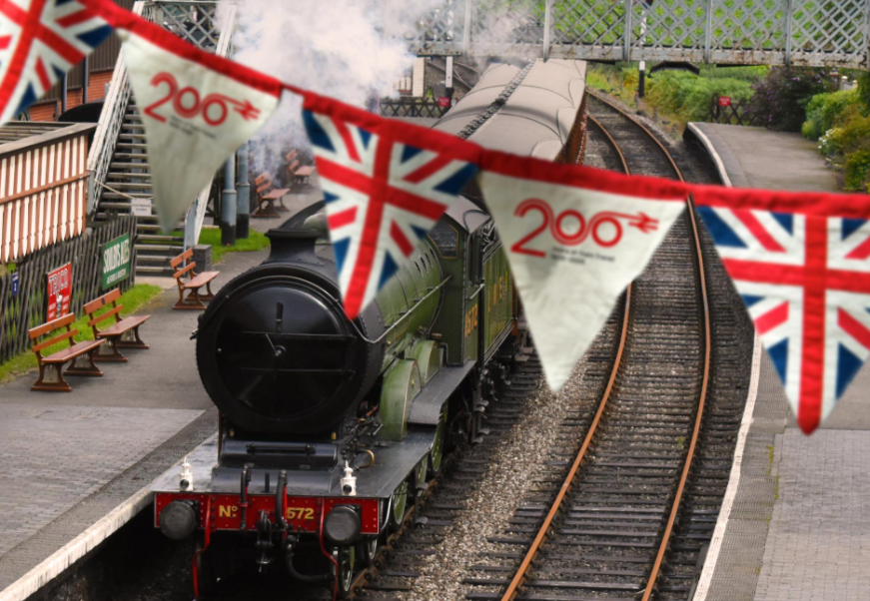
2025 – A year of celebration

Slide 31
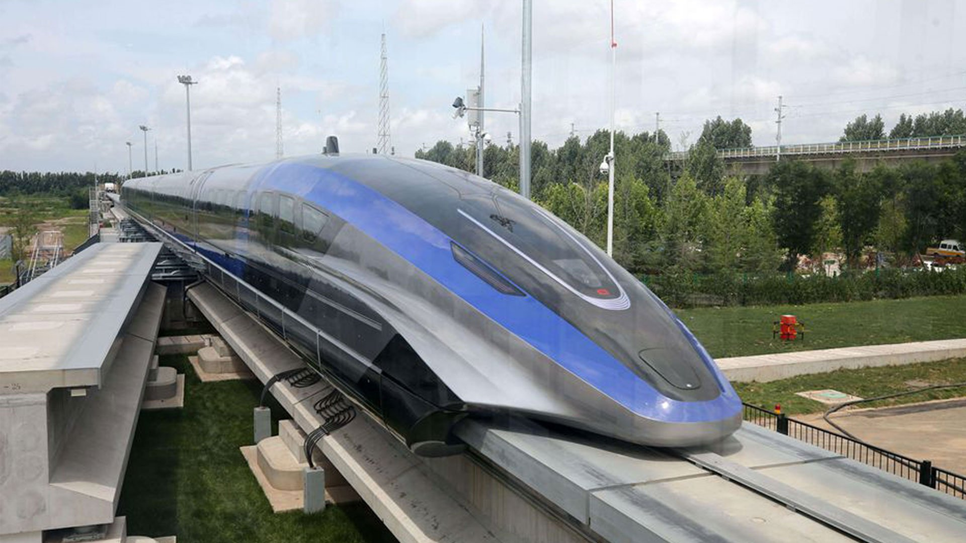
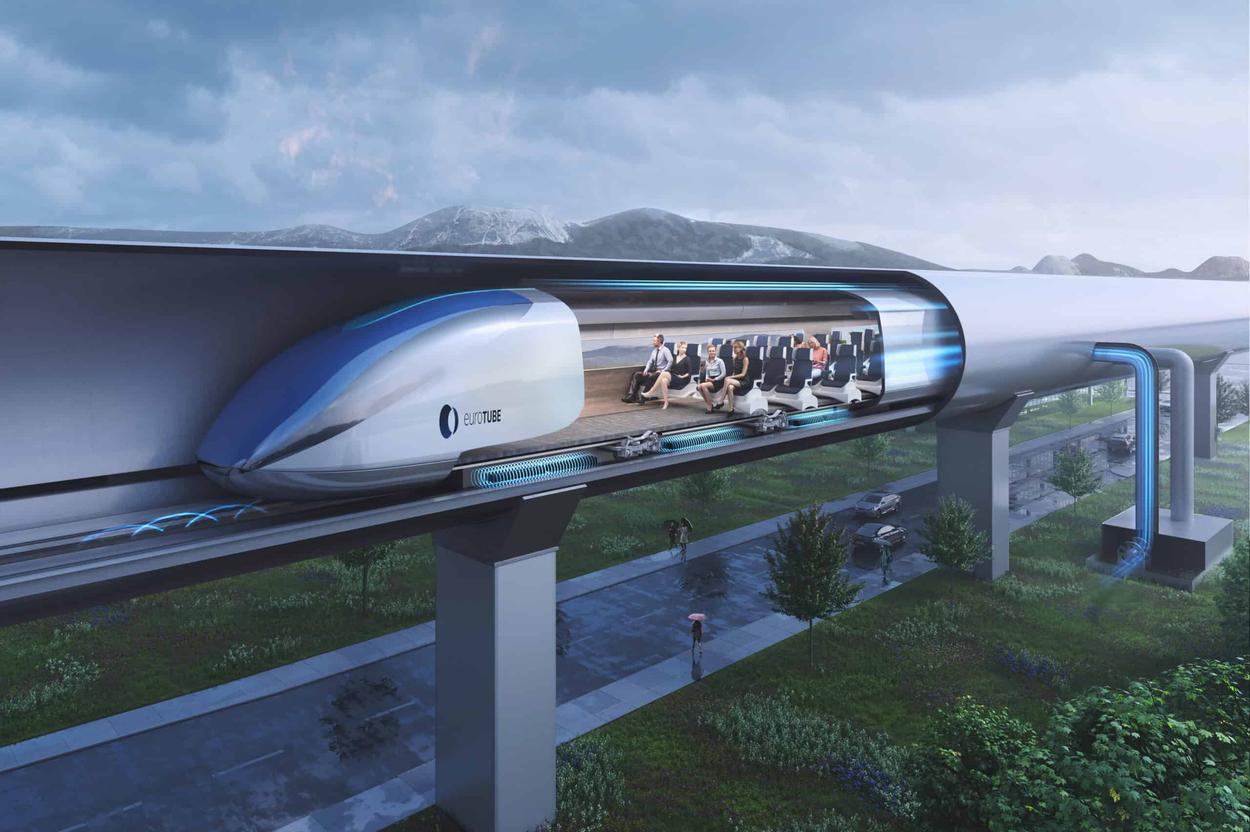
What about the future?

