Slide 1
Rail Safety Week

Slide 2
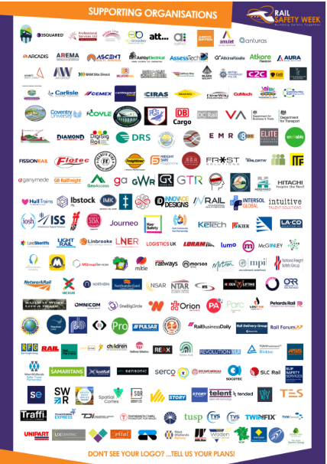

Slide 5
