Slide 1
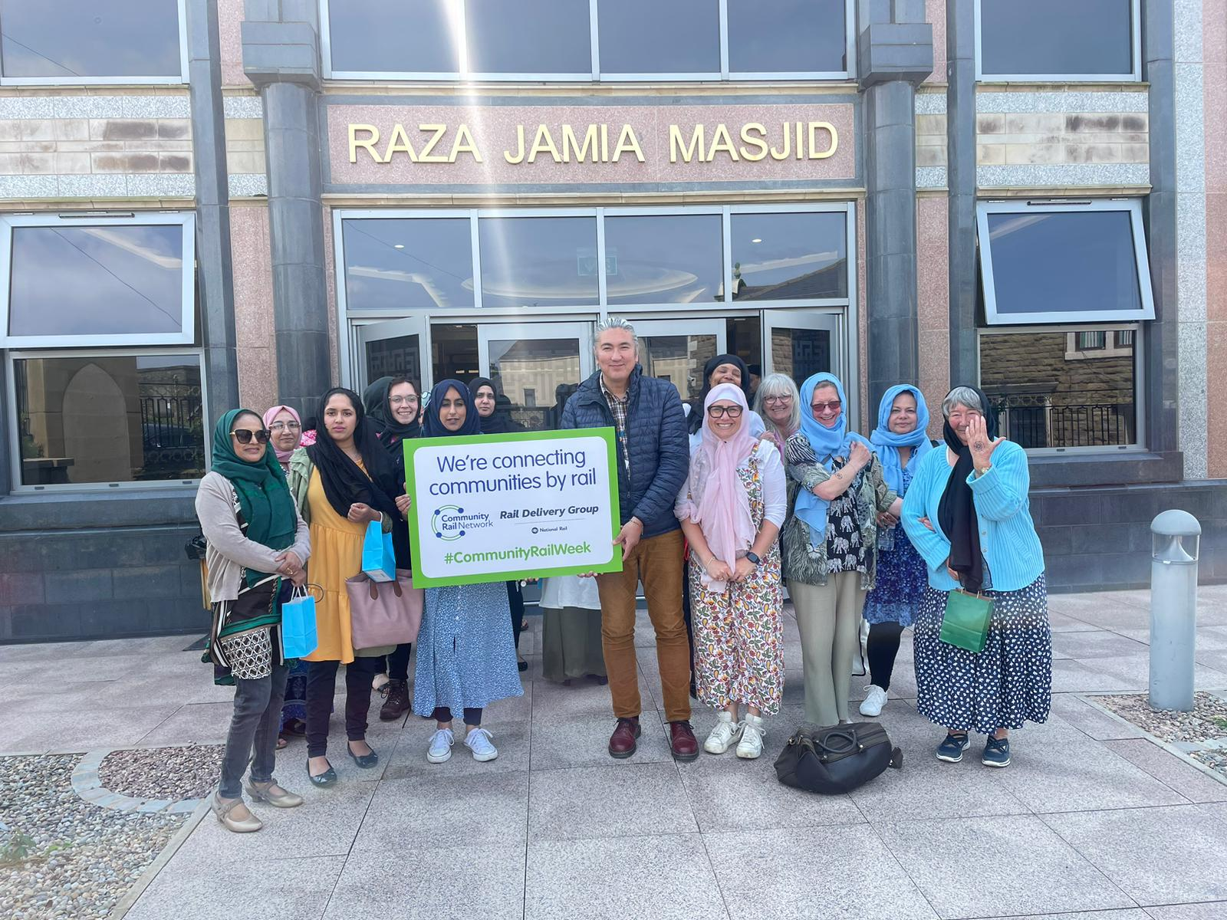
Working with Diverse Groups
Shahiesta Raja
Education Officer
Community Rail Lancashire

Slide 2
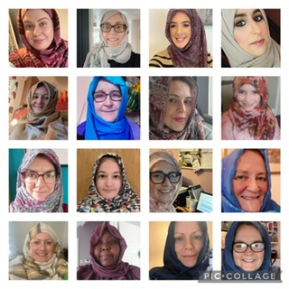

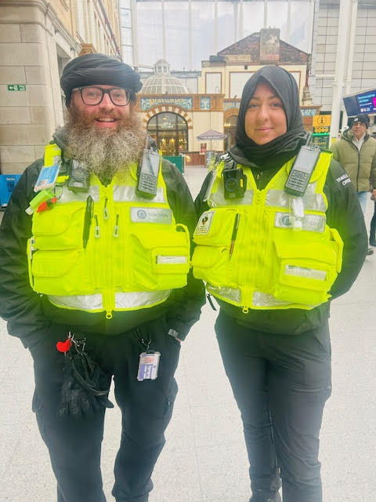
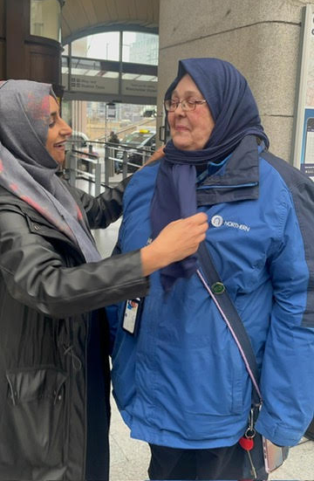
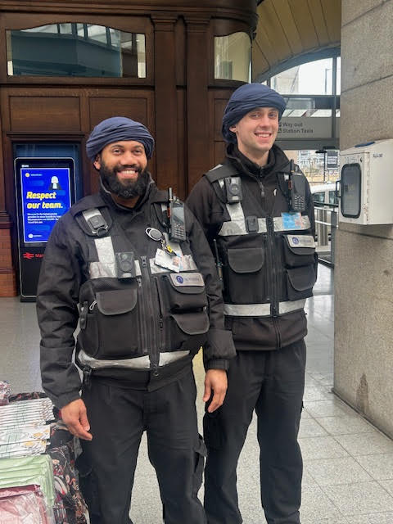
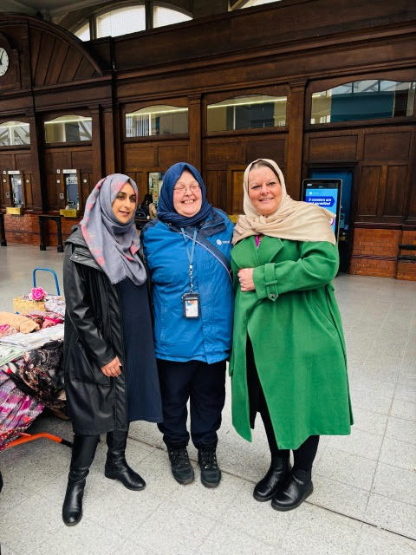
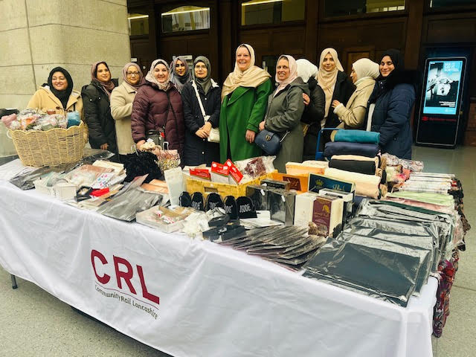
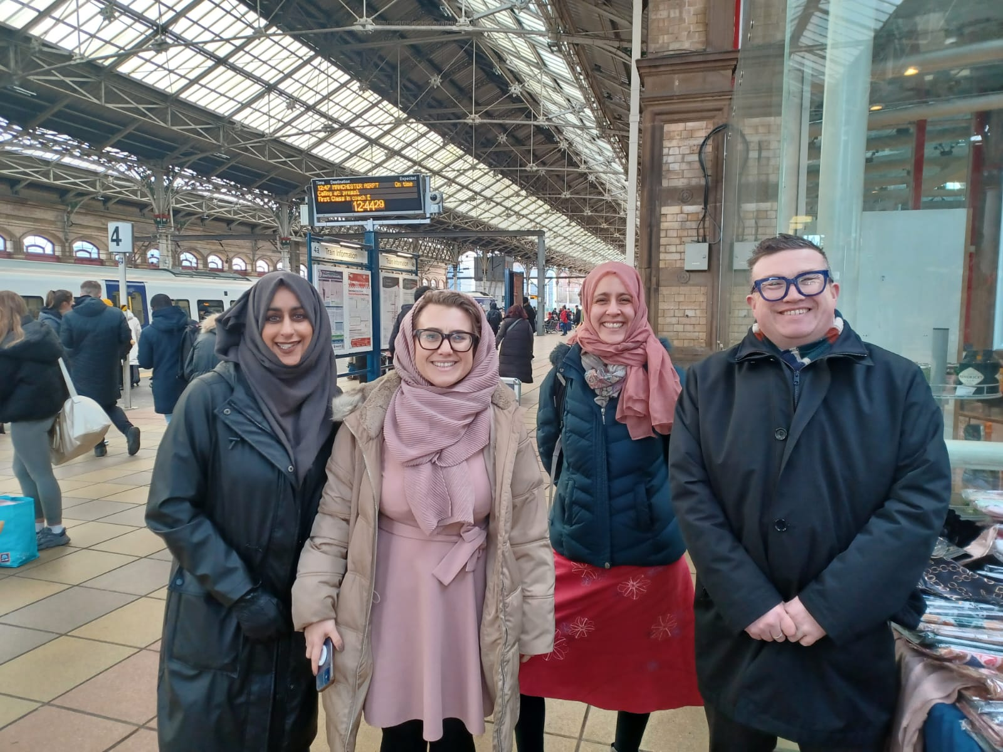


Slide 3
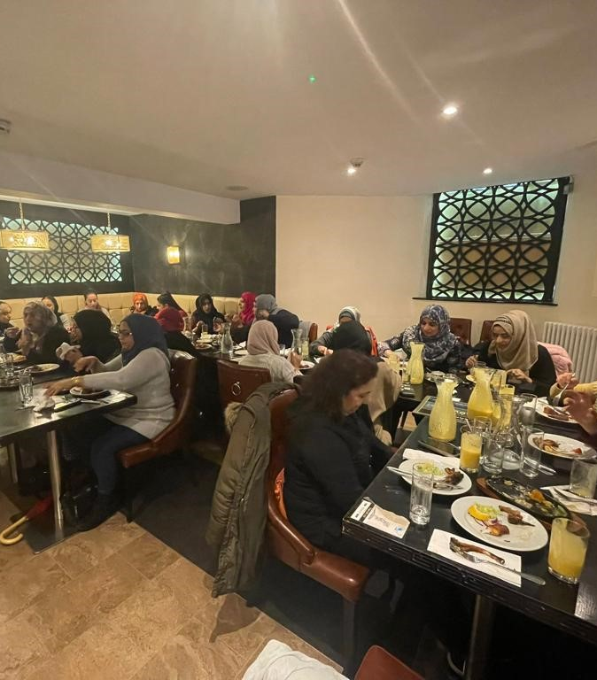
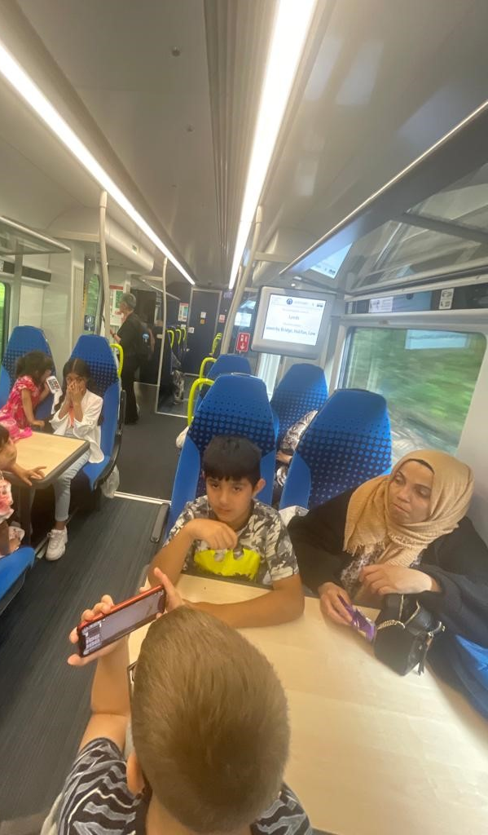
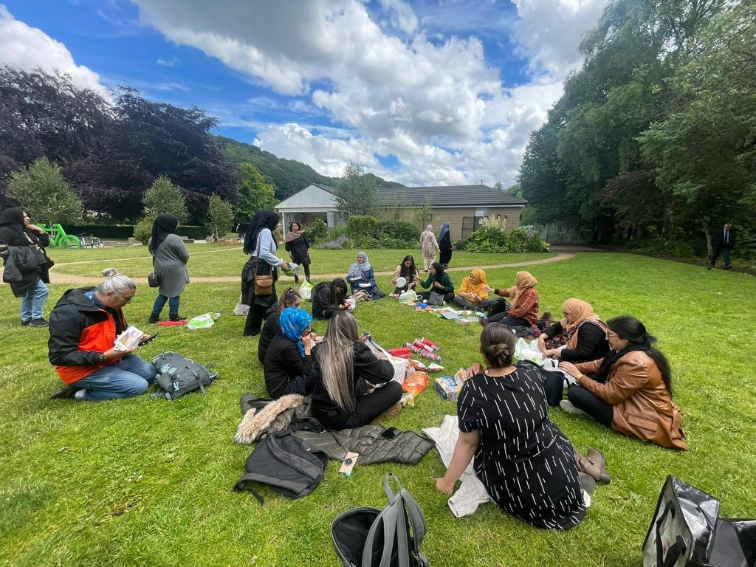
East Meets West

Slide 4
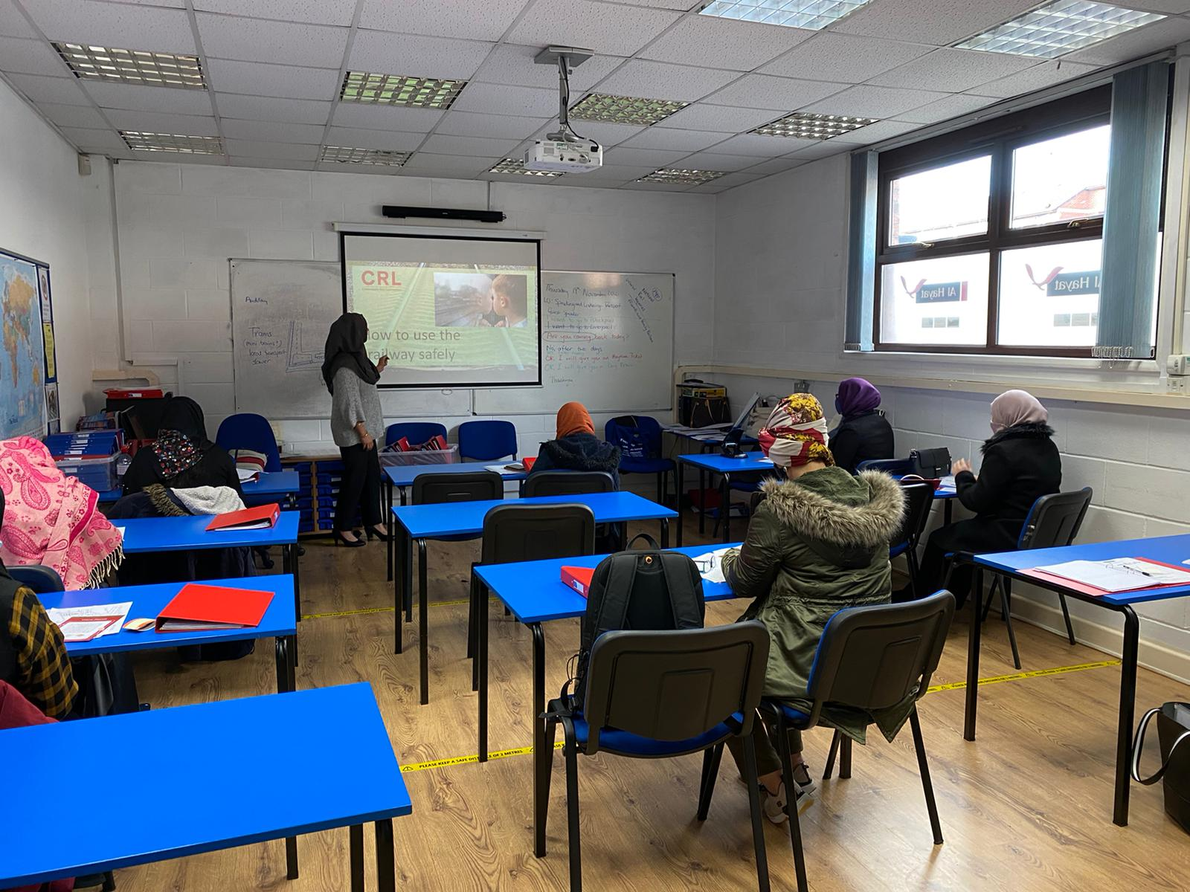
ESOL Classes
Awaaz, Accrington
Humraaz, Blackburn
Al Hayat, Blackburn

Slide 5
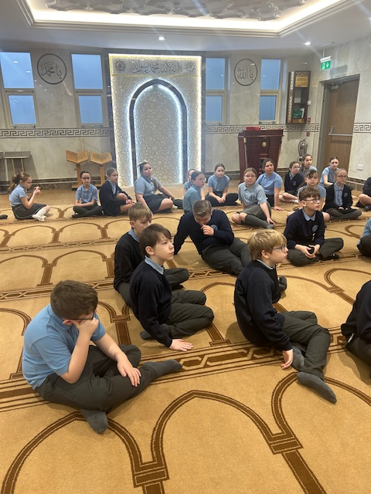
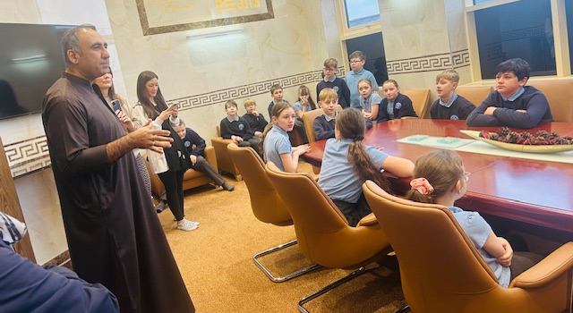
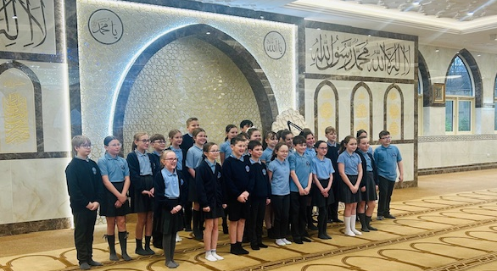
Mosque Links

Slide 6
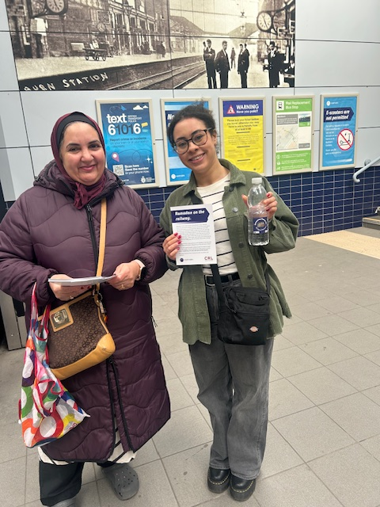
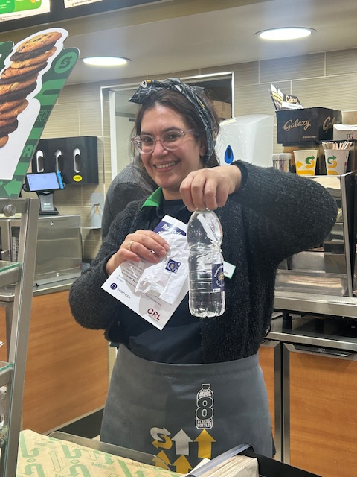
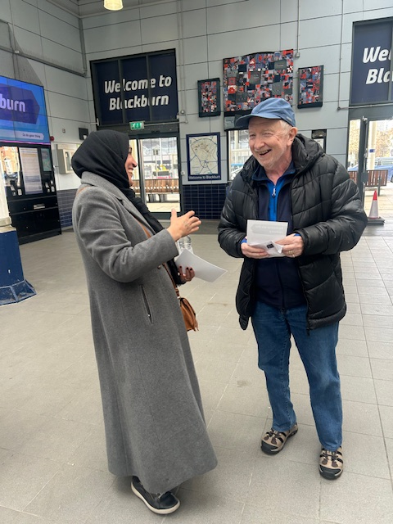
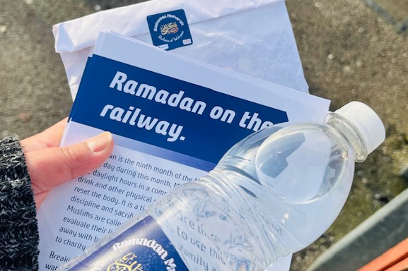
Ramadan on the Railway

Slide 7
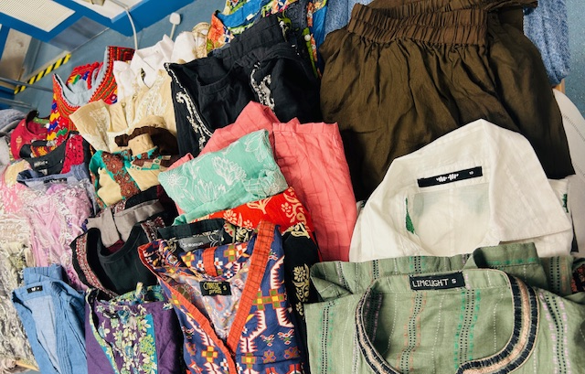

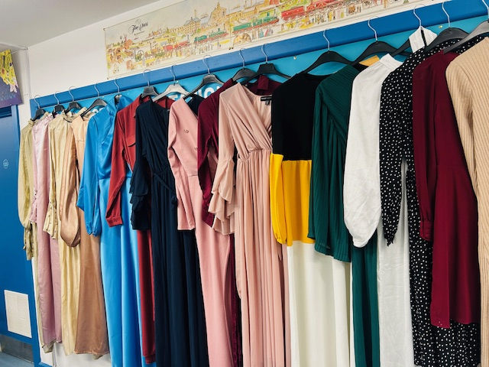
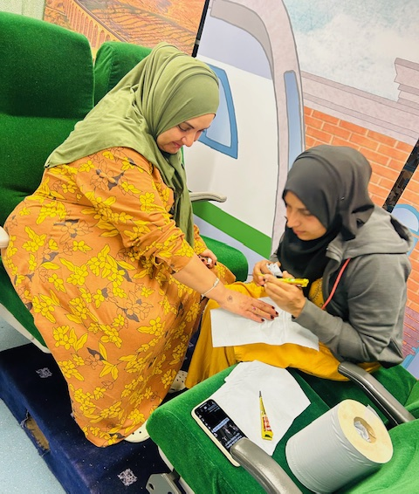
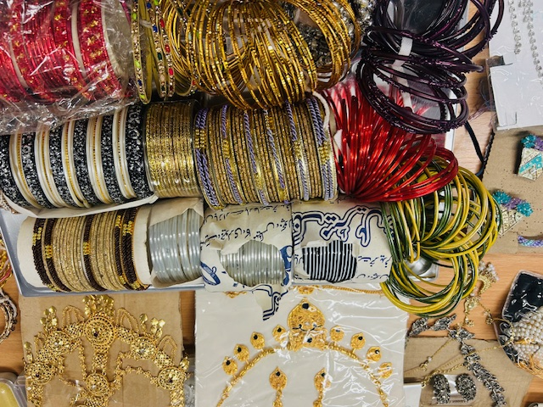
Boutique Bazaar

Slide 8
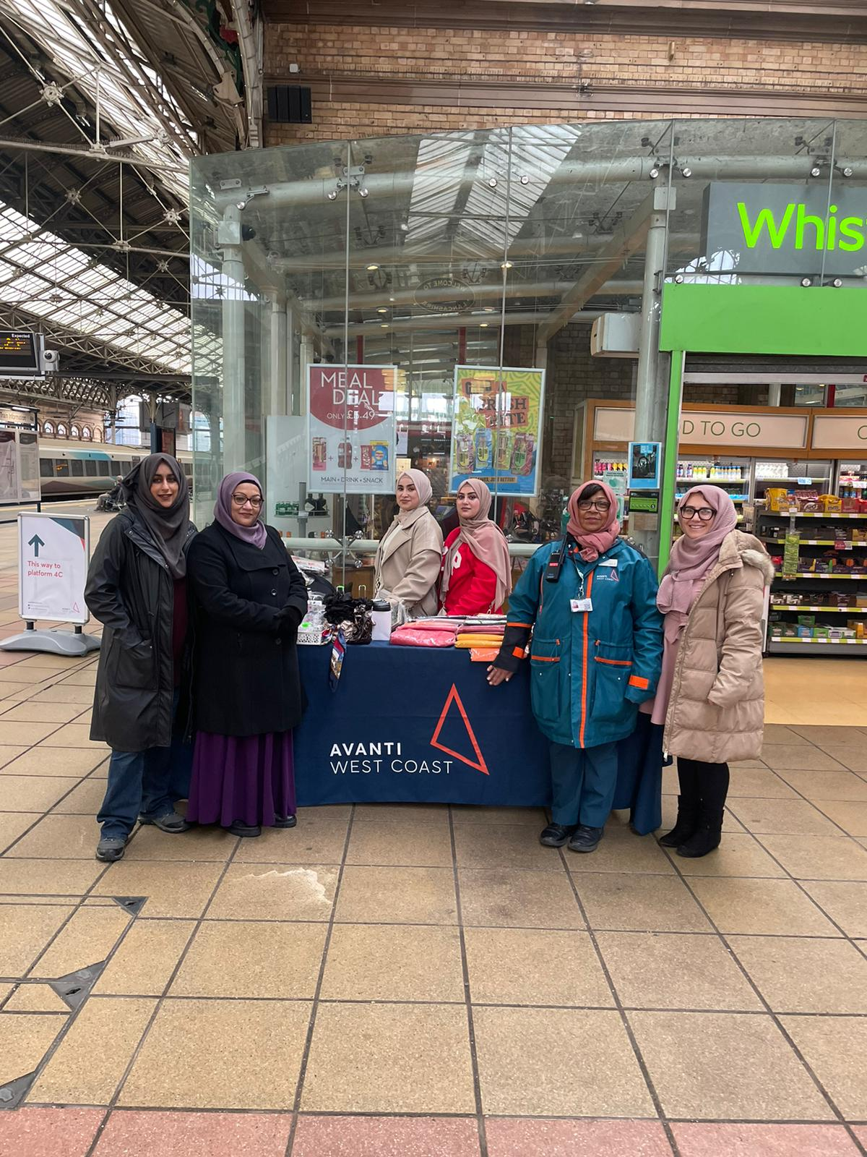
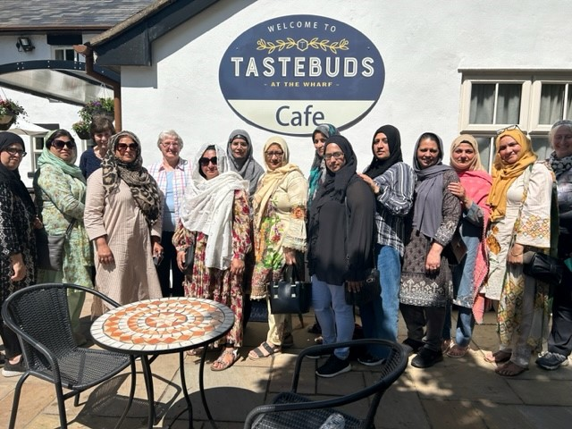
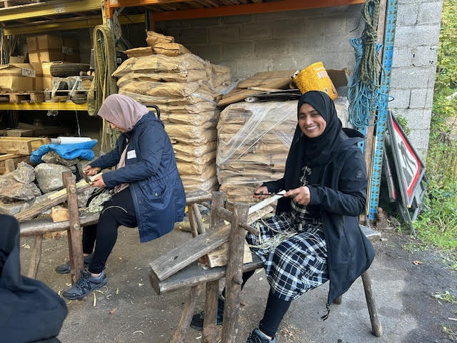
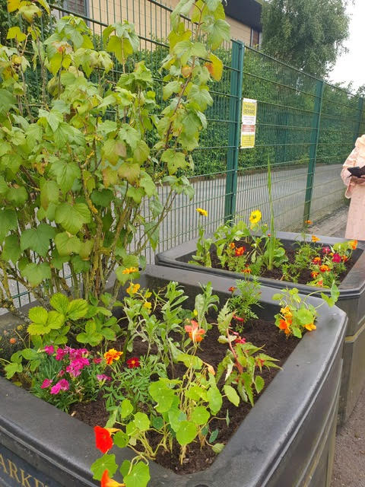
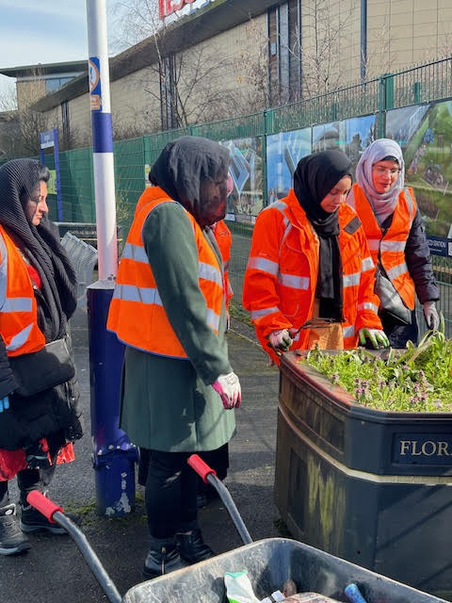

Stations of Welcome
Accrington Station’s adoption group, formed in 2022 at the end of the COVID restrictions as a support group, meeting weekly to chat and travel together, improving mental health
Involved in many CRL projects - World Hijab Day, Autism Awareness, Community Rail Week and East Meets West.
Look after station planters and community garden, improving the appearance of both platforms.
Working in collaboration with local community organisations to learn about gardening, including Prospects, Red Rose Recovery and Accrington and Rossendale College’s Rail Maintenance students.
We have learnt about coppicing with The Coppice Coop in Silverdale with a view to using some of these skills at the station.
Gained some publicity this year as the only station adoption group in the country made up of Muslim women of South Asian heritage, appearing in the local newspaper, BBC Lancashire News, Radio Lancashire, interviewed by Lancashire Life Magazine and BBC Sunday Morning Live
The group of women have successfully applied for funding to create some artwork to be displayed in the station garden.

Slide 9
