Slide 1

Rail Safety through PE lessons/sport

Slide 2


Background
Physical wellbeing
Mental wellbeing
Social and personal development
Schools are recommended to have 2 quality hours of PE per week.

Slide 3
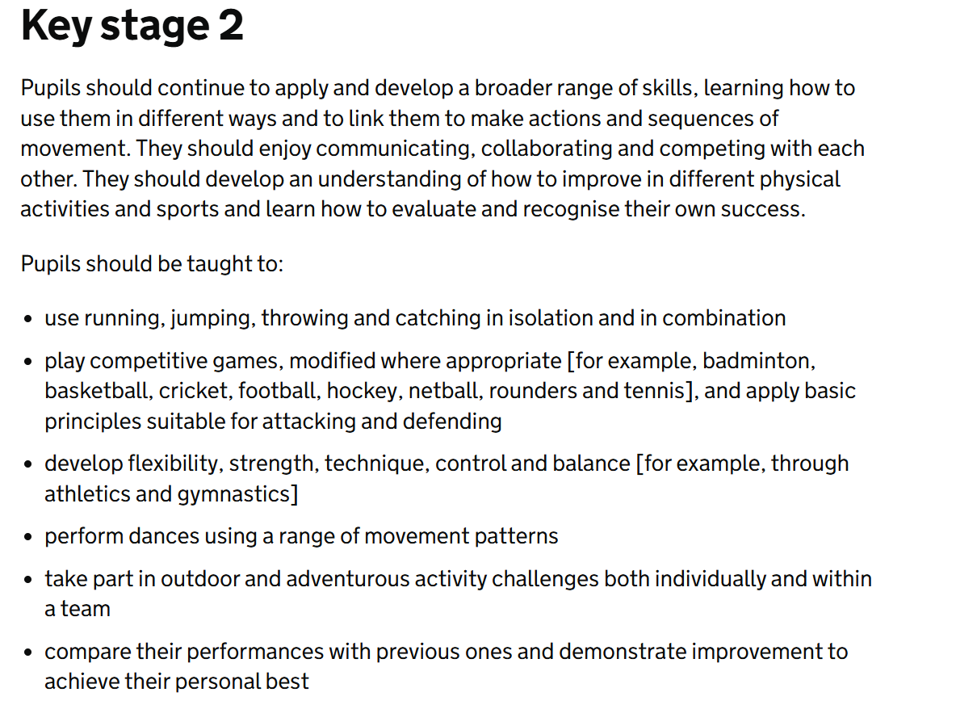
Curriculum
National curriculum in England: PE programmes of study - GOV.UK

Slide 4
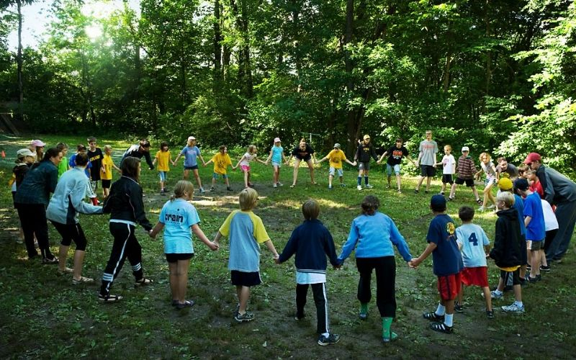
Pre-written activities
Try a railway safety quiz | Activities | Scouts
Play train controller crossing | Activities | Scouts
Play Trains and Ladders | Activities | Scouts
Train safety obstacle course | Activities | Scouts
Tune in when you switch on | Activities | Scouts
Distracted! You’ve crossed the line | Activities | Scouts

Slide 5
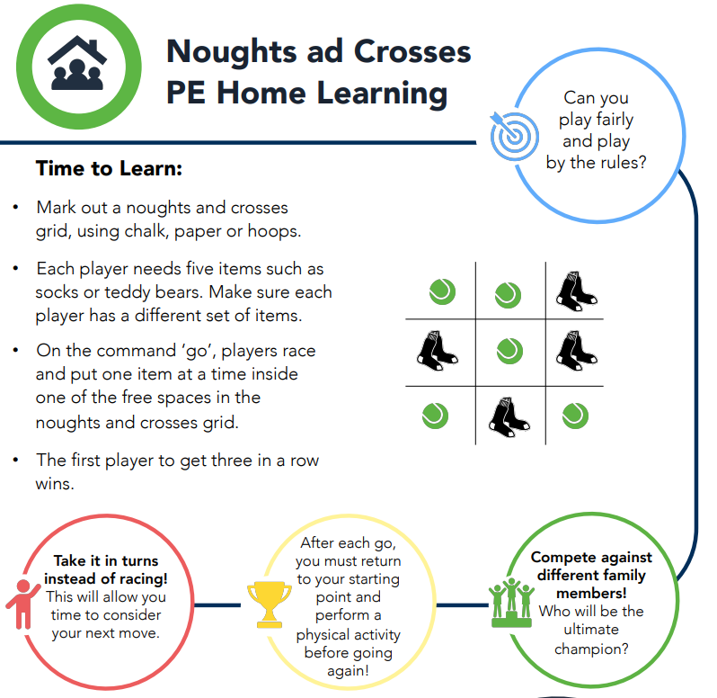
Creating your own games
Primary PE Activities - Youth Sport Trust

Slide 6
PE

