Slide 1
Chiltern
Railways
‘Inspiration’ Exhibition Train
Lessons Learnt
Harry Burr • 20 August 2025

Slide 2
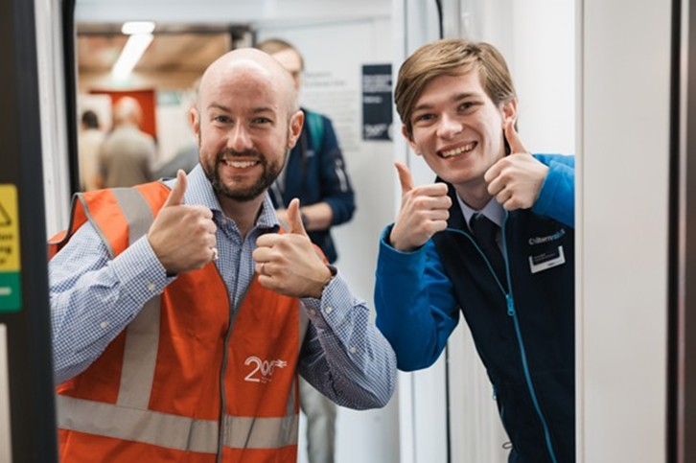
Introducing myself
Harry Burr – Stakeholder Executive
Stakeholder Executive and Community Engagement Lead at Chiltern Railways.
Looking after community and school engagement across the whole route.
Responsible this year for our Railway 200 communications and projects.

Slide 3
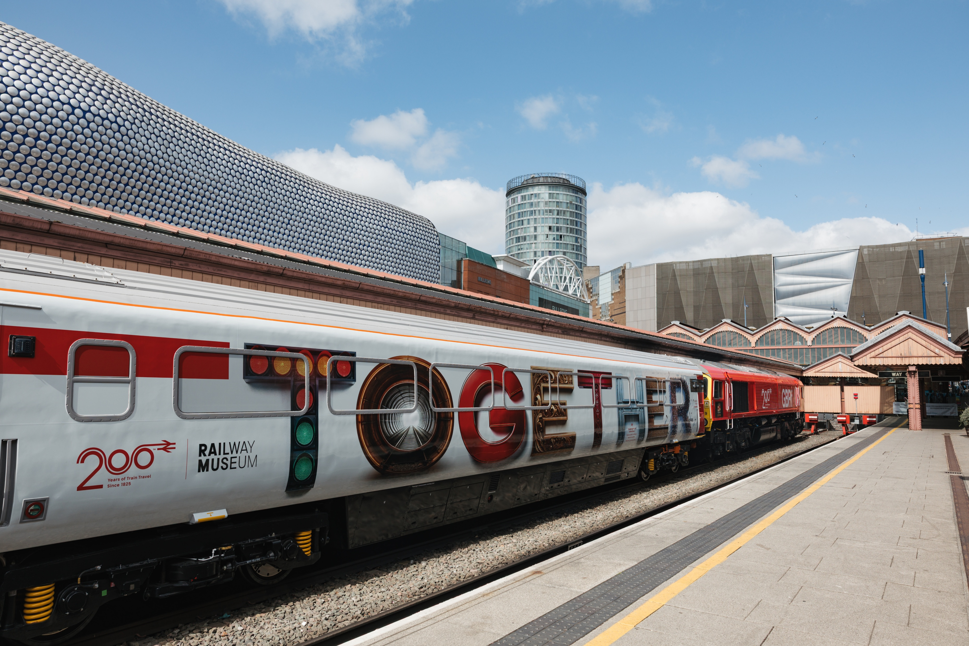
Overview
Location – Birmingham Moor Street station
Opening dates – 8th to 10th July, 10:00-16:00 (all weekdays)
Our aim – engage local communities and young people and showcase rail and the future of the industry in the West Midlands alongside industry partners.
We put together a comprehensive event plan for our volunteers, control team and management.

Slide 4
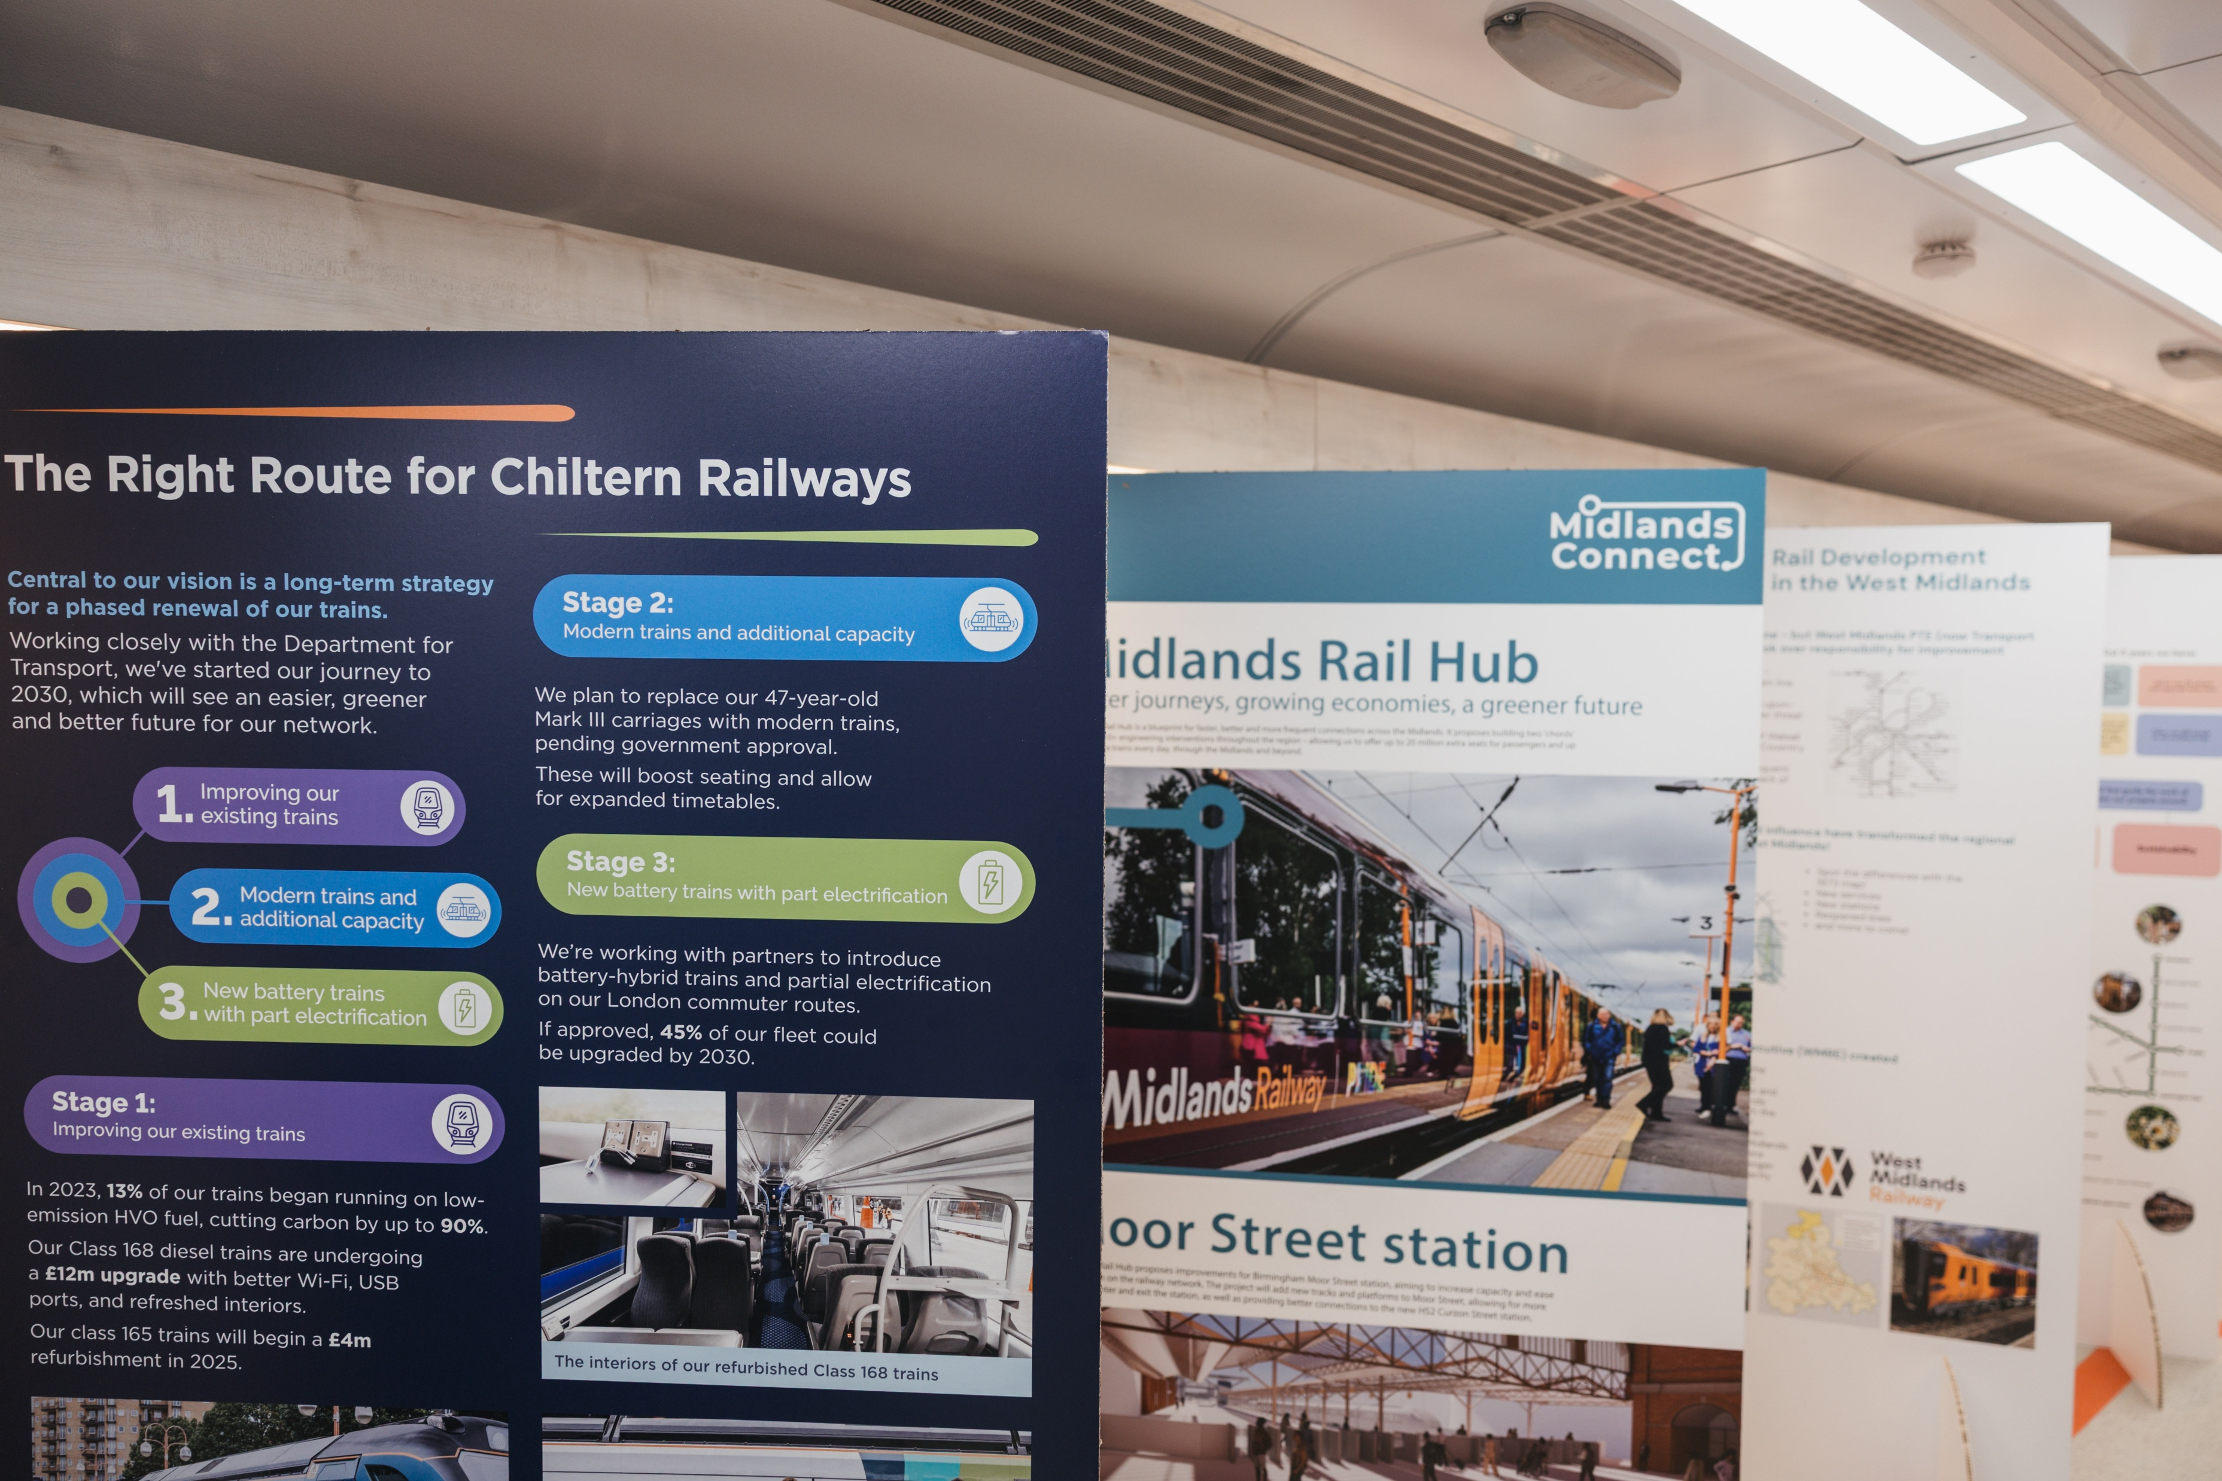
Partner Zone
We were one of few sites who booked out the partner zone for all three days ourselves.
We worked with industry partners to fill the partner zone with industry professionals, merch on a table and information about the future of rail in the West Midlands and the future of the Chiltern Railways network.
Heart of England CRP also exhibited in the partner zone including a ‘draw your own livery’ competition to take home.
We received positive public feedback from the partner zone and it gave the opportunity for members of the public, often our customers, to come face-to-face with our managers.
The video on the TV was a bit of a pain as my laptop kept going to sleep!

Slide 5
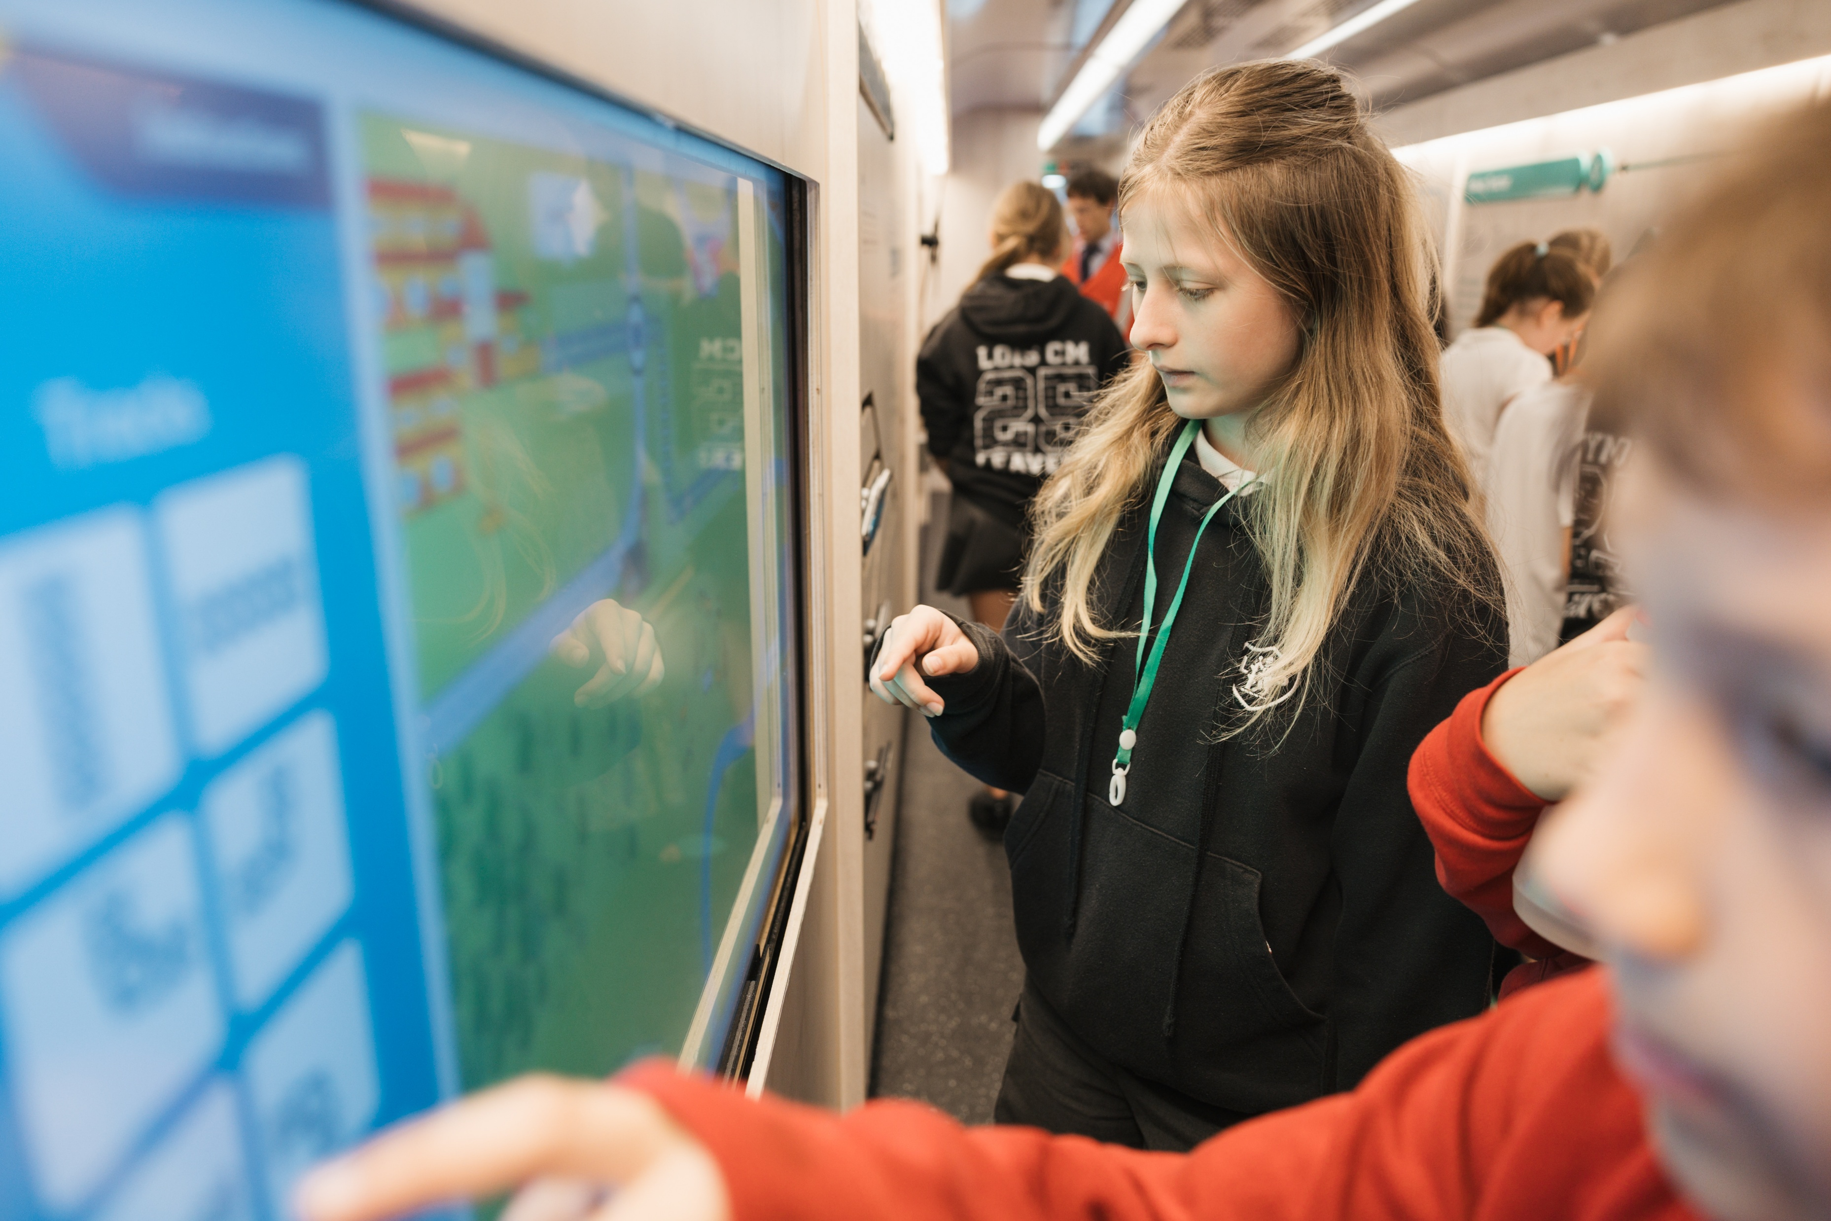
Schools
We invited four different primary school groups to come and visit the exhibition train.
We provided complimentary travel to Birmingham for schools on our route, further enforcing the positive impact of the railway.
The children particularly liked our complimentary branded jelly beans in the partner zone!
This was a highlight for us and for our colleagues – inspiring the next generation.
Those under 16 who were happy being photographed wore green lanyards and those who weren’t wore red – super useful for our photographer!

Slide 6
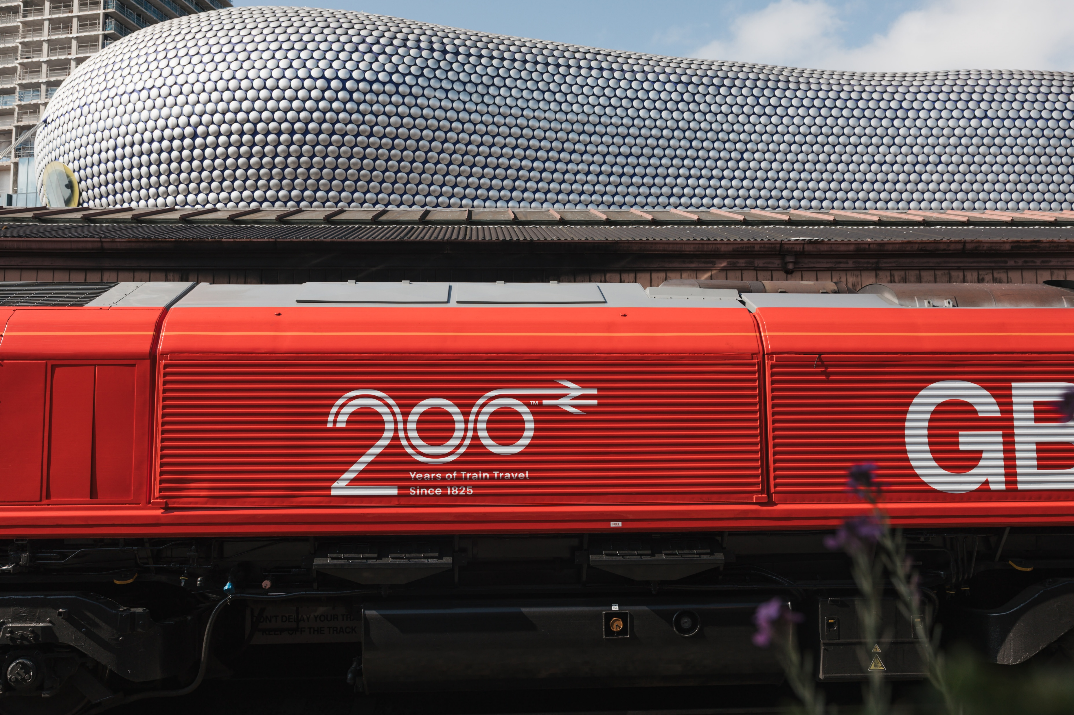
Operations & Logistics
Customer flows mostly smooth throughout the day thanks to our number of volunteers.
Our pre-planned roster built by our Area Manager was a key to the success and meant we were especially prepared both on the station itself (crowd control etc) and onboard the train.
Earlier access to the train would’ve helped preparation – as opening was late on the first day and we had to rush with our marketing agency to fill the partner zone.
However – having booked the partner zone for the whole time meant we didn’t need to pack/unpack every single day which was a positive!

Slide 7
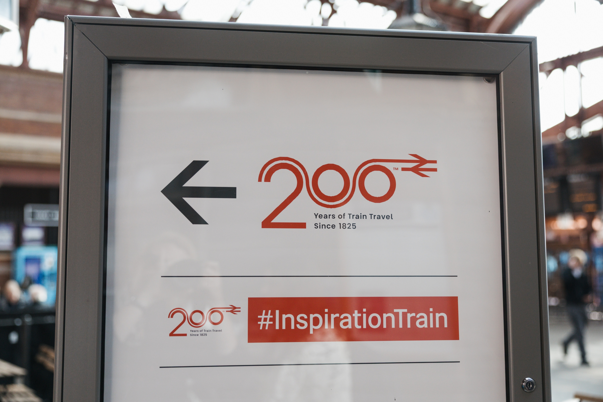
Planning
We had to make several amendments to our timetable in order to allow the train to access one platform 4, one of our two bay platforms, usually used for terminating our Leamington Spa stopping services.
These trains, alongside several Marylebone services, were sent up to Birmingham Snow Hill to spin there, and a single empty coaching stock movement was sent to Banbury in the evening (which would usually stable in platform 4).
This did come at a cost but did not inconvenience customers, especially since so many extra staff were available at Moor Street to ask for support thanks to our roster.

Slide 8
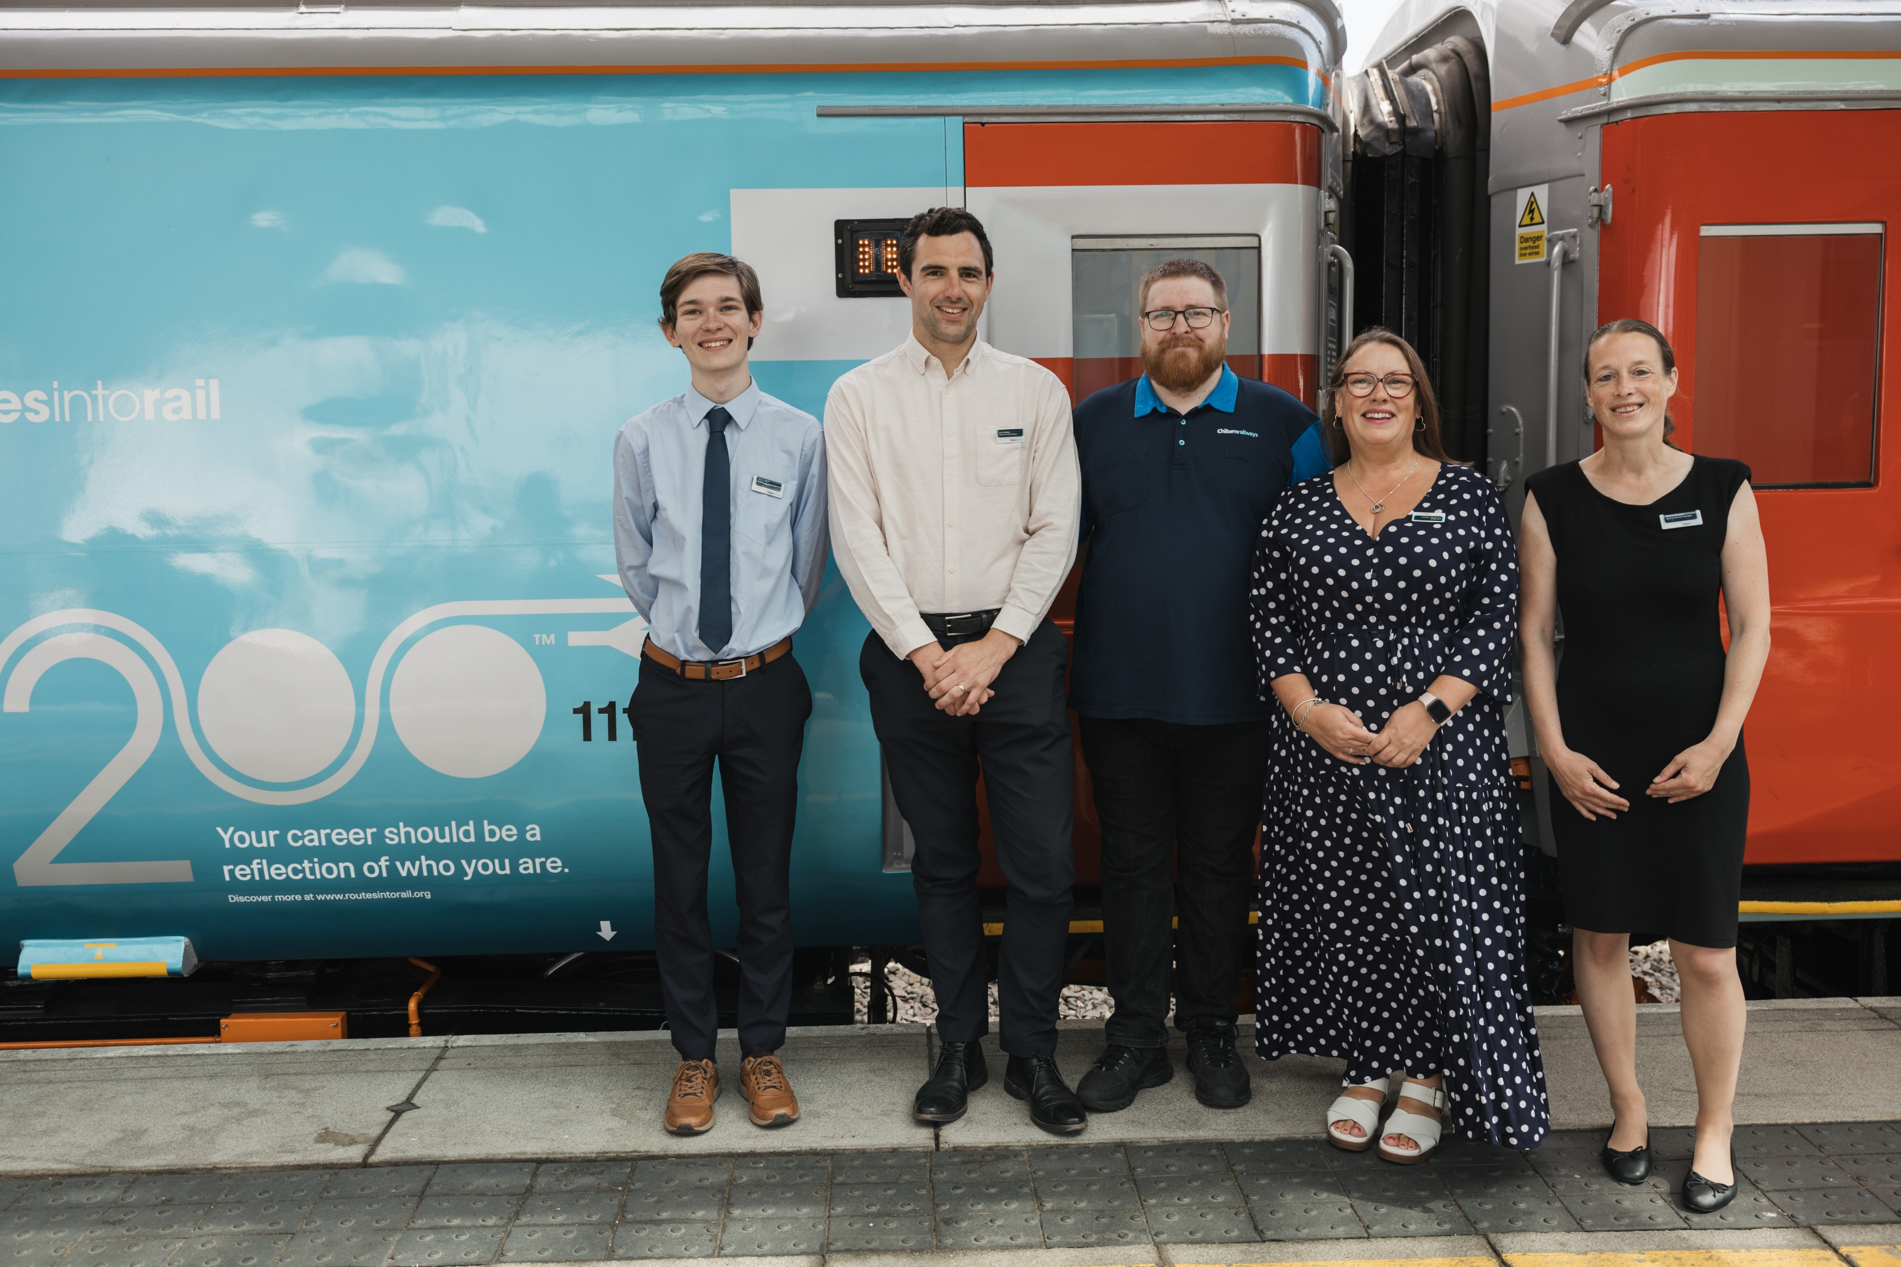
People & Delivery
We identified a small internal team to deliver the planning for the train – focusing our efforts and making things more efficient.
We split different responsibilities over different roles – while all these people also juggled their BAU responsibilities!
Operationally, volunteers were made up of Chiltern management support colleagues and external individiauls (retired railway workers, West Midlands Rail Executive, CrossCountry, HS2, etc)
These volunteers were briefed at the start of each day by our rostered-on event lead and the Railway 200 agency staff who came with the train.
Had to amend the roster to prevent heatstroke.
We have a professional photographer to thank for all of these brilliant photos – well worth it for any other host sites!

Slide 9
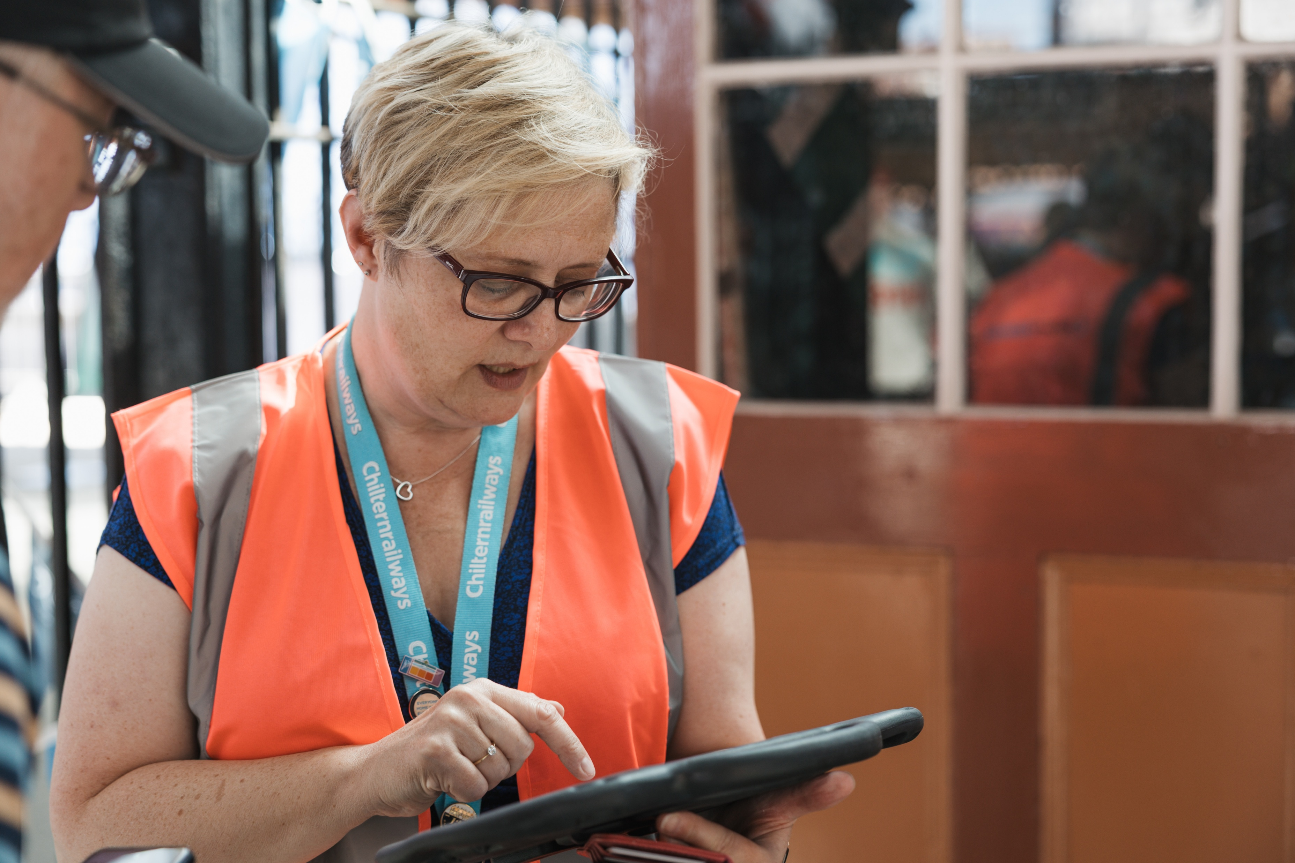
Technical & Equipment
Overall, the exhibits were reliable – but as we were the second stop, there were some teething problems.
As this is a once-in-a-lifetime kind of operation, we were understanding of the fact not everything goes to plan first try (we know it from BAU!)
Any issues that we had with equipment short-term went to the on-hand agency staff from Railway 200 and any long-term or more strategic issues went to Christy from the Railway 200 events team.
We also had a lessons learnt session with Railway 200 after the train left Moor Street.
In future – one person managing all of the delivery would have been much easier! Resource constraints.

Slide 10
Thank you

