Slide 1


Maddy Mills
Education Officer
Southeast CRP

Slide 2
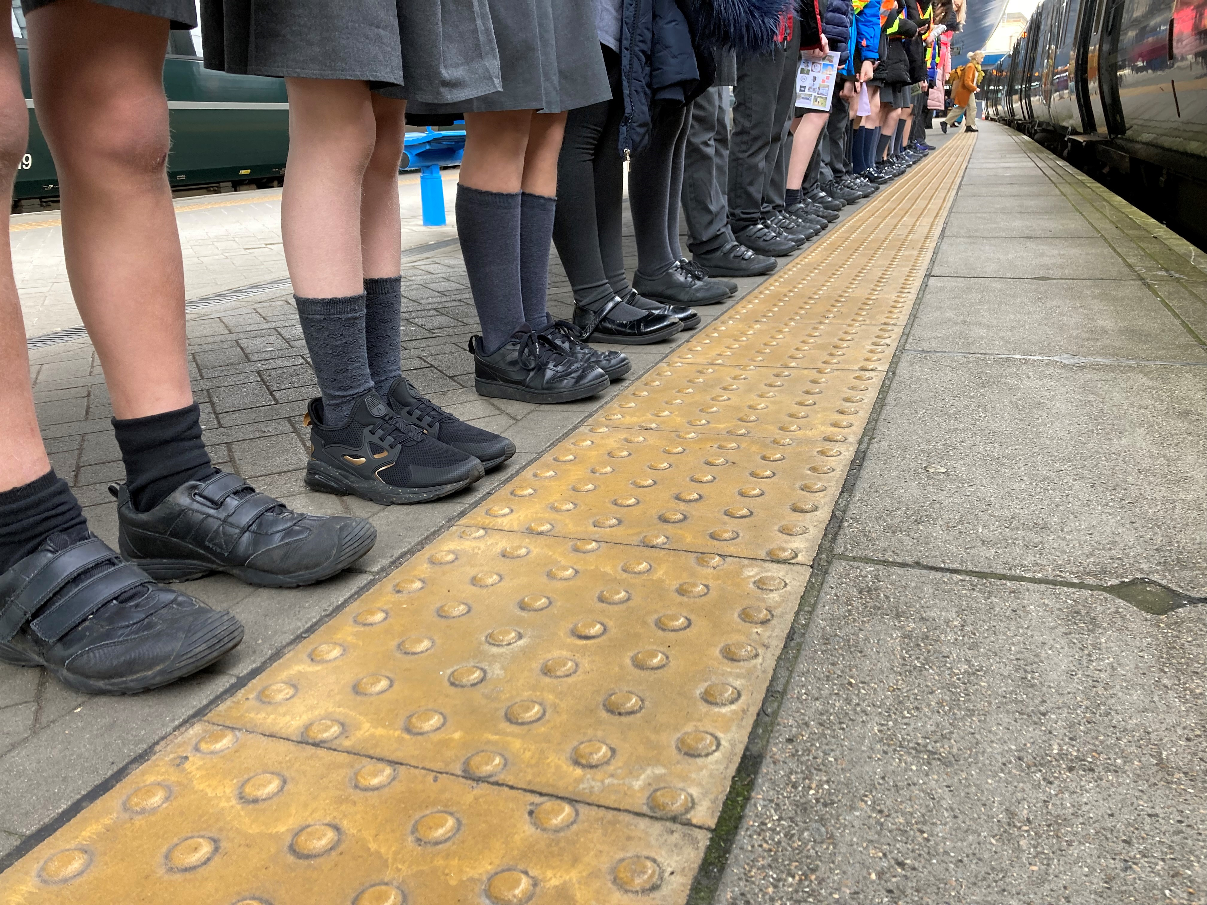


Slide 3


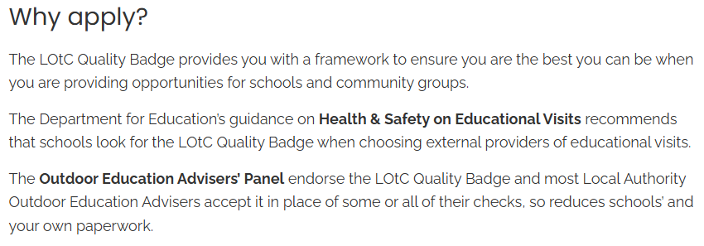

Slide 4
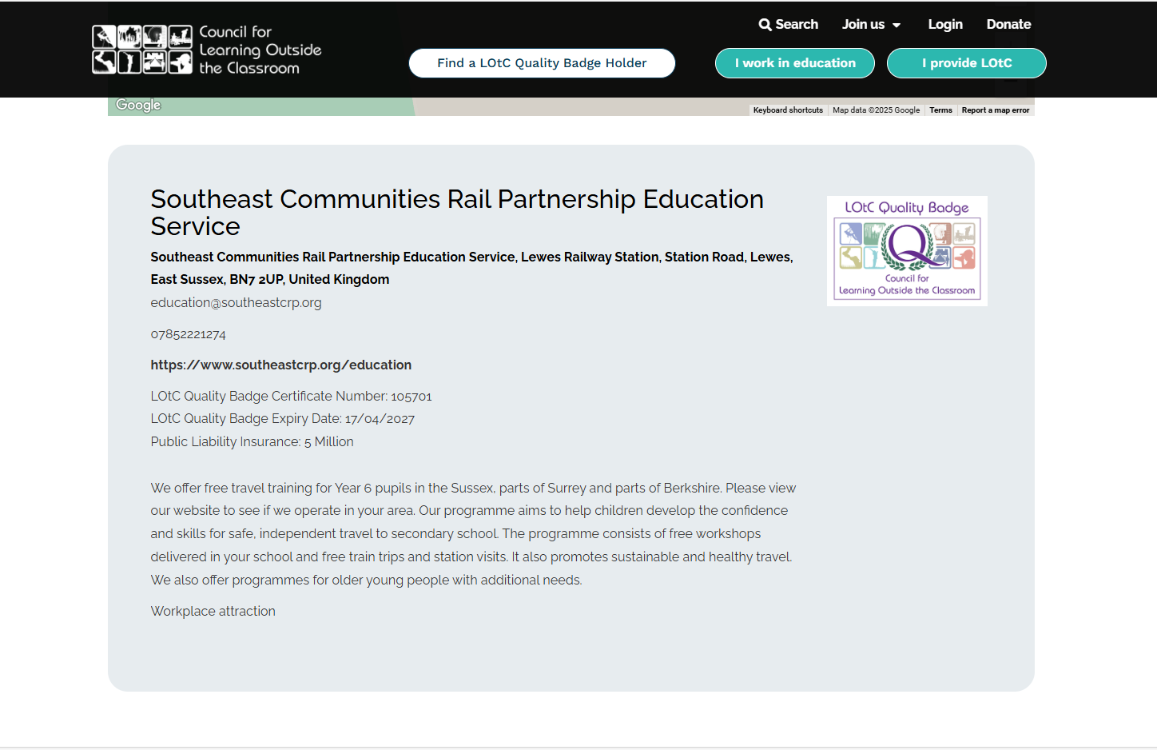

Slide 5
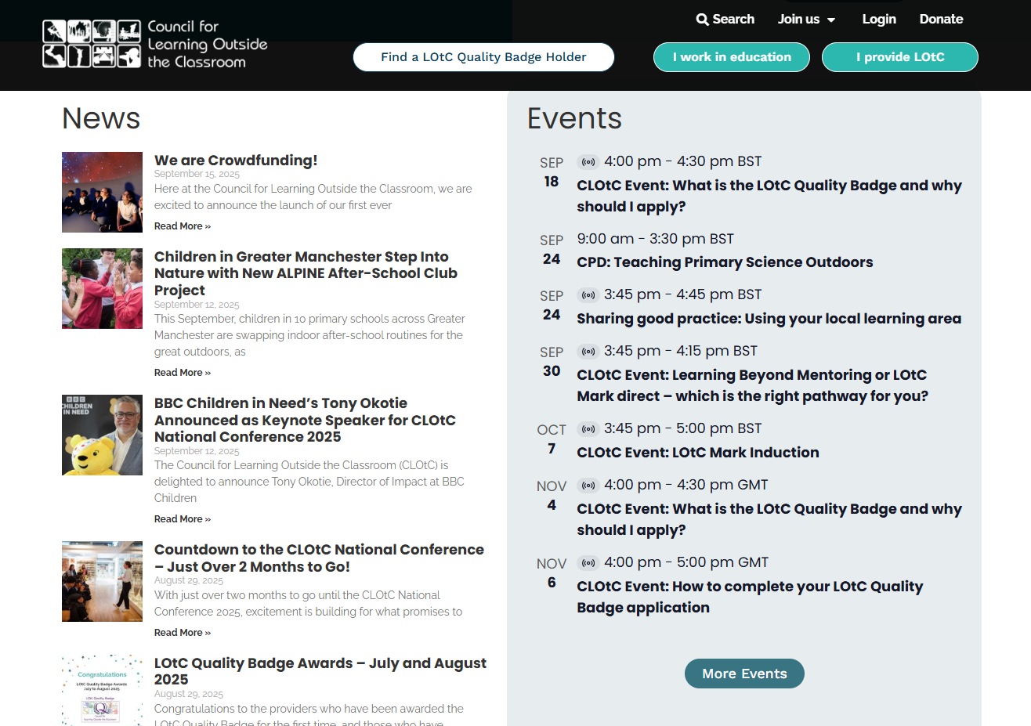

Slide 6


Slide 7


Slide 8

Costs:
Annual membership £170
Quality Badge Holder application £270
(renewed every 2 years)

Slide 9
The process…
Complete self assessment form (18 pages)
Collect ‘evidence’
Upload forms to online portal
Wait…

Slide 10
Eligibility criteria:
Risk Management
Safeguarding
Food Safety
Transport
Education Quality
Communication

Slide 11
The challenges:
Gathering information from the TOCs/NR (Risk assessment, electrical certificate)
Updating our safeguarding policy
Setting up safeguarding training for staff and directors with the NSPCC
Creating Lesson Plans and Terms & Conditions

Slide 12


Slide 13
Got any questions?
Maddy Mills
Education Officer
Southeast Communities Rail Partnership CIC
Mobile 07852 221274
Email maddy@southeastcrp.org
Web www.southeastcrp.org

