Slide 1

Cross-curricular work

Slide 2
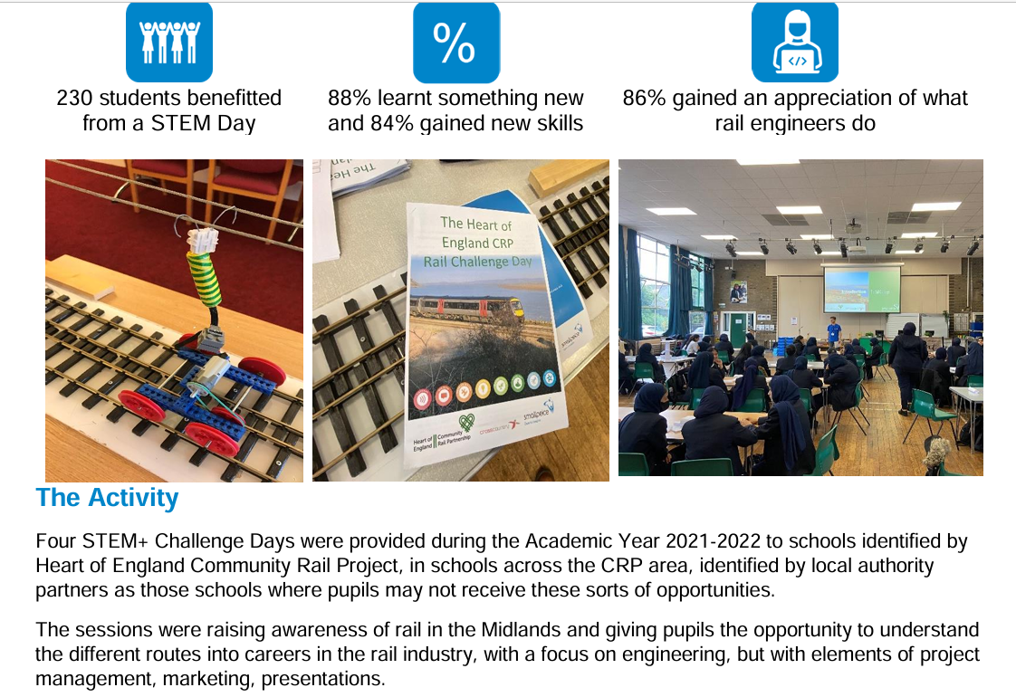


STEM
WCCC-1615347118-891

Slide 3


Art/Design
Bradford's Seat-y of Culture - TrainEd

Slide 4
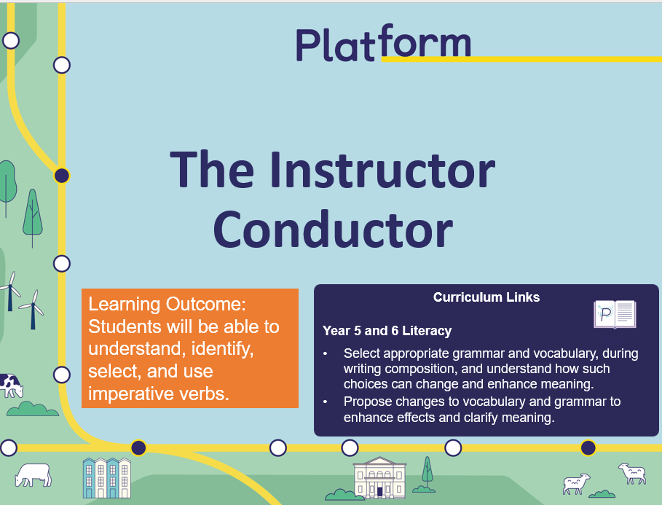

English
Resources Archive - Platform

Slide 5
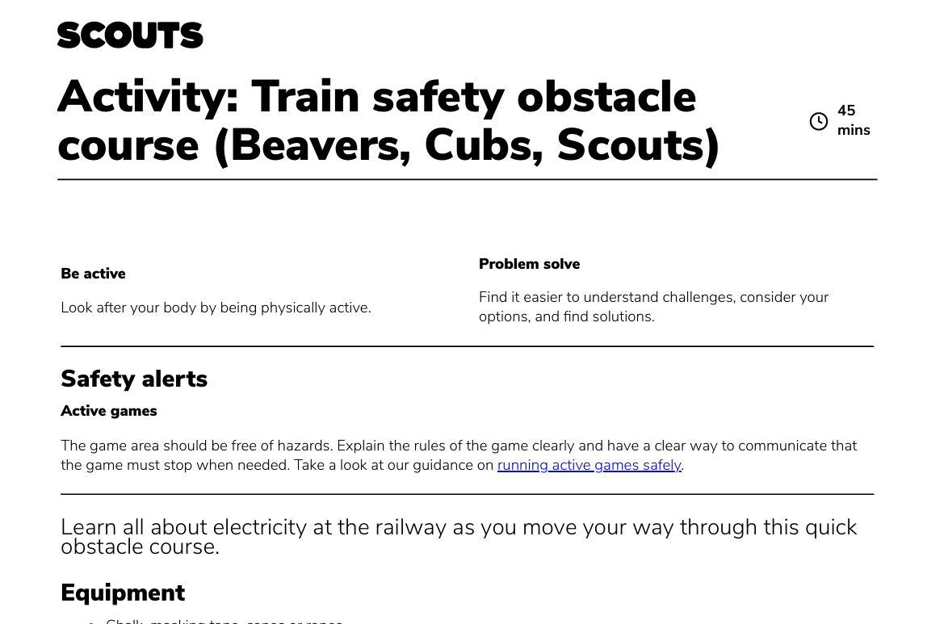

PE
The Rail Industry | Scouts

Slide 6
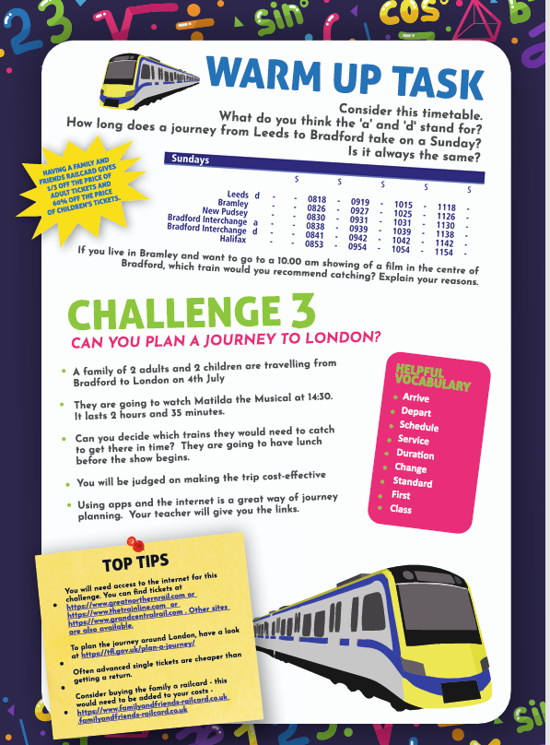
Maths
Reasoning Express - Engagement with the Railway Through Maths - TrainEd

Slide 7
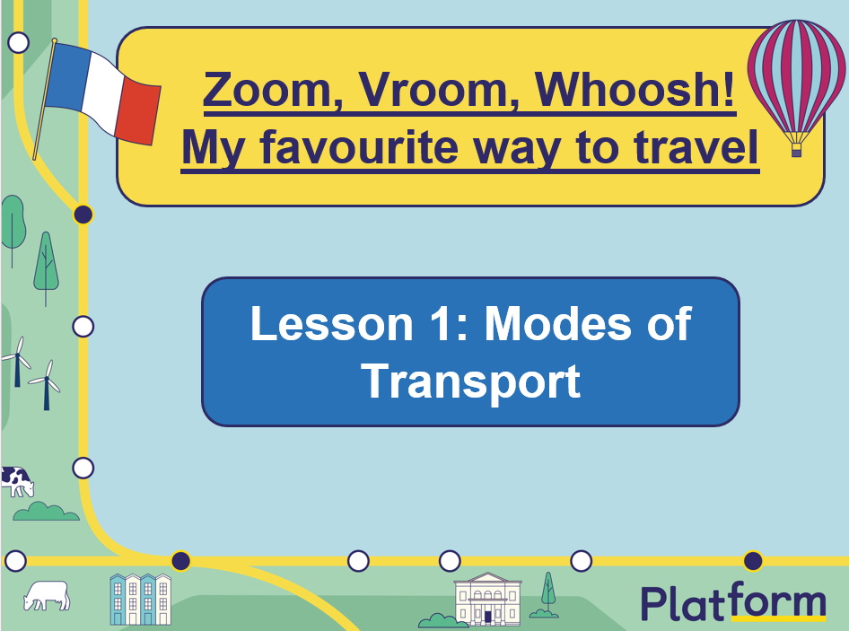
MFL
Resources Archive - Platform

Slide 8
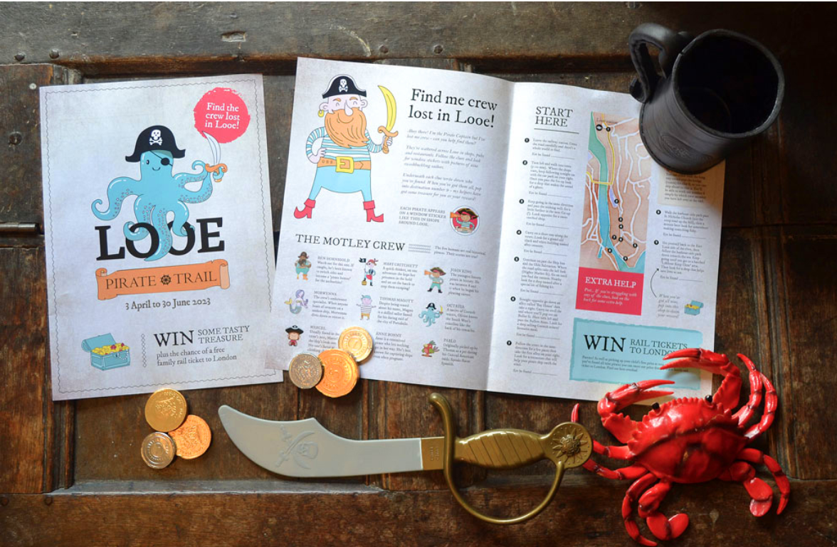

Geography
Looe Pirate Trail - Devon and Cornwall Rail Partnership

Slide 9
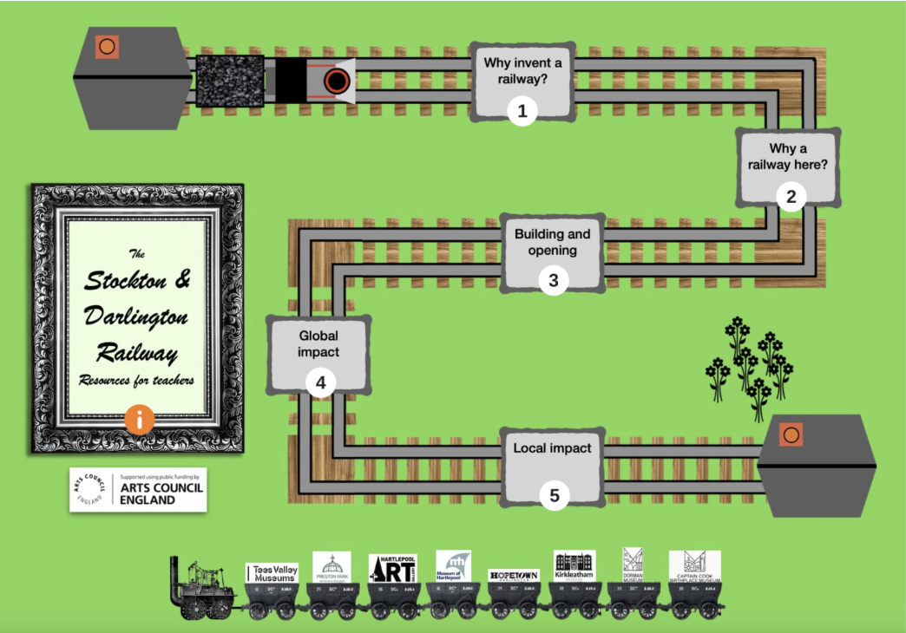

History
The Stockton and Darlington Railway Toolkit and Class Challenge - Tees Valley Museums
Education materials – Railway 200

Slide 10
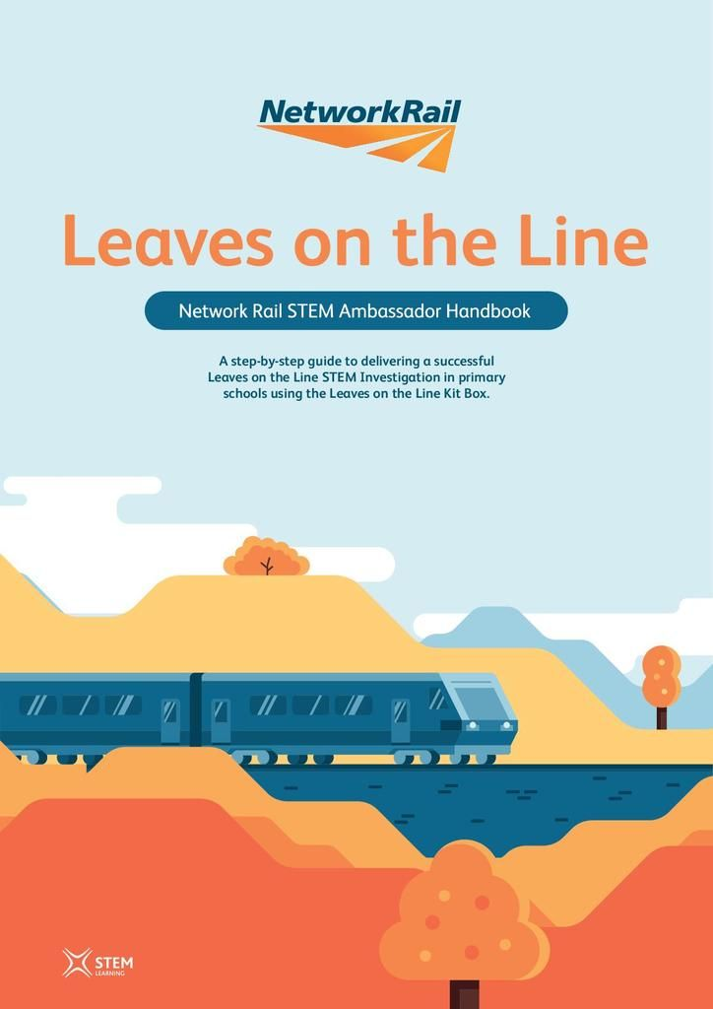

Science
Educational resources for children - Network Rail

