Slide 1

Karen
Bennett
2025 – Education Network

Slide 2
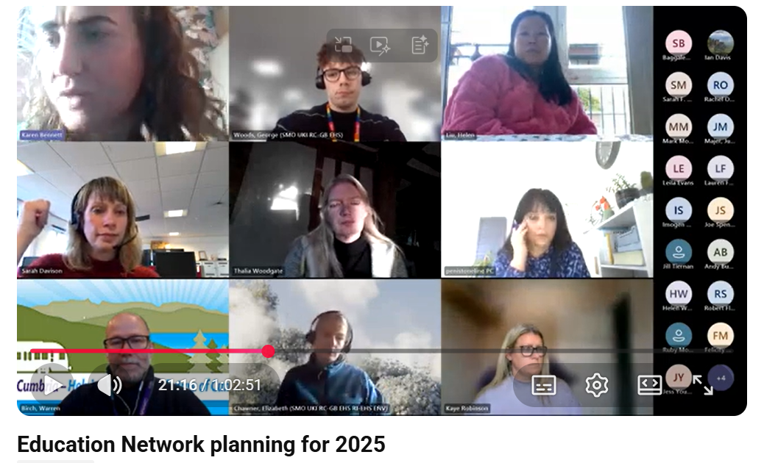
20th November 2024
You said you wanted:
*Active Travel session
* Sustainability
*R200
*Curriculum – what’s on it? What do academies teach?
*How to run a careers fair session
*Duke of Edinburgh Session
*High Peak and Hope Valley Drama project
*Active sessions – including PE

Slide 3
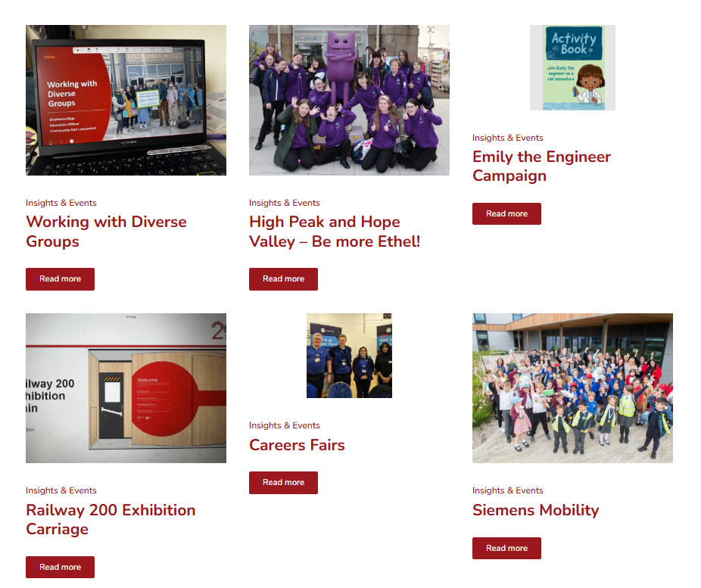
May
Apr
Mar
Feb
Jan
Members Meetings - TrainEd

Slide 4
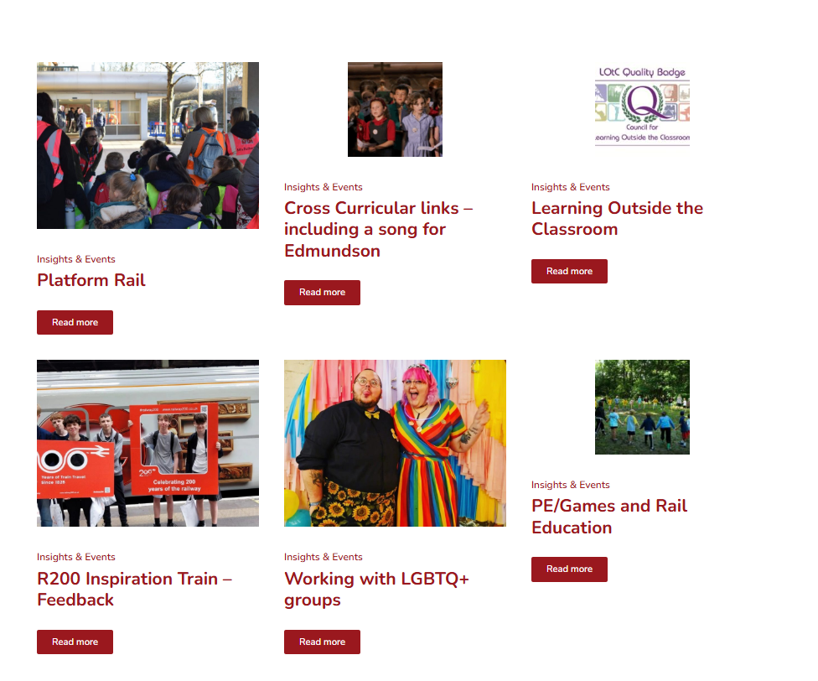
Nov
Oct
Sep
Aug
Jul
Jun
Members Meetings - TrainEd

Slide 5



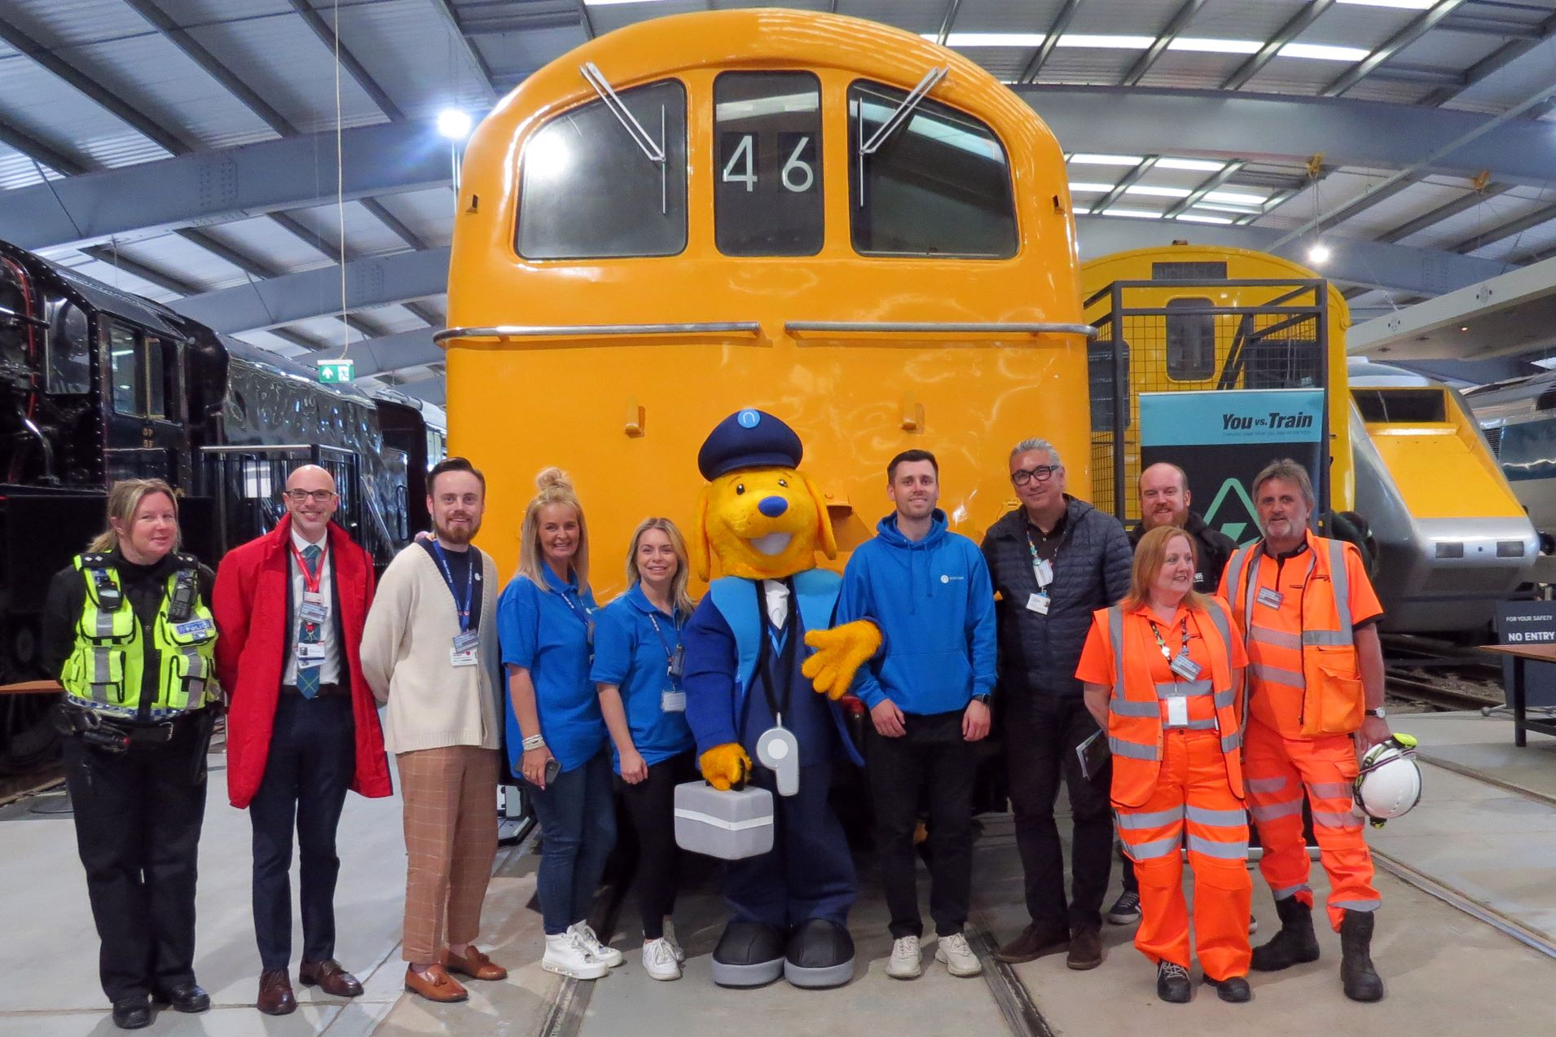
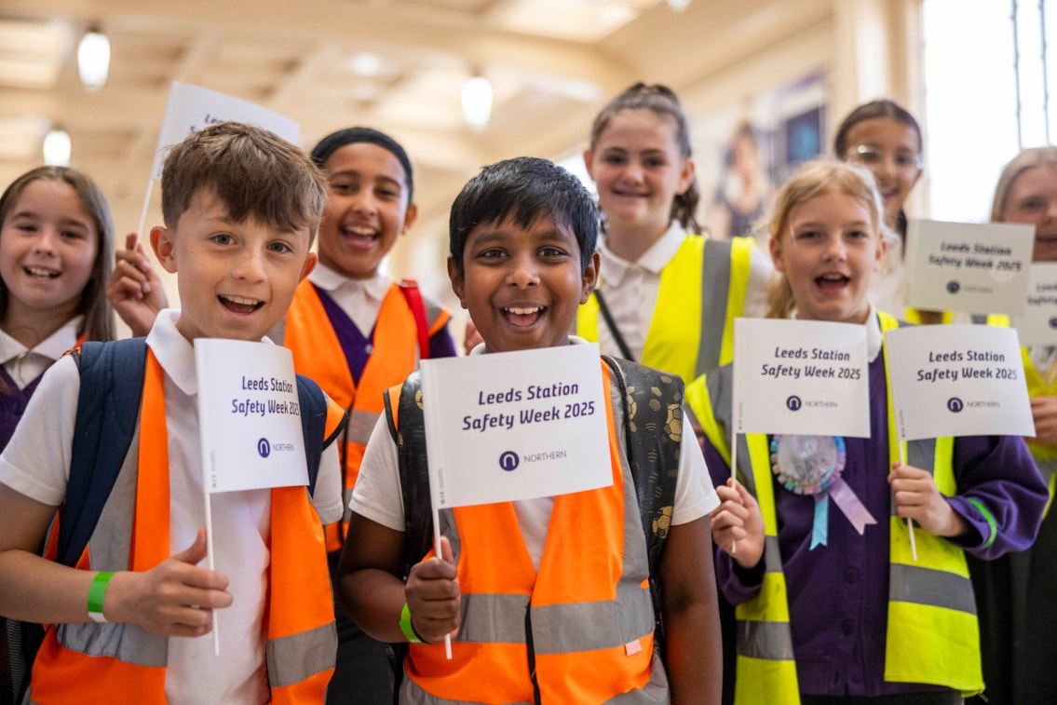
2025

Slide 6
2026
*Active Travel session – link with Gary’s network
* Sustainability
*Duke of Edinburgh Session
*permissions at stations/acquiring land
*event trains
*Using AI

