Slide 1
Year in Industry and graduate scheme at Northern

Slide 2
“What does psychology have to do with rail?”
I was asked this a lot!
MSci in Psychology from the University of York
Particular interest in the psychology of crime
Struggling to find a placement until…

Slide 3
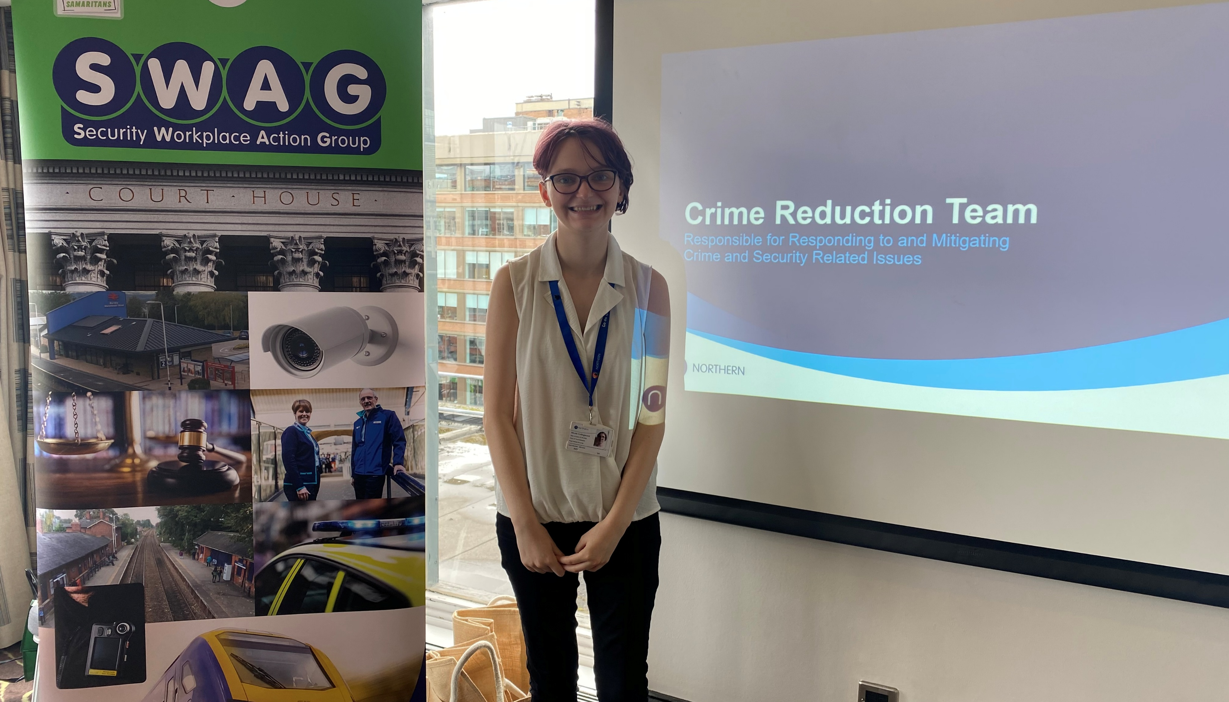
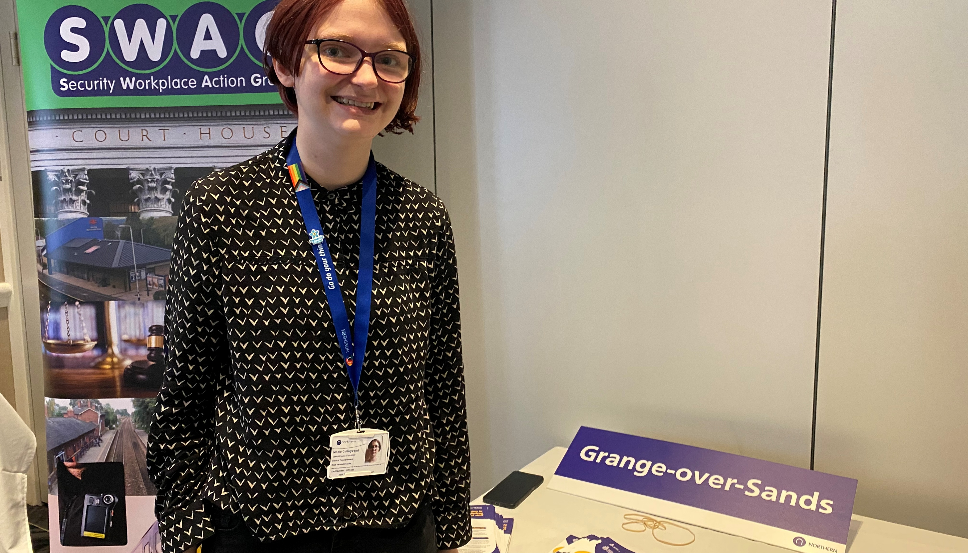
Year in Industry: Crime Reduction team

Slide 4
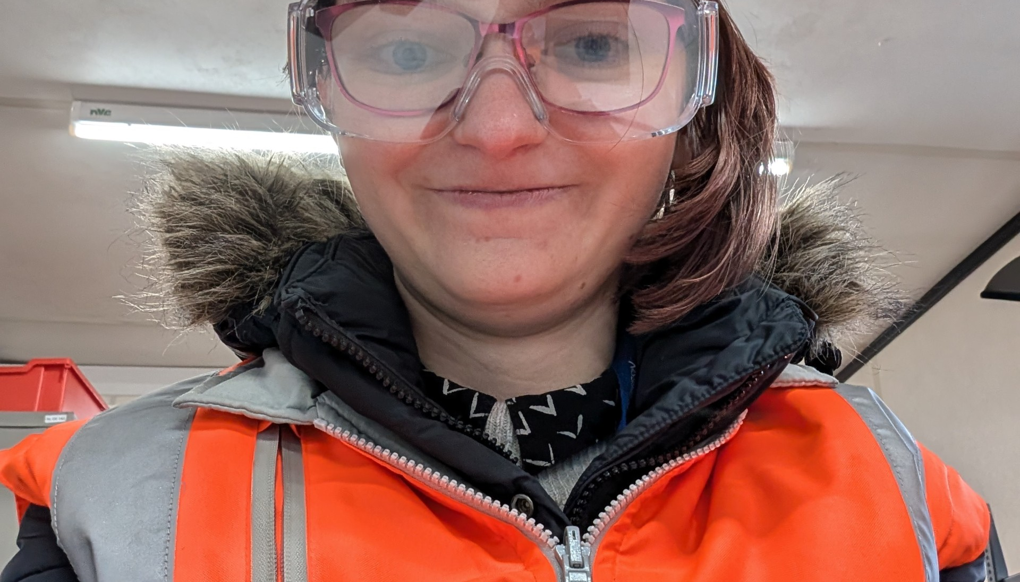

Graduate rotation 1: occupational health & safety

Slide 5
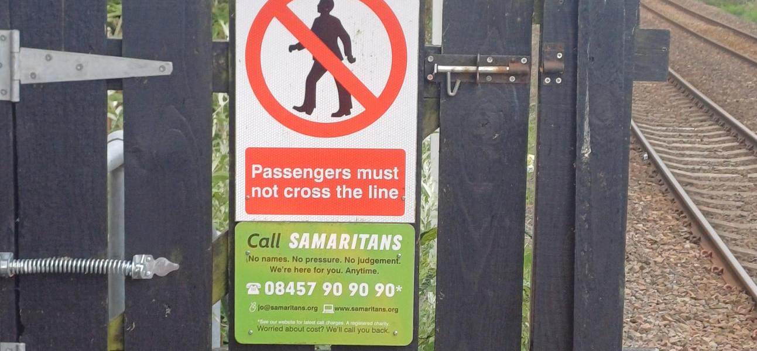
Graduate rotation 2: crime reduction

Slide 6
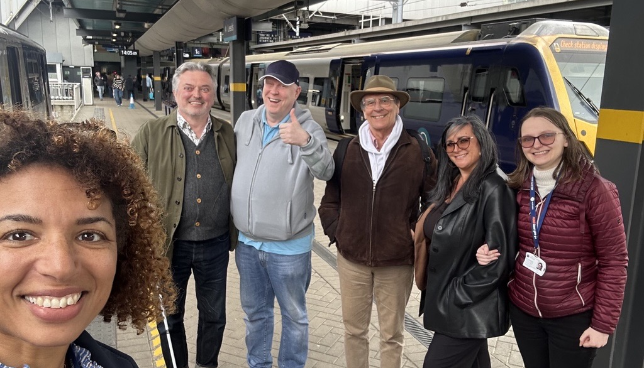
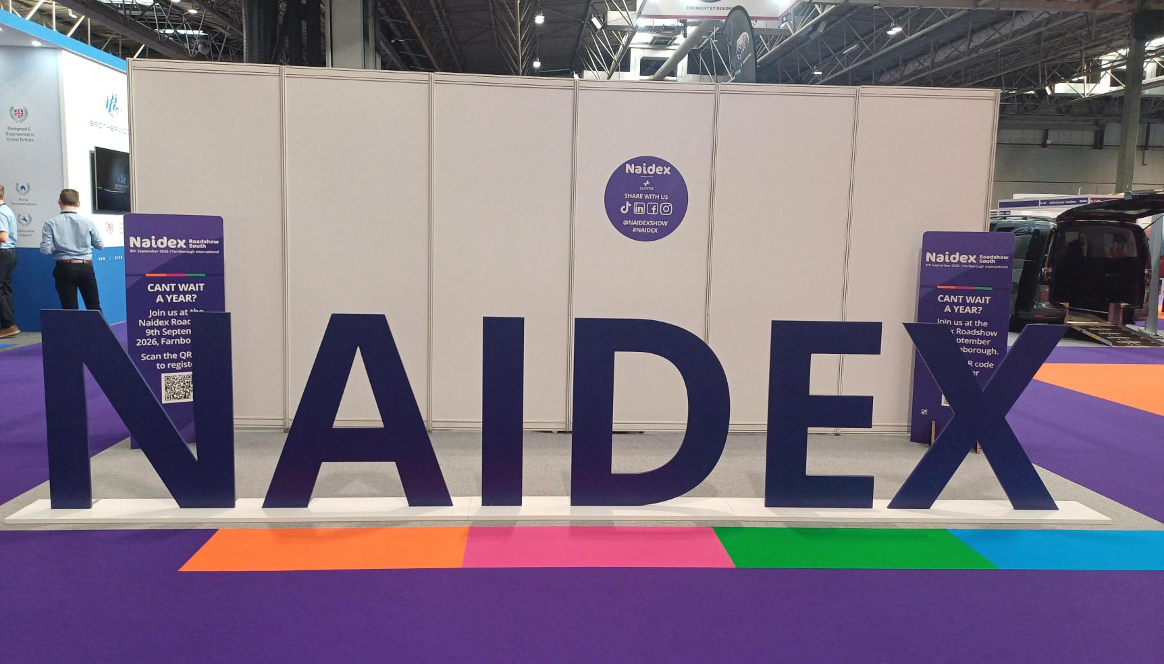
Graduate rotation 3: accessibility

