Slide 1

Rail Safety Education
A ready to use resource for schools to support upcoming PSHE curriculum changes

Slide 2
About the campaign
Overview
Network Rail, alongside the rail industry, has launched a new suite of five educational rail safety films for schools: one animated film for older Key Stage 2 pupils and four live‑action films for Key Stages 3 and 4. The films form part of a wider range of rail safety resources available for free via the Switched On Rail Safety website, including interactive games and classroom activities with accompanying teacher guidance that help pupils recognise risky behaviour and develop hazard‑spotting skills. Designed for classroom use, the films use realistic scenarios with TV and film special effects to show the real‑world consequences of unsafe behaviour around the railway.
Why now?
Growing risk: Each year we have around 19,000 trespass incidents with appox 4,000 of these involving under‑18s Seasonal increase: Incidents rise during warmer months - 57% occur between April and August Curriculum change: Rail safety education becomes compulsory in England’s PSHE curriculum, for both Primary and Secondary schools, from September 2026

Slide 3
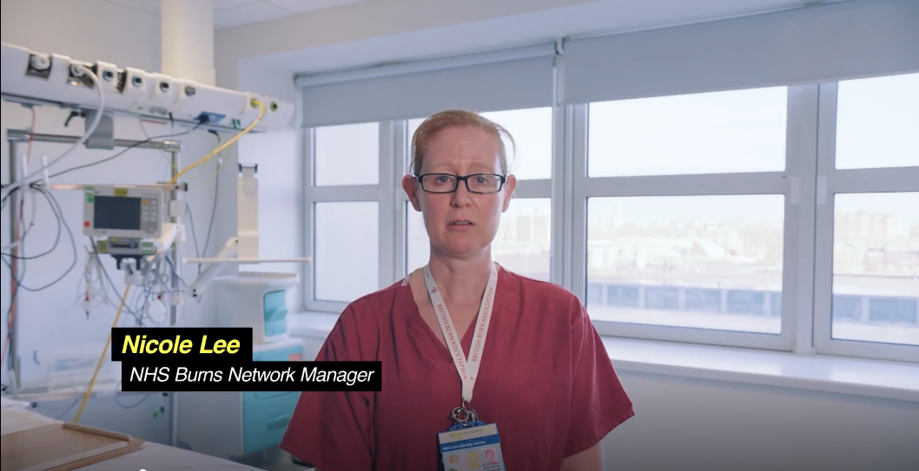
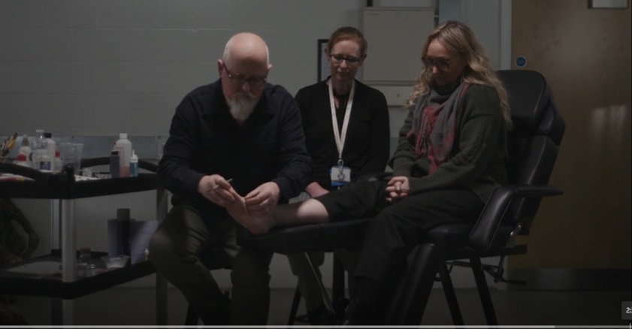
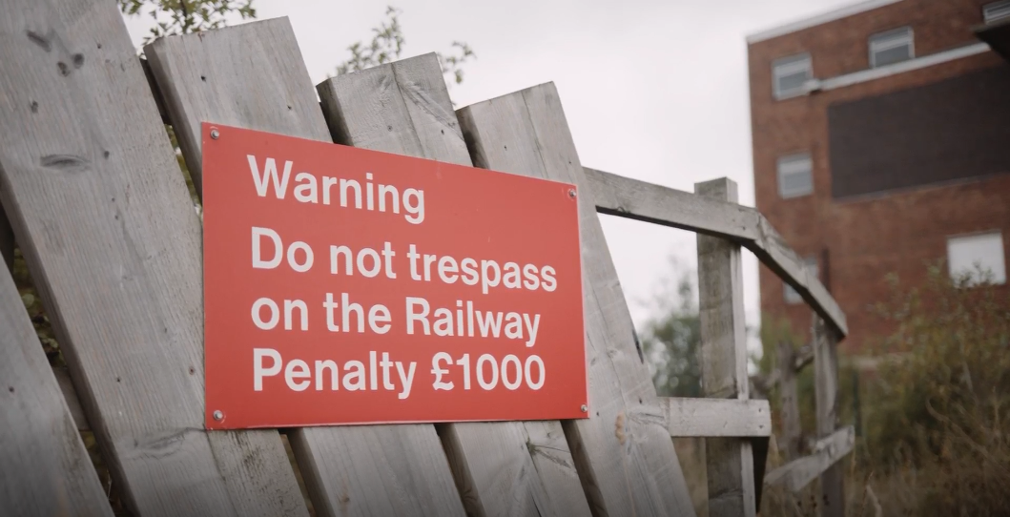
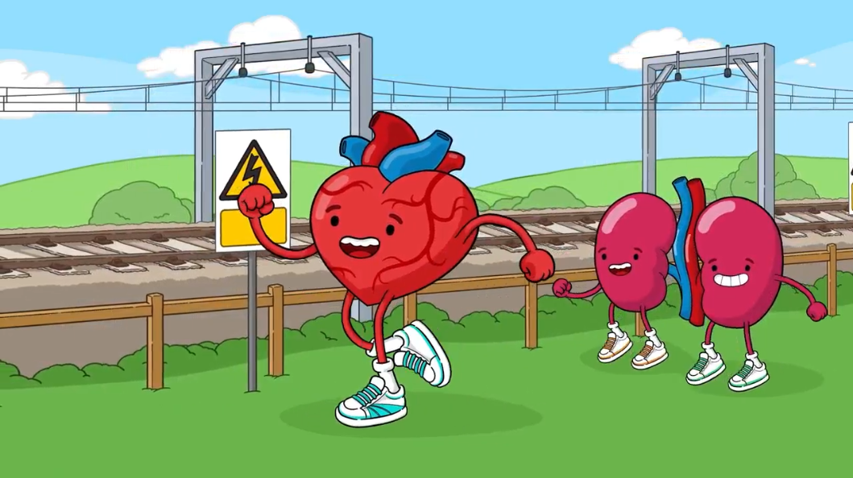
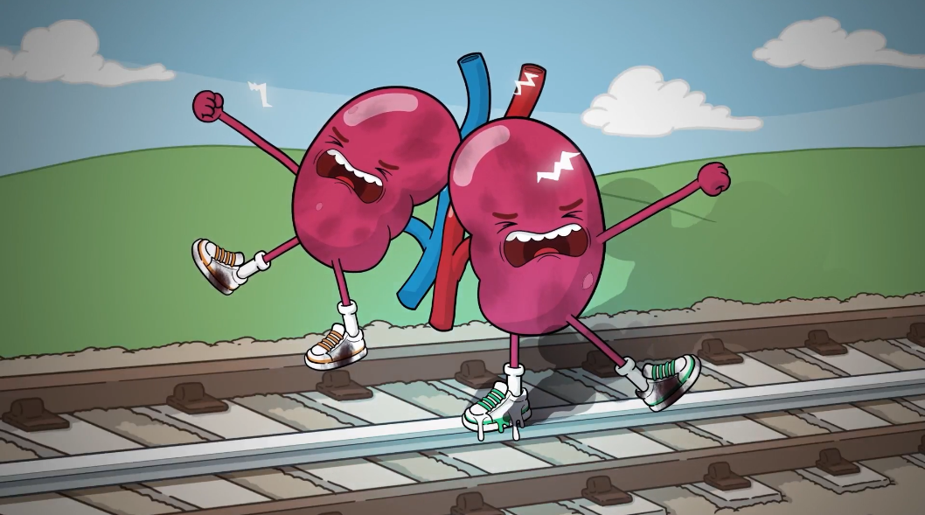
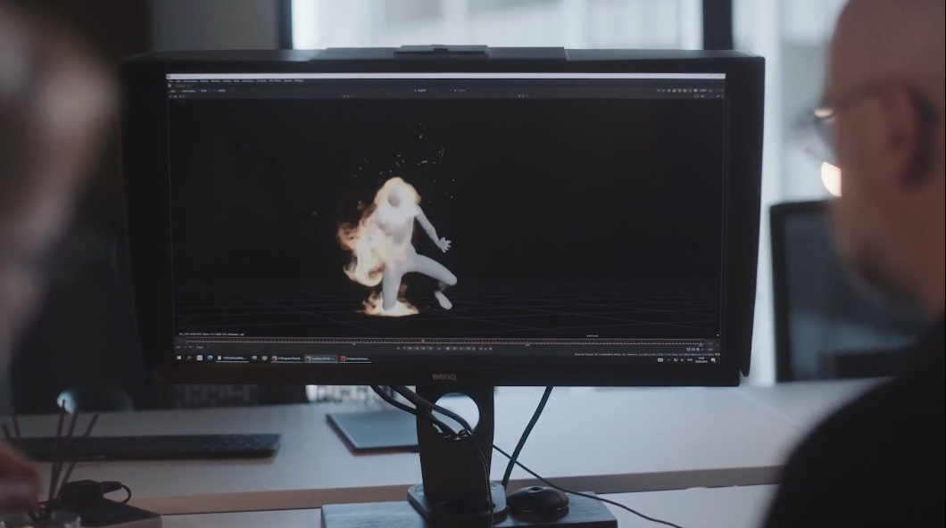
Film assets
A mix of animation and live action brings rail safety risks to life for different age groups.

Slide 4
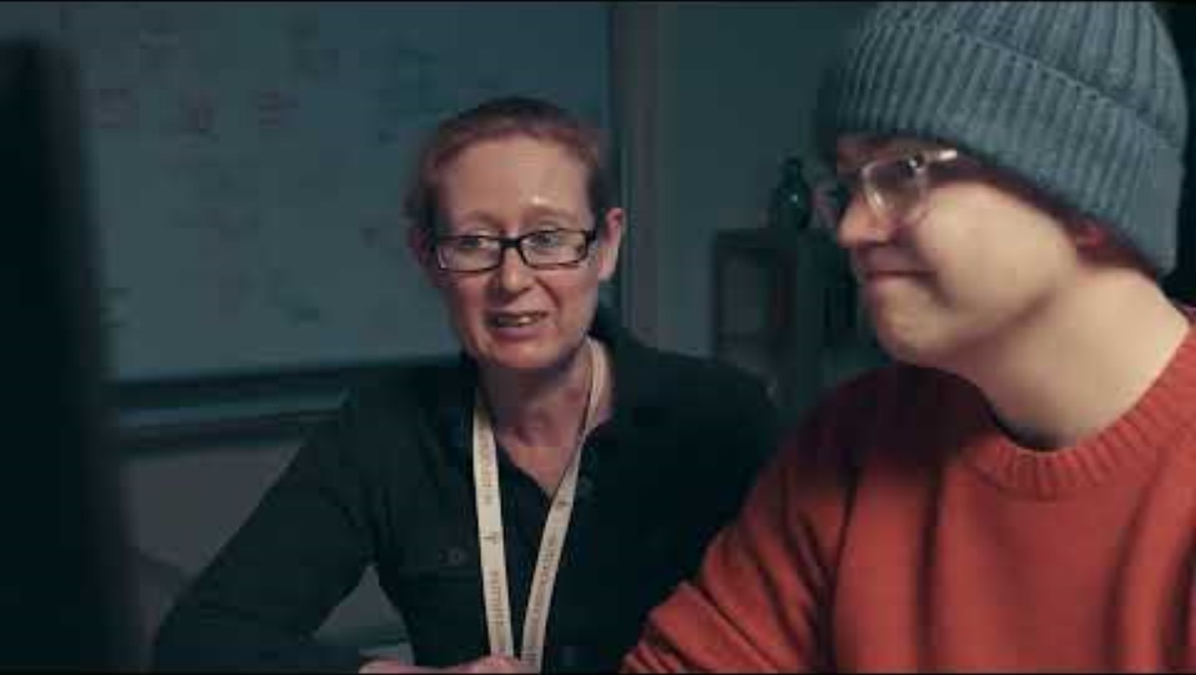
Stay off the tracks - KS2 Film
Animated storytelling introduces rail risks in an engaging, age appropriate way.

Slide 5
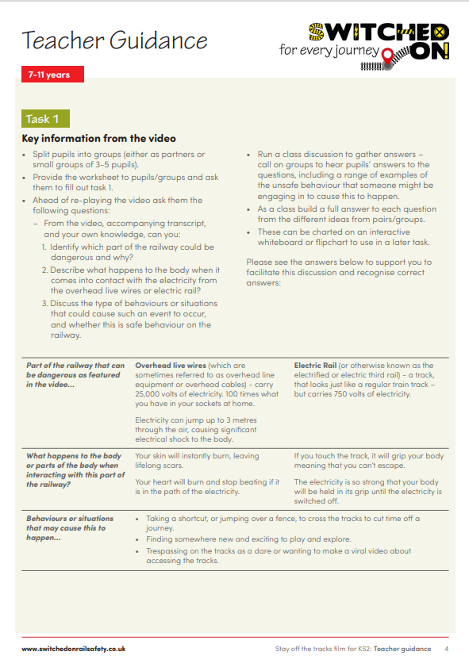
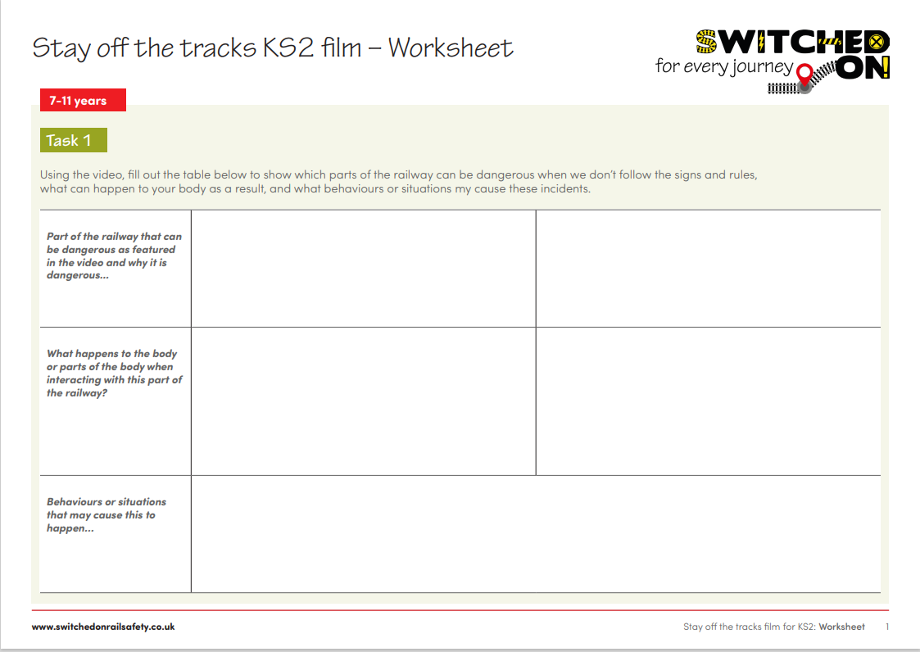
Stay off the tracks - KS2 Film
This animation is suitable for the upper KS2 audience, 9-11yrs.
There’s an accompanying worksheet to support the learning.

Slide 6
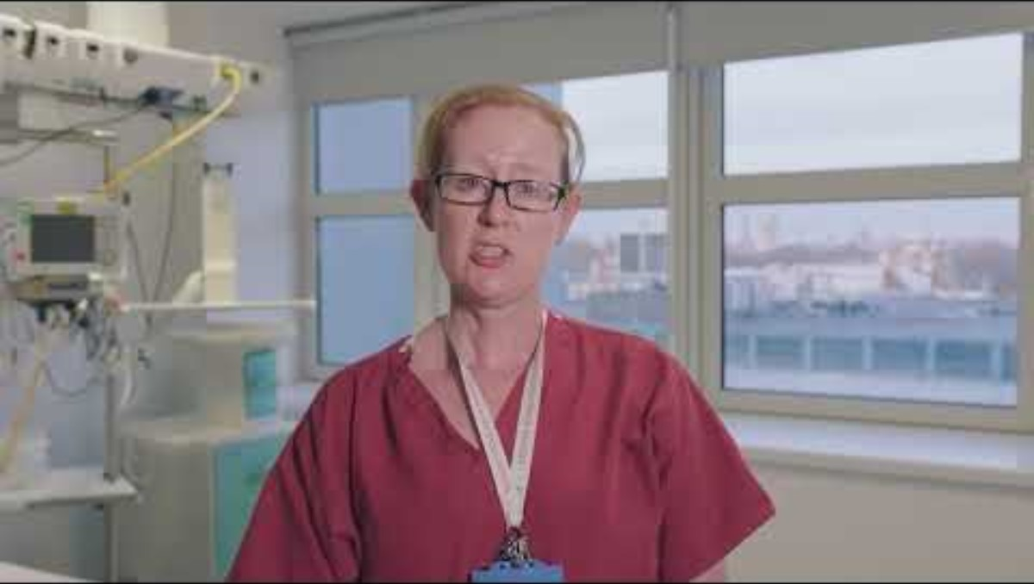
Stay off the tracks - KS3 Overhead live wires film
Live action films show real world consequences and reinforce the seriousness of risk.

Slide 7
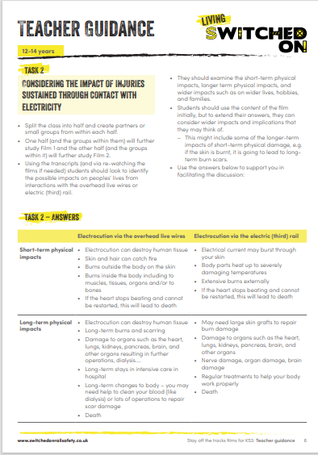
Stay off the tracks - KS3 and KS4 films
We differentiated between the films and activities for 12-14yrs and 14-16yrs to allow for a harder hitting version for the older age range, and a difference in activities as they move up through the key stages.
These are important resources to educate on the dangers of electricity on the railway, and the differences between overhead live wires and electric (third) rail.
We recognise rail terminology such as ‘third rail’ aren’t appropriate for this audience and instead refer to the electric rails.

Slide 8
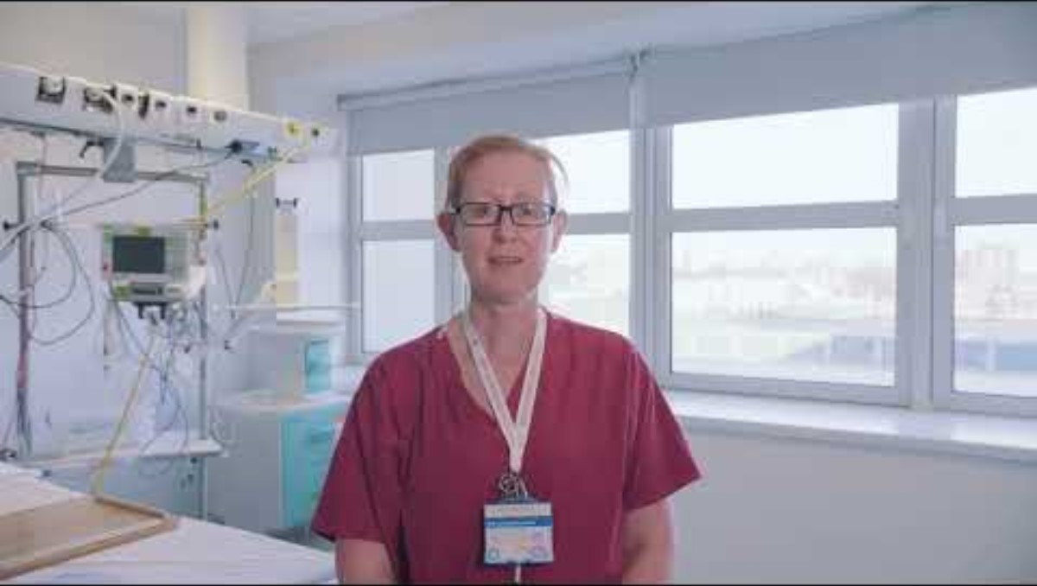
Stay off the tracks - KS4 Electric rail film

Slide 9
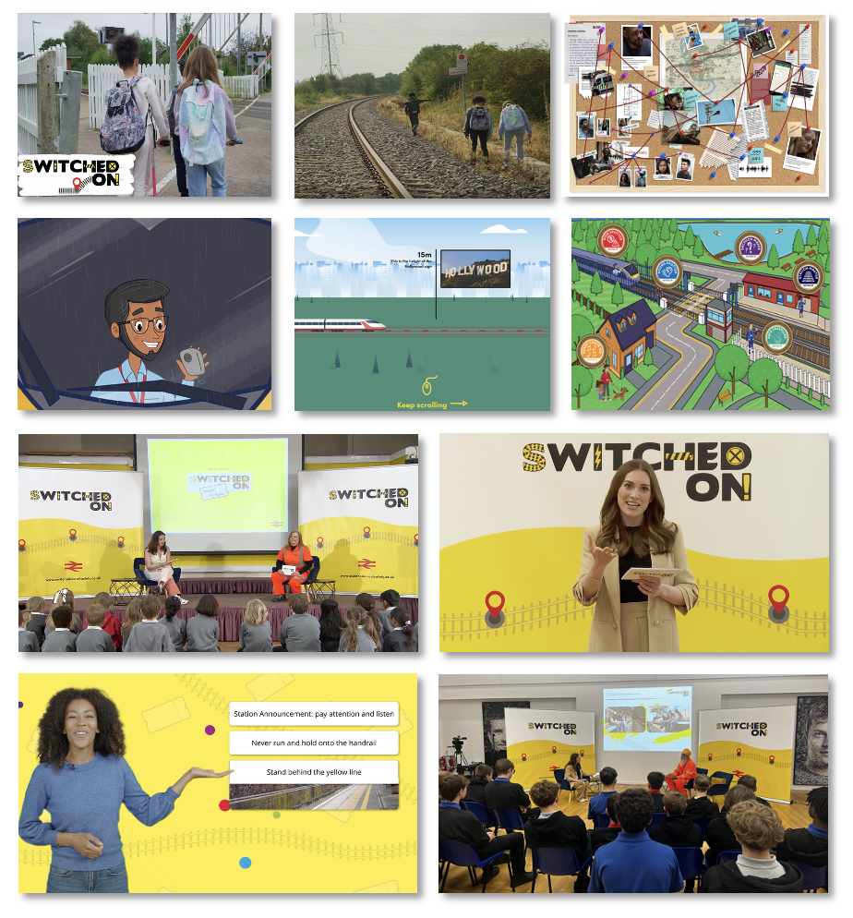
switchedonrailsafety.co.uk
The Switched On platform includes:
A range of rail safety resources for 3-16yrs, including interactive games, classroom activities and on-demand sessions.
Teacher guidance for each resource and teacher learning pathways.
Classroom posters and activity books
All resources are free to access and designed for easy classroom use.

Slide 10
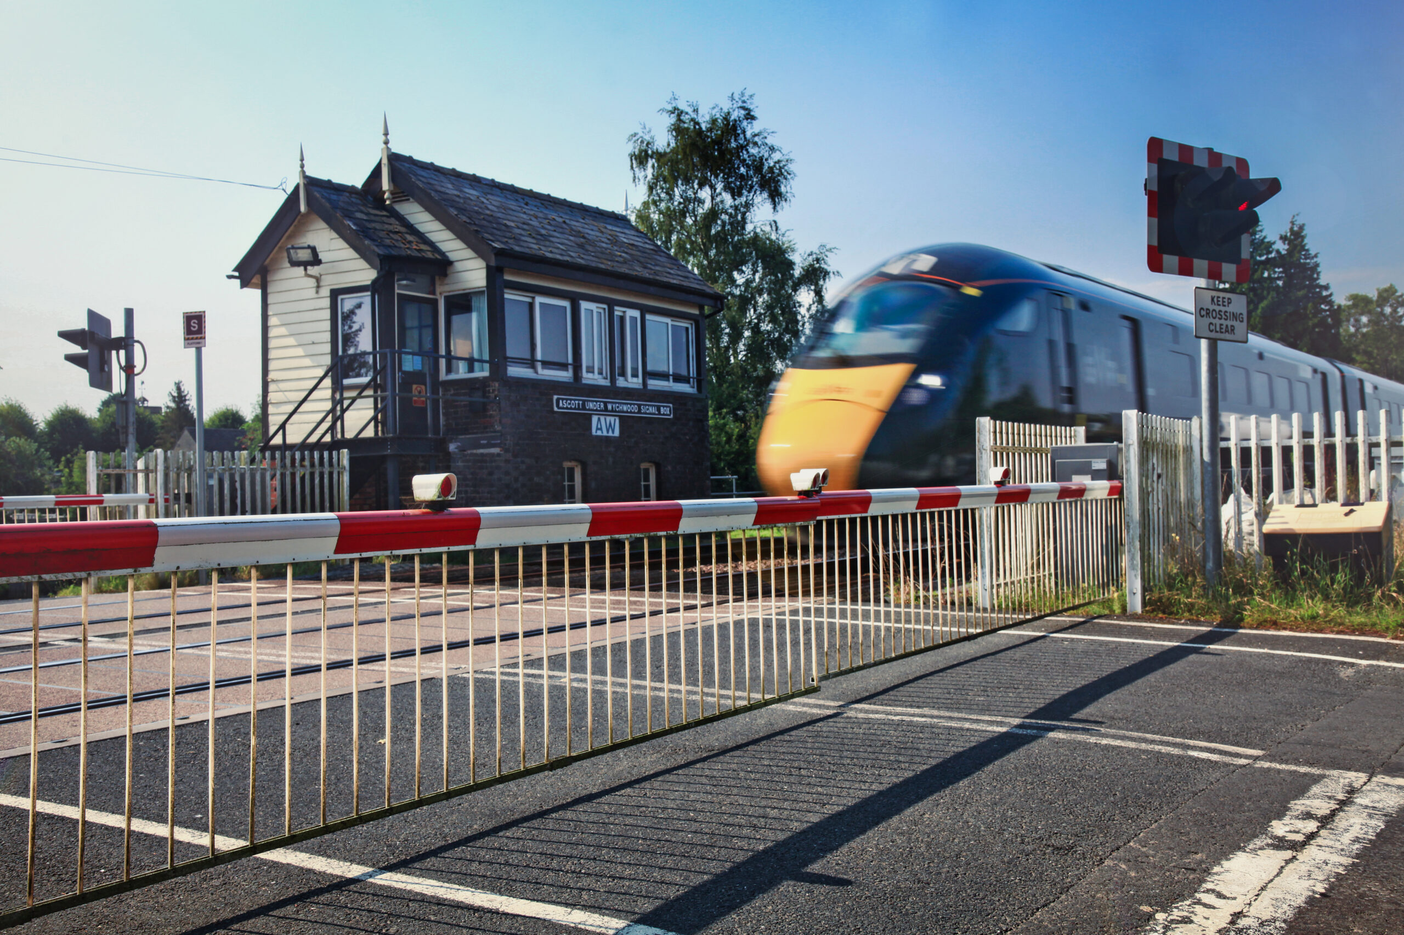
BREAKOUT ACTIVITY
Goal: Share ideas and explore how these resources could work in your sessions
Instructions:
Split into small groups (3-5 people)
Discuss the questions on the following slide (10-15 mins)
Jot down any useful reflections
We’ll come back together to share a few highlights with the group!

Slide 11
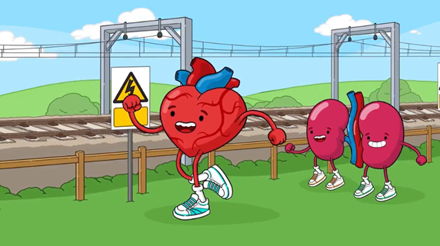
BREAKOUT ACTIVITY
What challenges do you face when teaching rail safety or similar topics?
What approaches most effectively engage pupils with high-risk subjects?
How could these resources fit into your current sessions?
What would help you deliver this content more confidently?

Slide 12
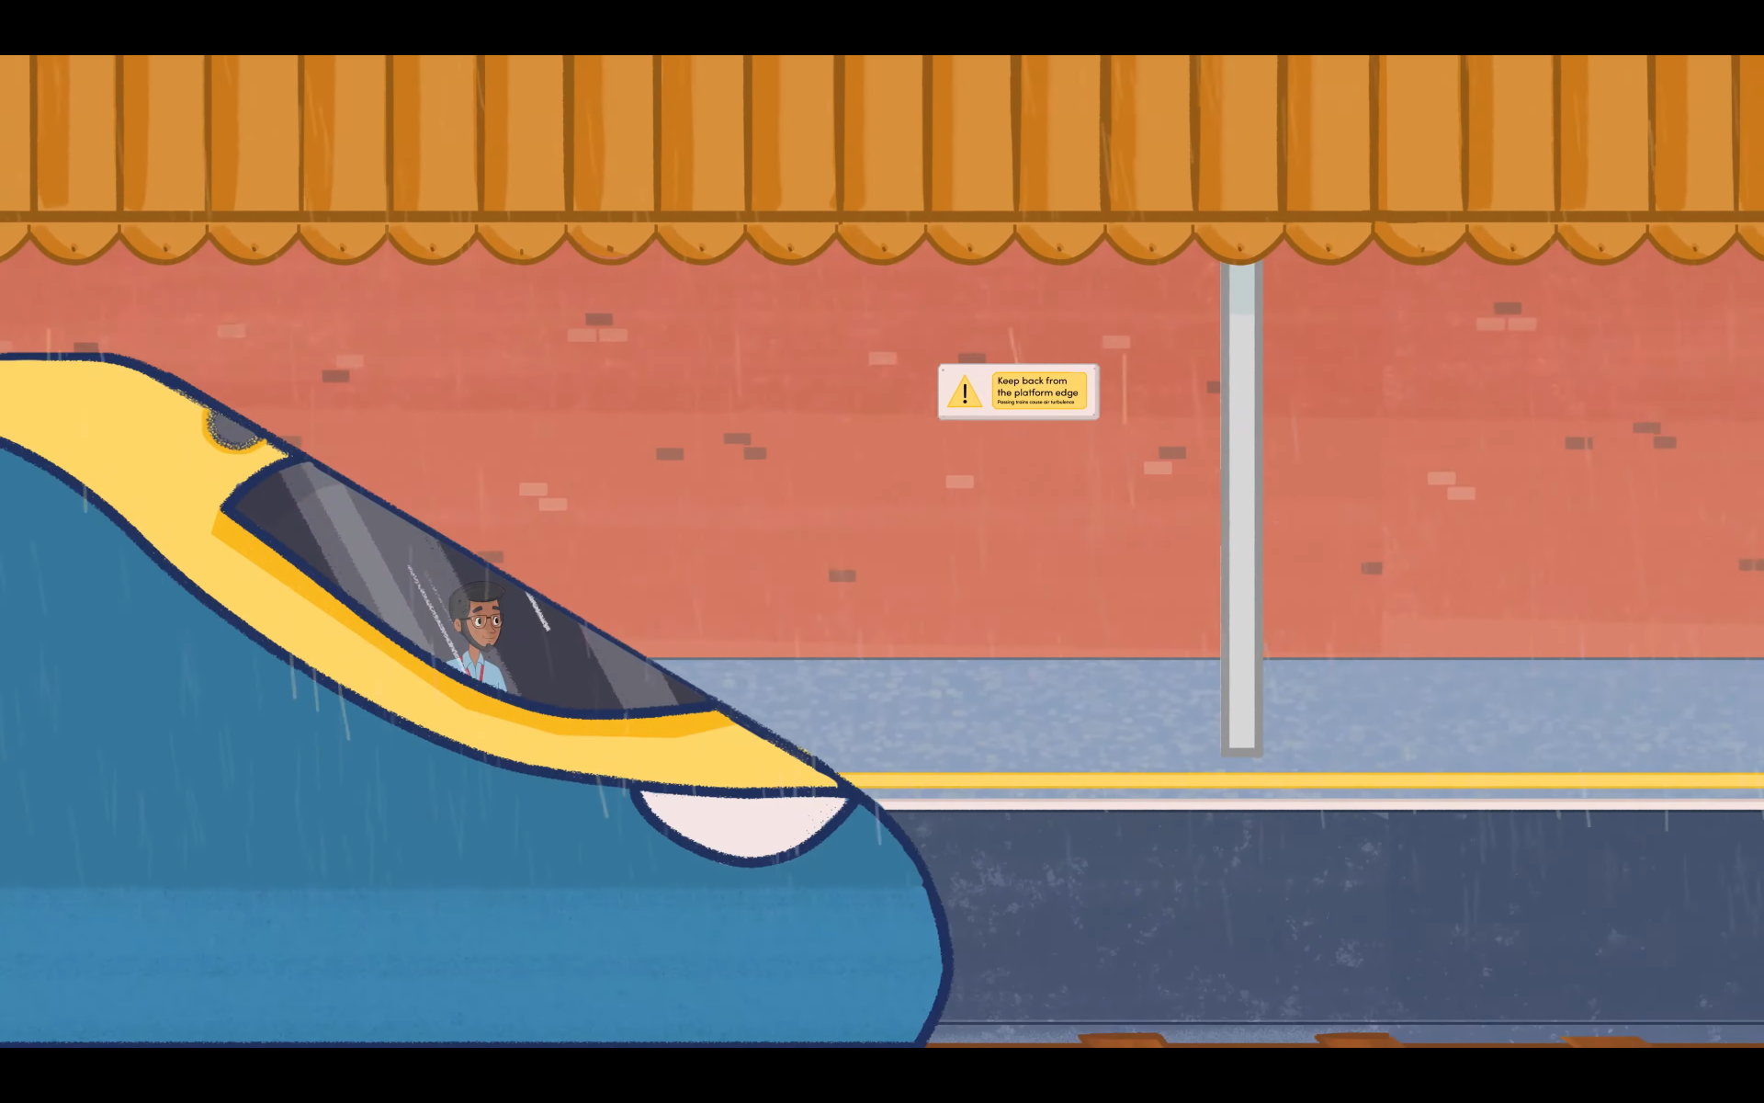
Closing question:
What’s one idea you could take straight into your next session?

Slide 13
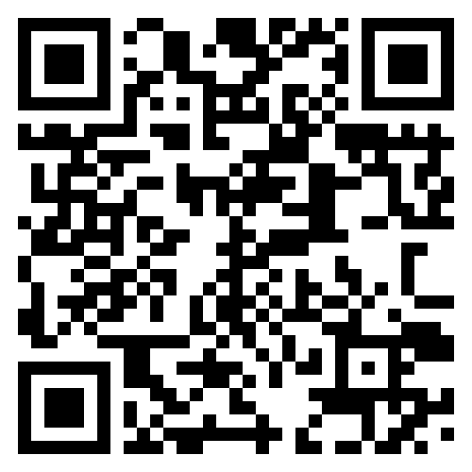
Any questions?
Thank you for supporting Switched On Rail Safety - the rail industry’s trusted hub for rail safety education.
For more information, please contact: Victoria.Clent@networkrail.co.uk
Scan for Switched On website:

