Slide 1

Introducing
Chartered Institution of
Railway Operators
(CIRO)
and
Rail Start
Shaping the future of rail, together

Slide 2

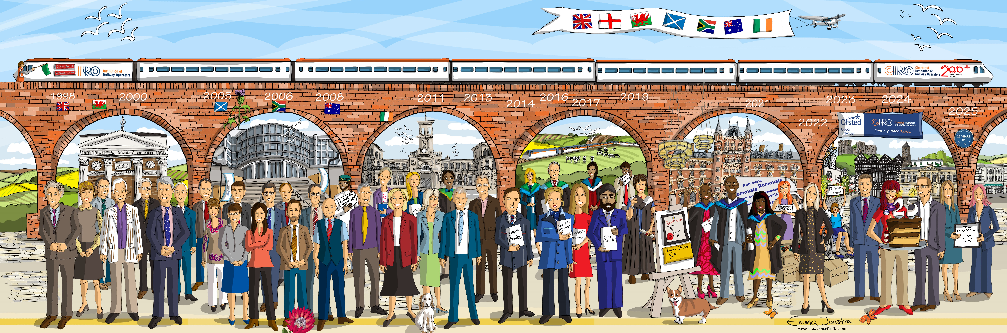
Chartered Institution of Railway Operators
Founded in December 2000, the Institution was formed in the UK by a group of likeminded senior railway operations professionals
Shaping the future of rail, together

Slide 3

Awarded Royal Chartership in 2021.
For CIRO, the Royal Charter means formal recognition as the Chartered Institution of Railway Operators, confirming its professional standing and authority in railway operations.
CIRO’s Royal Charter gives it the authority to advance education, promote professional standards, and recognise competence in railway operations.
Shaping the future of rail, together

Slide 4

Chartered Institution of Railway Operators - CIRO
Our mission:
To lead, inspire and accelerate the growth of rail professionals, cultivating collaboration to support the success of rail organisations now and in the future.
Member Focused – Inclusive – Collaborative – Professional and Accountable – Knowledgeable – Innovative
Our Values:
Shaping the future of rail, together

Slide 5
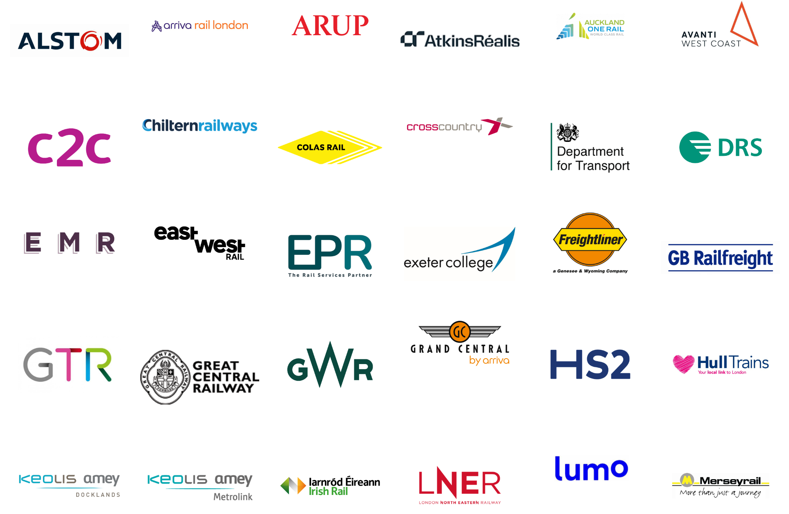
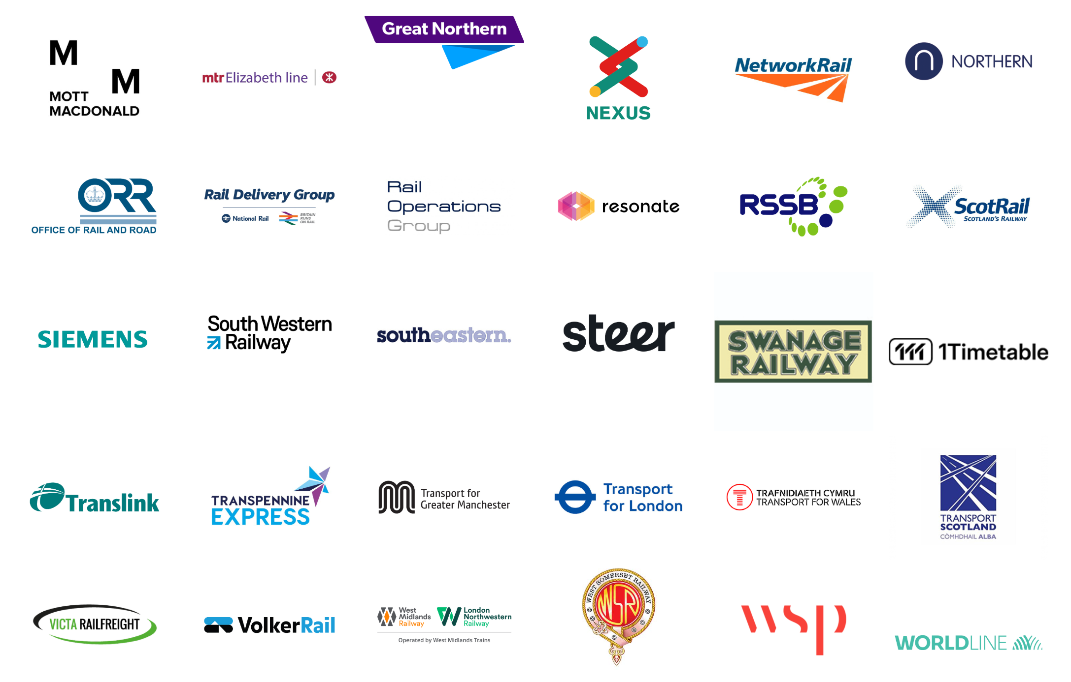
Membership
a professional network of over 14,000 individual members
Corporate Members
Gain professional affiliation and recognition within the industry
Be entitled to many additional benefits
Shaping the future of rail, together

Slide 6
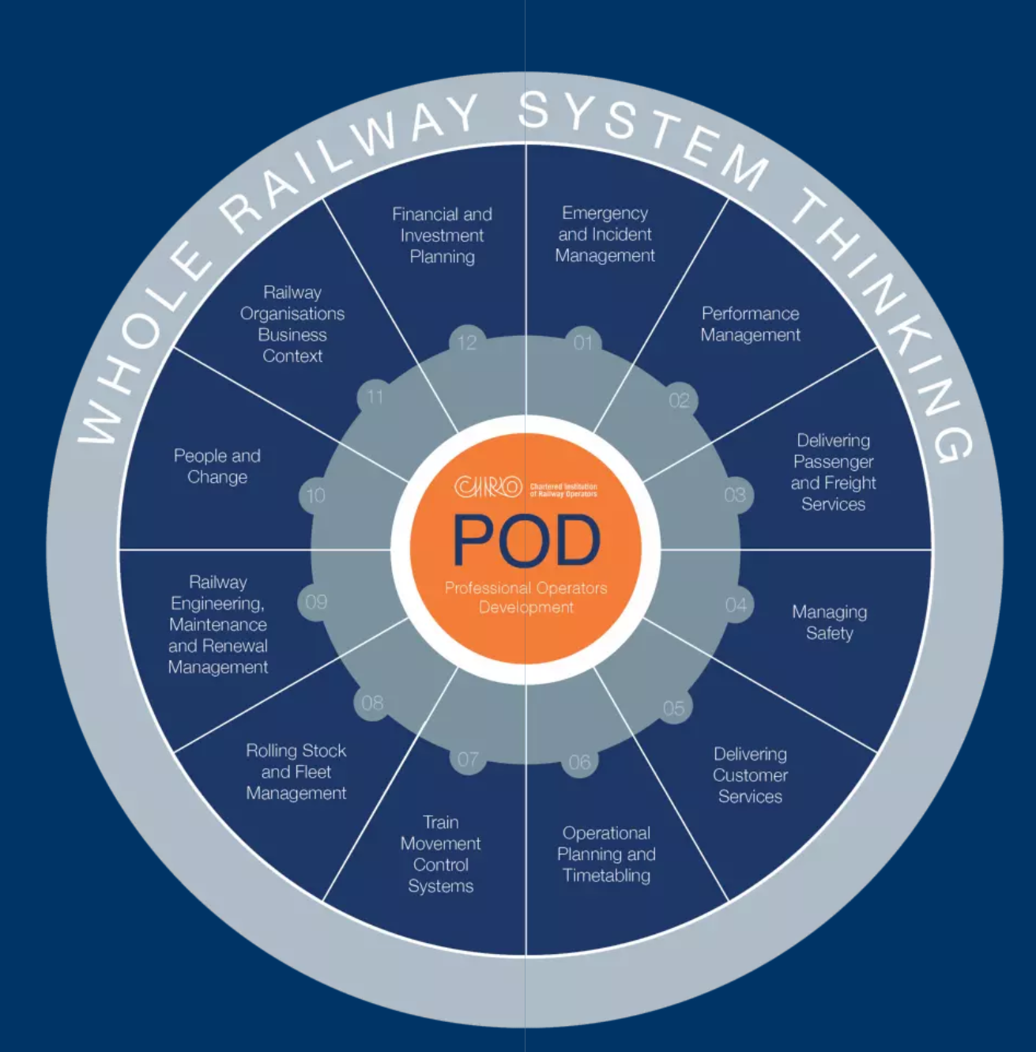
CIRO Professional Operators Development Framework
The framework is designed to:
Enable self-assessment of knowledge and capability
Help professionals focus and target their learning
Provide a structure to track development over time
Support career progression and CIRO membership upgrades
Shaping the future of rail, together

Slide 7
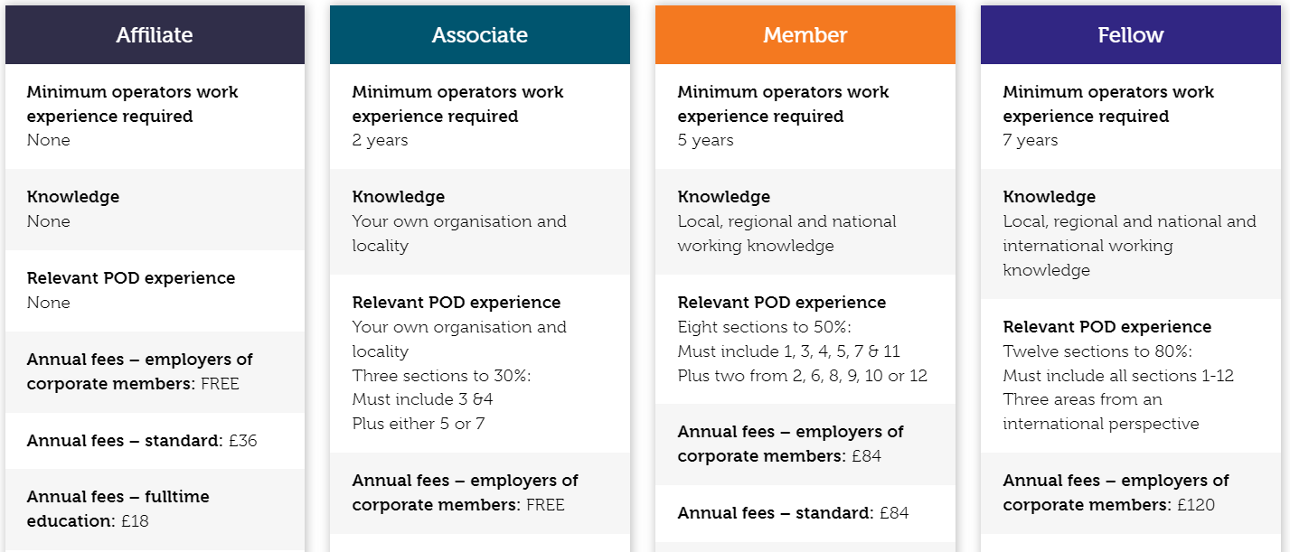

Upgraded membership
More upgrading info
Demonstrate your knowledge and experience by upgrading to the membership level that fits your career position.
“Not being a CIRO Member meant that I missed an interview opportunity. I’d been an Affiliate for a long time, and this was the indication that I was selling myself short by not upgrading my membership.”

Slide 8
CIRO’s Learning Portfolio
Academic
Rail Academy
Apprenticeships
End Point Assessment
Awarding Organisation
Shaping the future of rail, together

Slide 9

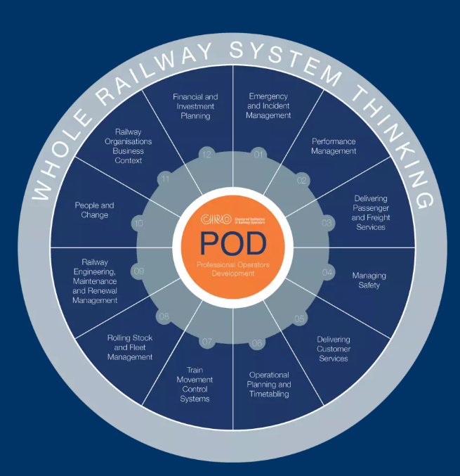

Rail Start
An entry level course that:
Works around the CIRO POD, one element at a time
Shares engaging rail facts and real-world examples
Checks understanding through quick quizzes
Links each POD area to career routes
Shaping the future of rail, together

Slide 10

Emergency and Incident Management

Slide 11

Performance Management

Slide 12

Delivering Passenger and Freight Services

Slide 13

Managing Safety

Slide 14

Delivering Customer Services

Slide 15

Operational Planning and Timetabling

Slide 16

Train Movement Control Systems

Slide 17

Rolling Stock and Fleet Management

Slide 18

Railway Engineering, Maintenance and
Renewal Management

Slide 19

People and Change

Slide 20

Railway Organisations Business Context

Slide 21

Financial and Investment Planning

Slide 22

Completing the course gives learners knowledge, confidence, career direction and a recognised CIRO certificate to add to their CV.
Builds awareness of the wide range of rail careers
Helps learners understand how the railway works as a system
Shows where their interests and strengths could fit
Gives confidence to talk about rail in applications/interviews
Provides evidence of early career exploration and motivation
Links directly to apprenticeships, career pathways and next steps
Supports employability skills: curiosity, decision-making and career planning
Creates a stronger CV statement than just “interested in rail”
Shaping the future of rail, together

Slide 23
We would really value your input on how this programme should look, feel, and be accessed to make it work in practice.
Shaping the future of rail, together

Slide 24
Questions
Q1 – Format, Engagement and Presentation
  What type of format would most engage your learners, i.e. video, animation, AI avatar, digital/in-person session
Q2 – Access and delivery
  How would this fit into your setting?
Shaping the future of rail, together

Slide 25
Questions
Q3 – Cost, value and finding models
  Would this need to be: free, subsidised, paid for?
  If paid for, what do you consider a reasonable price point?
Q4 – Partnership and scalability
  What would encourage you to champion or recommend this?
Shaping the future of rail, together

Slide 26
Questions
To finish:
What are your 3 key recommendations
1 “non-negotiable”
1 “avoid this” warning
Shaping the future of rail, together

Slide 27

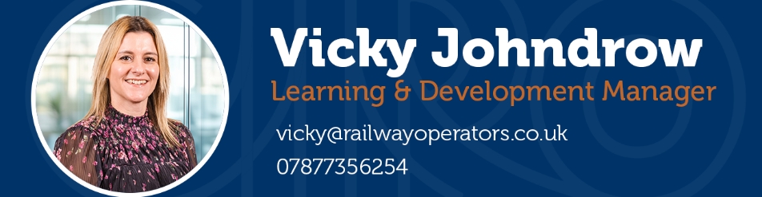
The journey’s only just begun.
ciro.org

