Slide 1

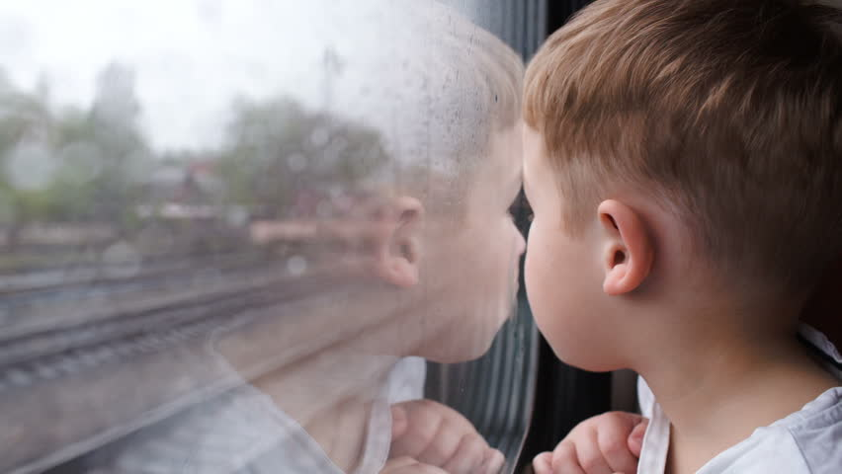
How to use the railway safely

Slide 2
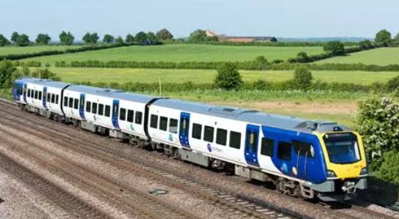
Who has been on a train before?
Where have you been to?
Who did you go with?

Slide 3
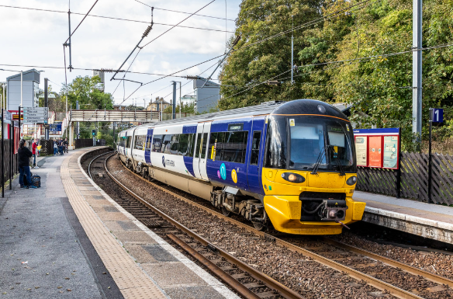
A train is the safest form of land transport
9 times safer than
travelling by road!

Slide 4
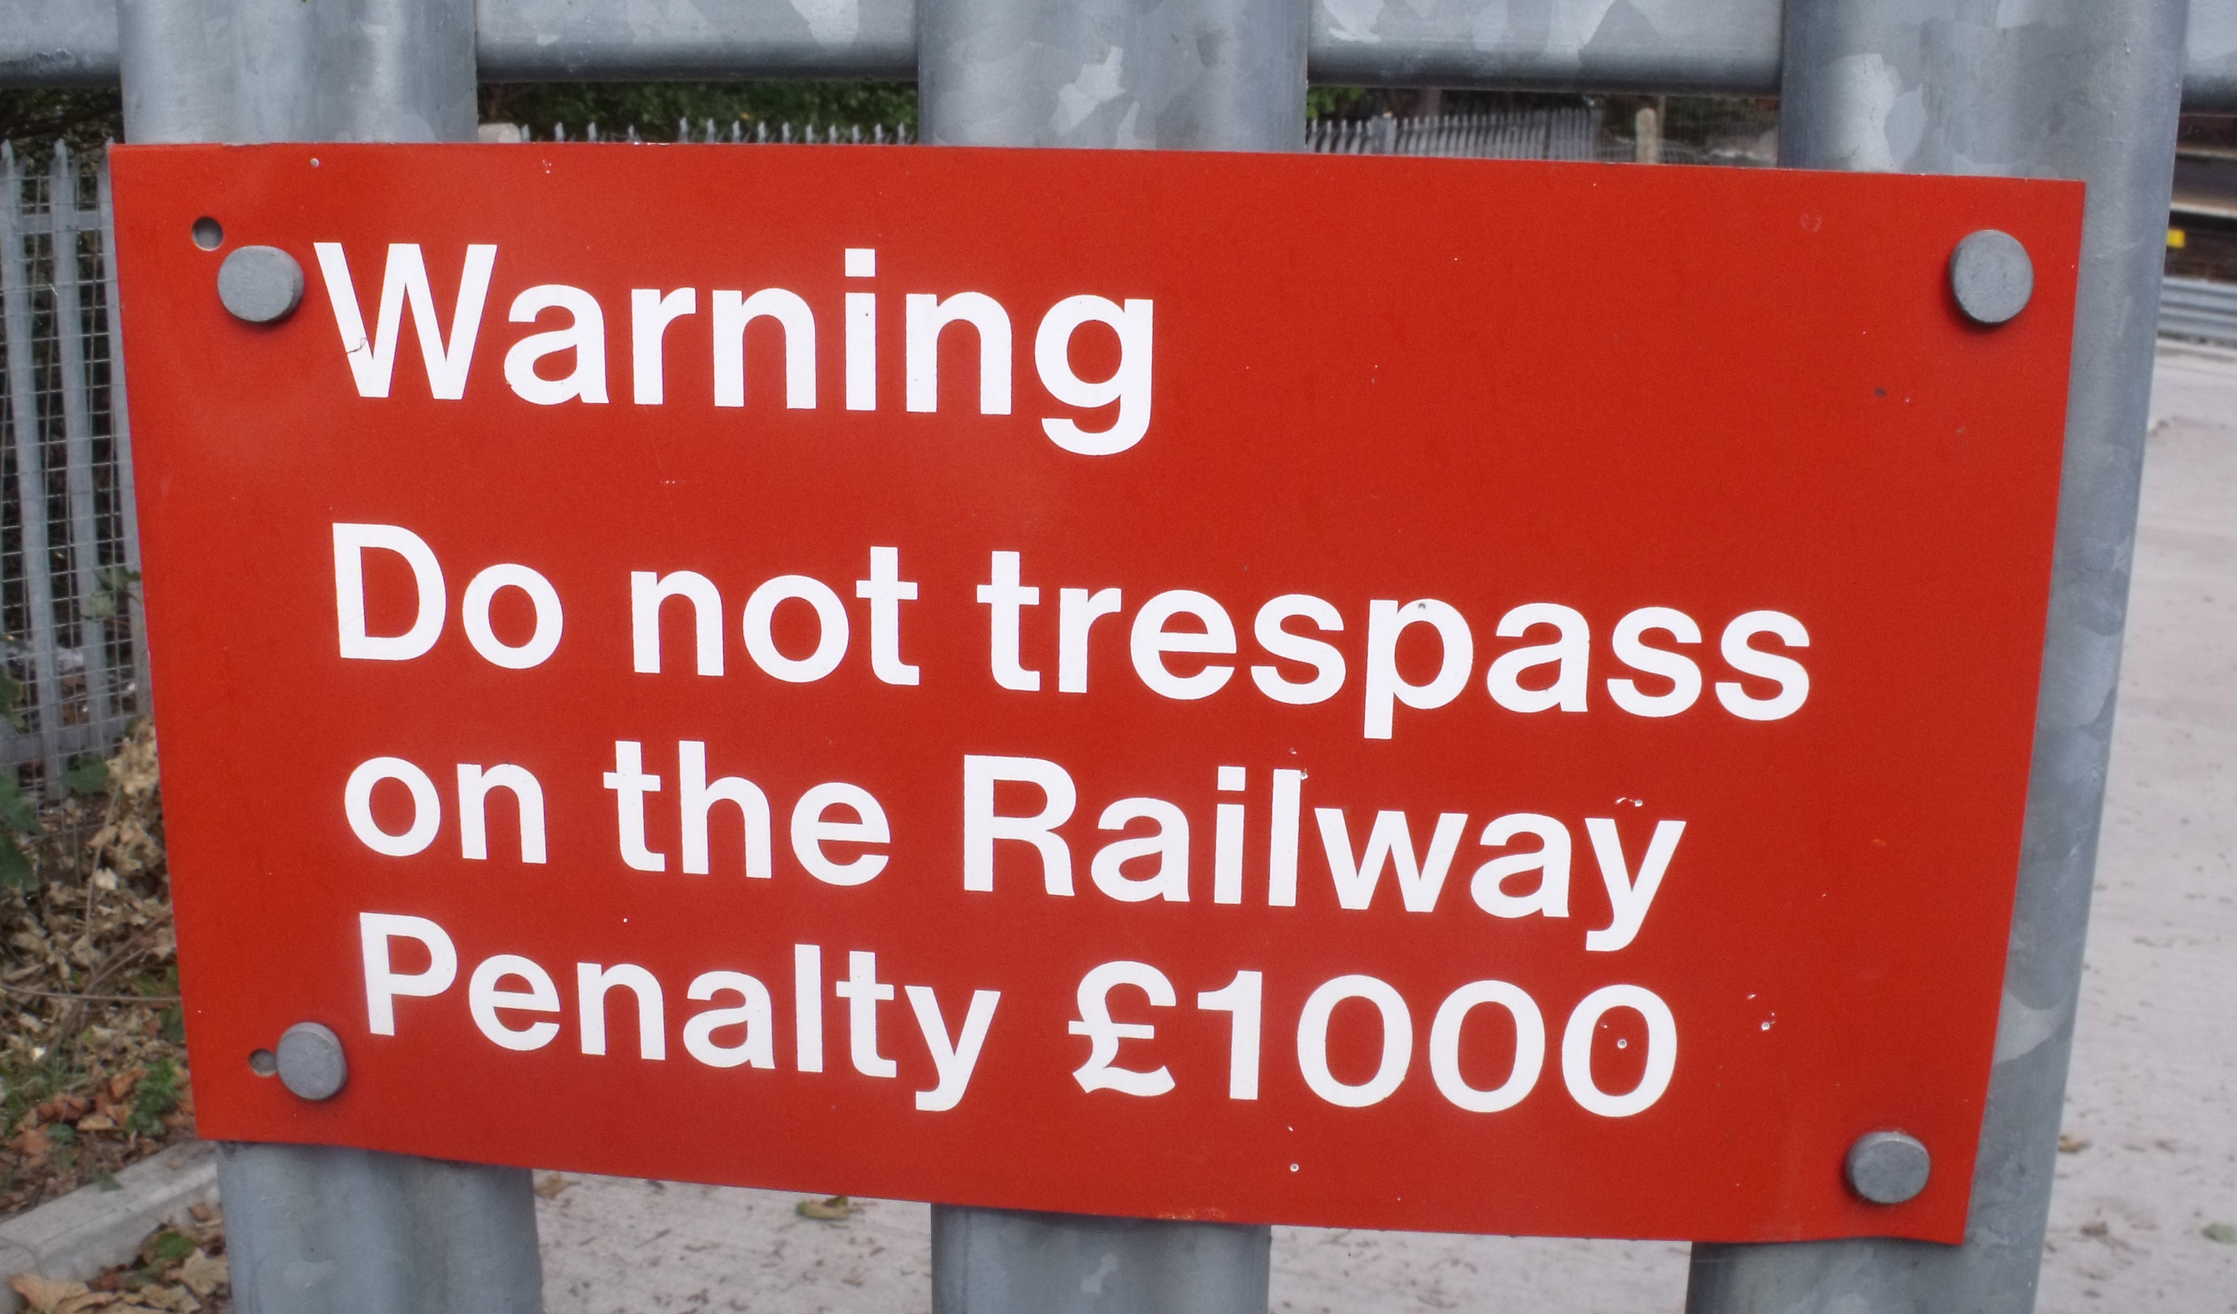
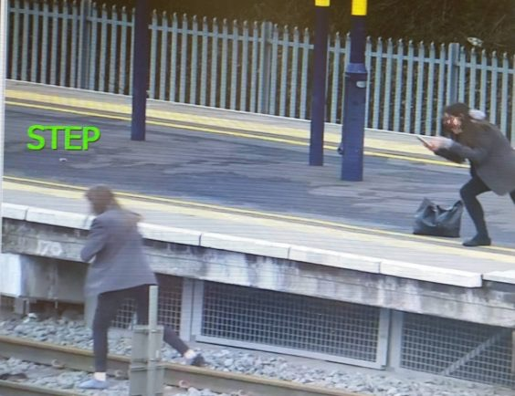
Trespassing
Never play on railway tracks – you are putting your life in danger! Unlike cars which have steering wheels, trains cannot steer out of your way.
If you trespass on the railway you could end up with a £1000 fine – or even worse, you could lose your life!

Slide 5
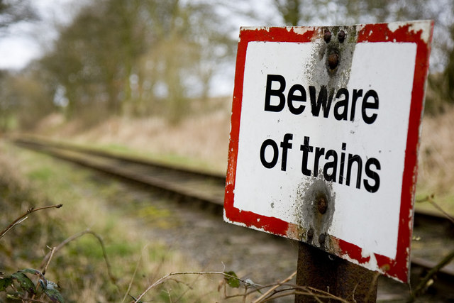
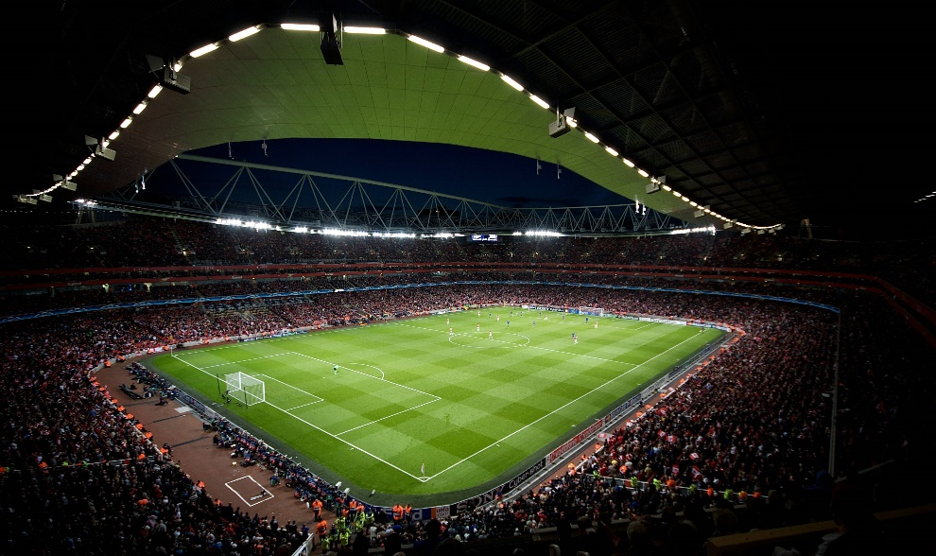
Trains are fast
Trains travel quickly (125mph and even 140mph on high speed lines). They take 20 football pitch lengths to stop when travelling at full speed. Unlike cars which have rubber tyres to grip to the road when a brake is pressed, trains have metal wheels which glide along a track – creating less friction which means they can travel fast.

Slide 6
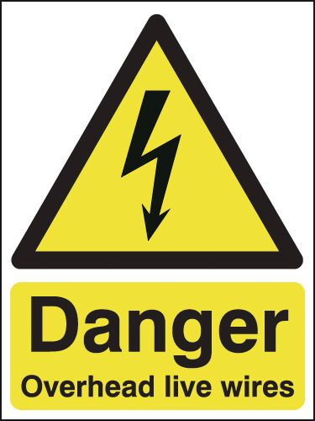
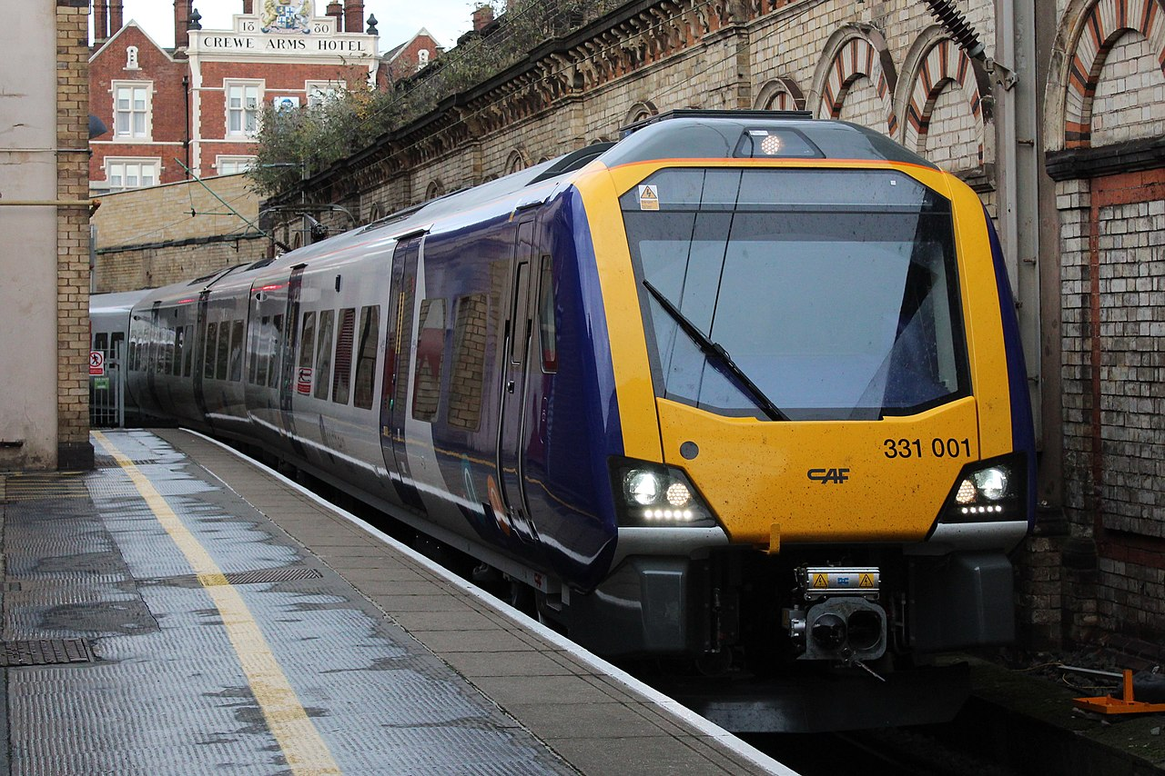
Some trains are
powered by electricity
More and more railways are now using electric trains as it means a more quieter, reliable service and it’s better for the environment! However, it is extremely dangerous! 9/10 people that come too close to live wires and tracks die.

Slide 7
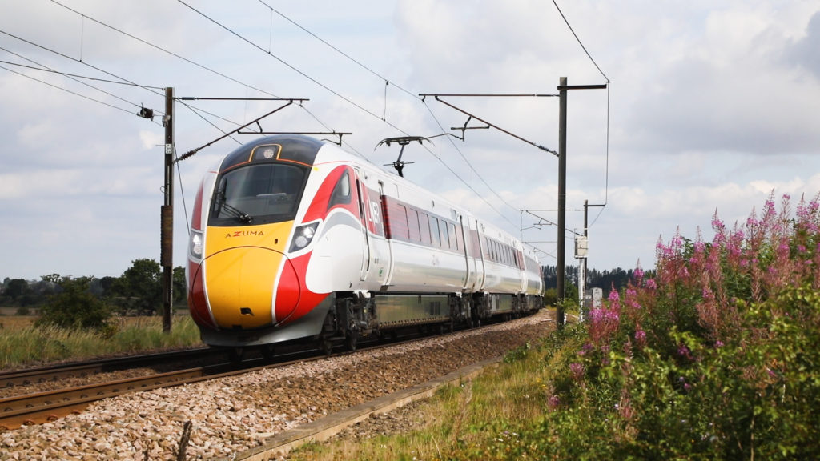
Some trains are
powered by electricity
The rail next to the track has 750 volts running through it . Overhead power lines carry 25000 volts – that is 100 times greater than the power supply in your home. The electricity can even jump so you don’t necessarily have to touch the live wires and rails to be injured.

Slide 8
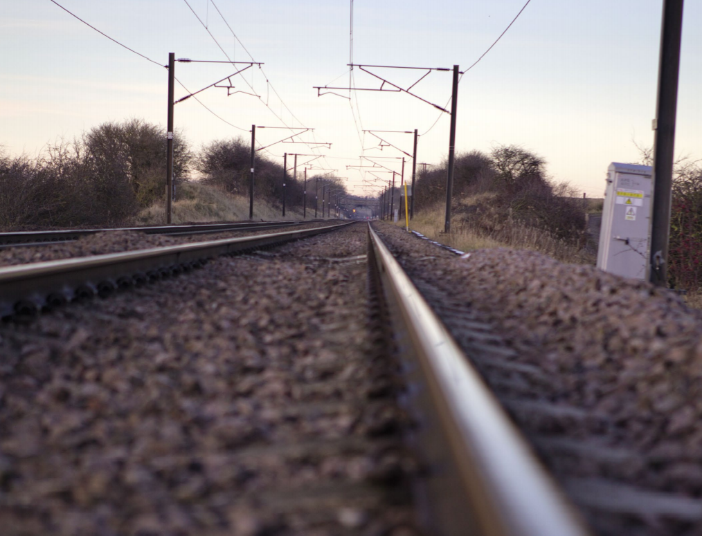
Where are
the four locations
electricity can be found on the railway?
Turn to your partner and see if you can work out where they are.

Slide 9
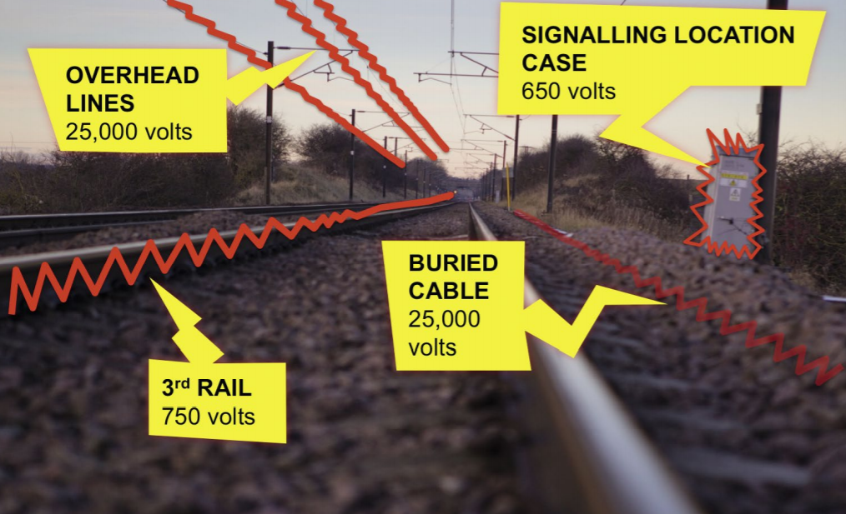
Remember:
Electricity on the railway is never switched off!
Why should you never fly a kite or balloon near the track?

Slide 10
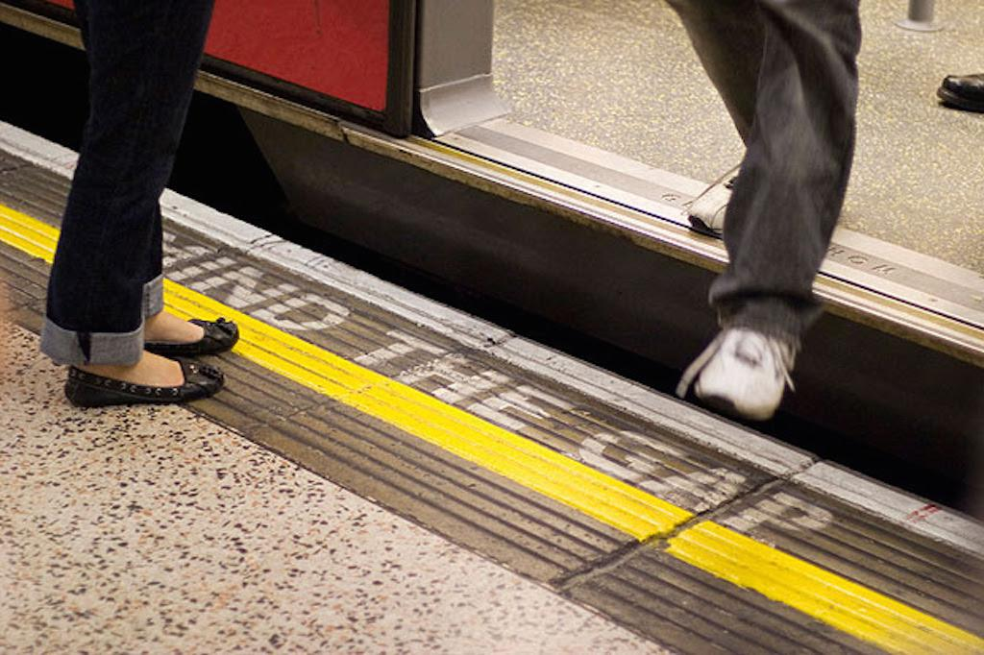
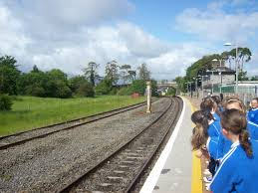
At the station
Wait behind the yellow line until the train has stopped. Passing trains cause air turbulence which can suck you under them.
Take care when getting on and off the train. Mind the gap! If you ever drop something on the track – never get it yourself. Speak to a member of staff. Always let passengers off before you get on and keep your hands
away from the doors.

Slide 11
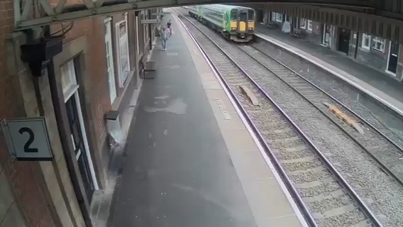
Dangers of Air Turbulence
As this freight train passes through Nuneaton Station, a pram is sucked towards it (thankfully no baby was in it at the time!) This is why you need to keep back from the edge

Slide 12
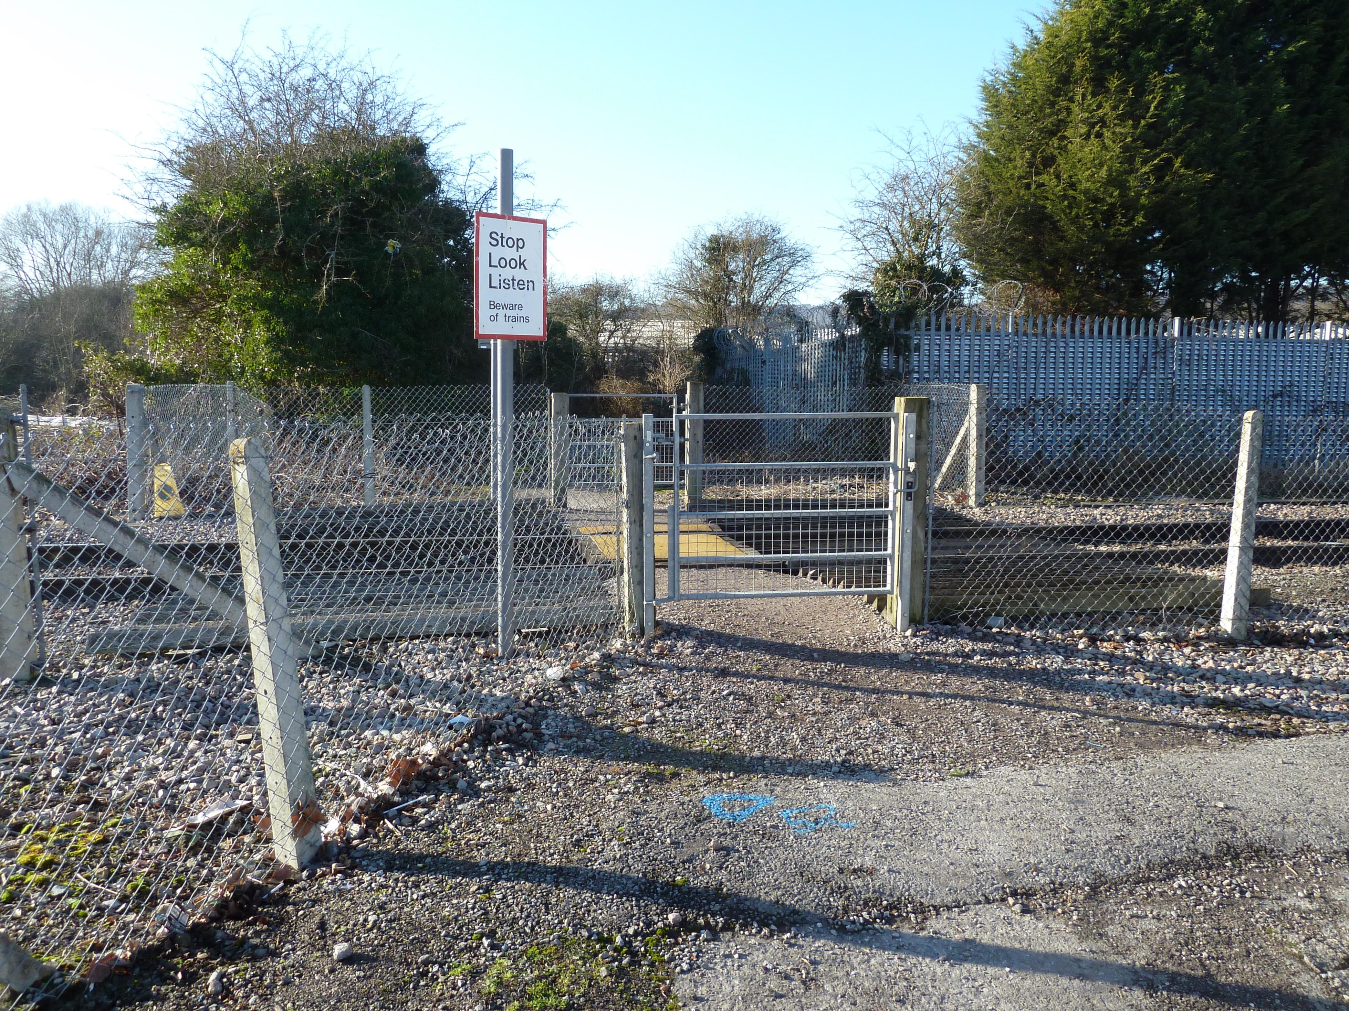
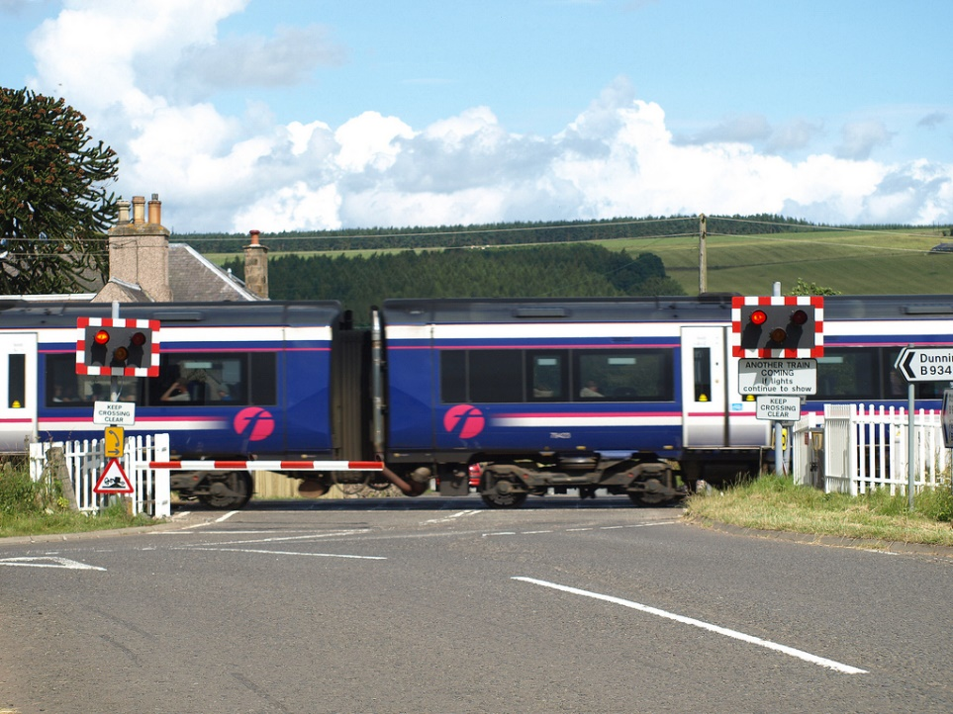
Level Crossings
A level crossing is where people and vehicles can cross the track safely.
If the barriers are closed, you hear an alarm or see flashing red lights this means a train is coming – do not cross!
Once the train has passed, you must wait for the barriers to lift and alarm and lights to stop before you cross.
Walk, don’t run. Get off your bike and stay alert!

Slide 13
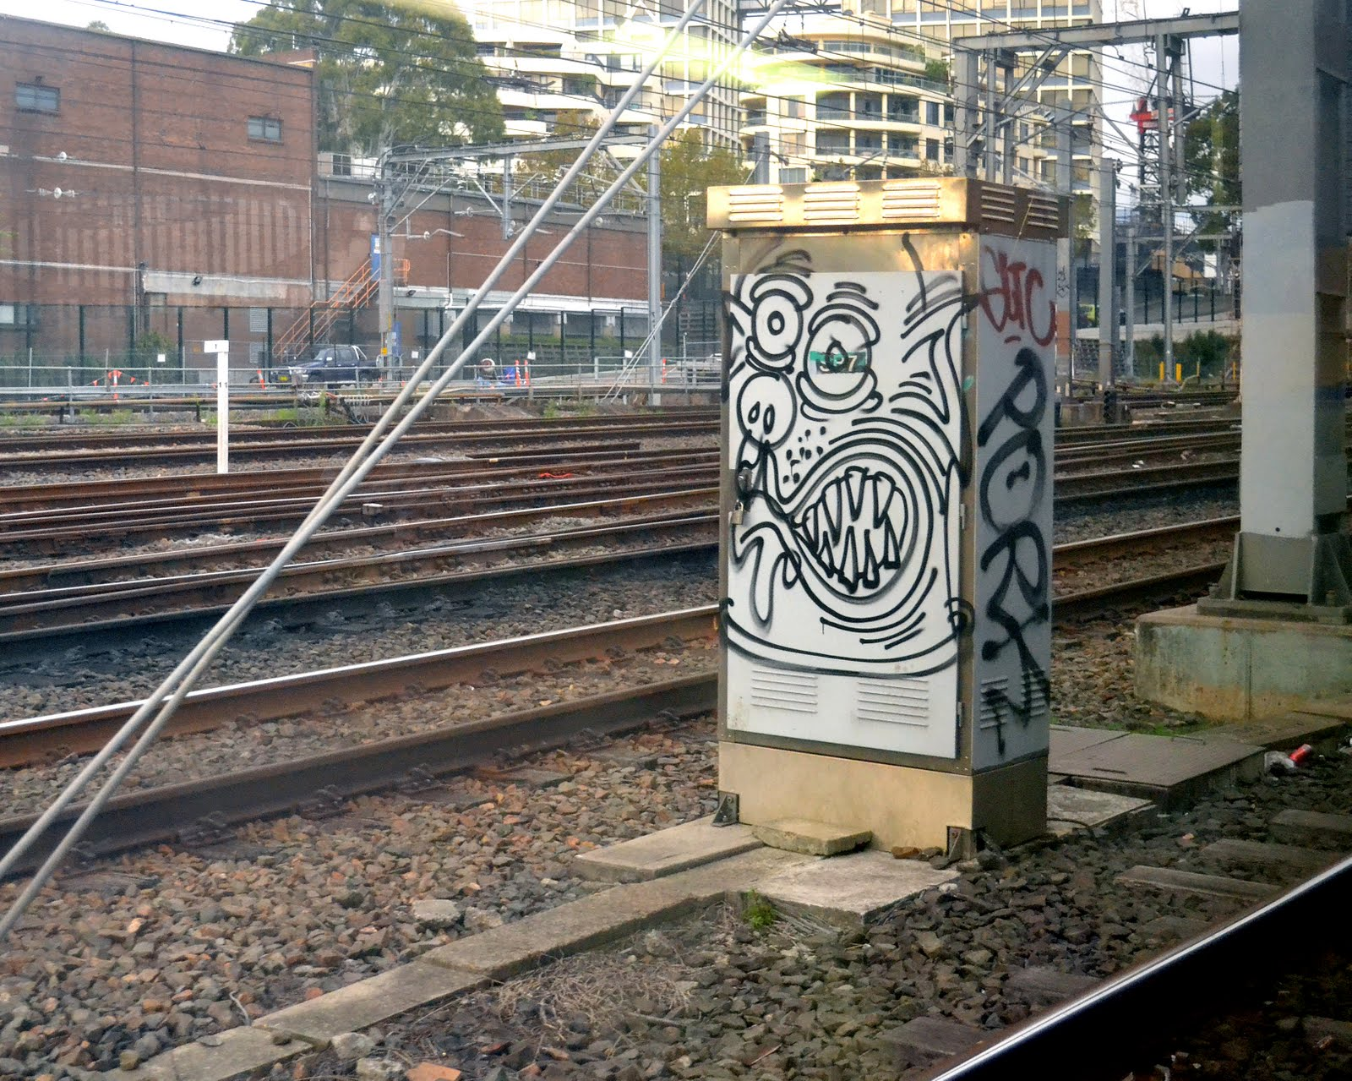
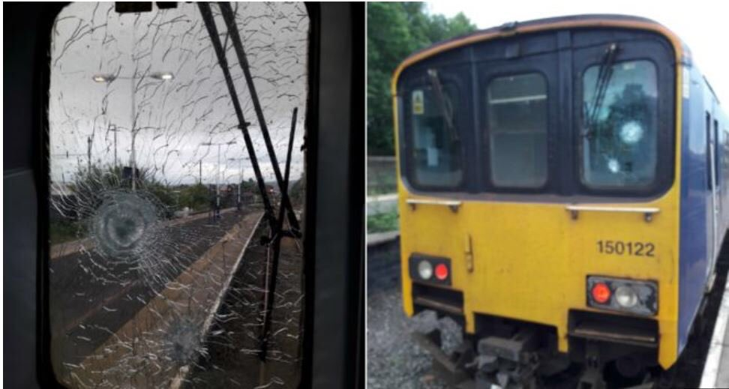
Vandalism
Trespassing on the railway to graffiti is against the law and dangerous. Many people have died doing so.
Throwing rocks at trains could kill or harm not only the driver, but also the passengers too.
You will face severe consequences – eg go to prison- for throwing objects at a train or putting them on a track.

Slide 14
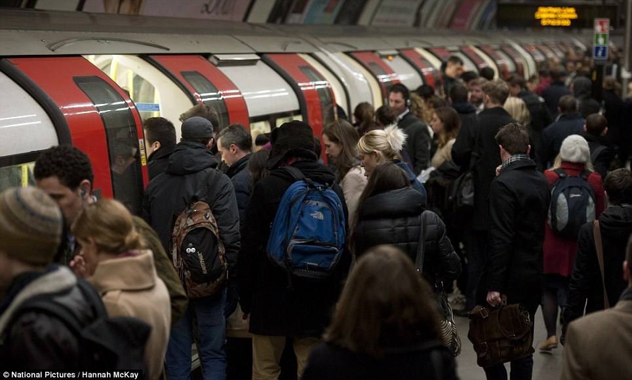
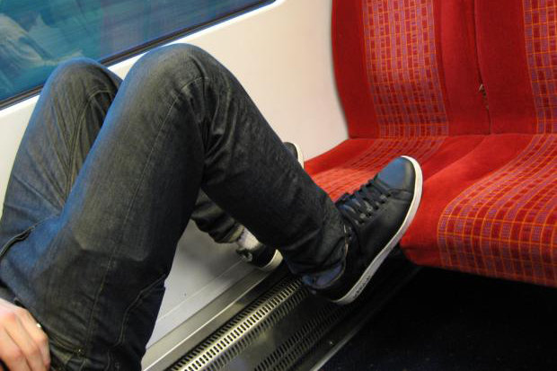
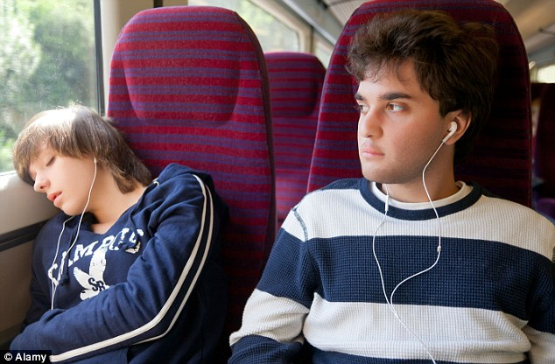
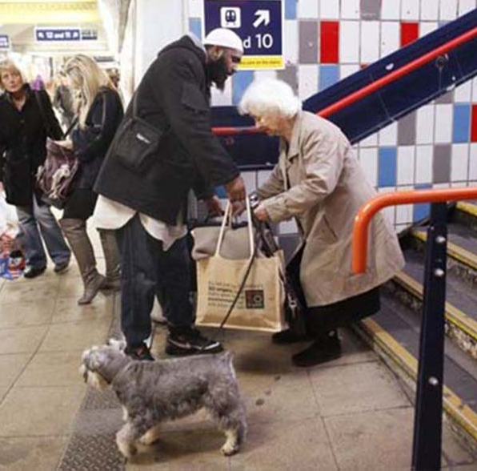
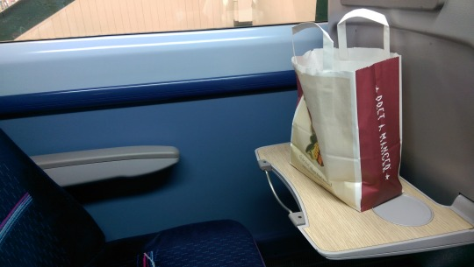
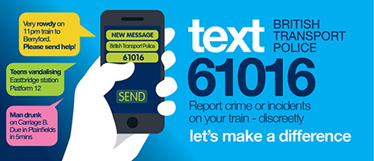
Being a good passenger

